Slide 1
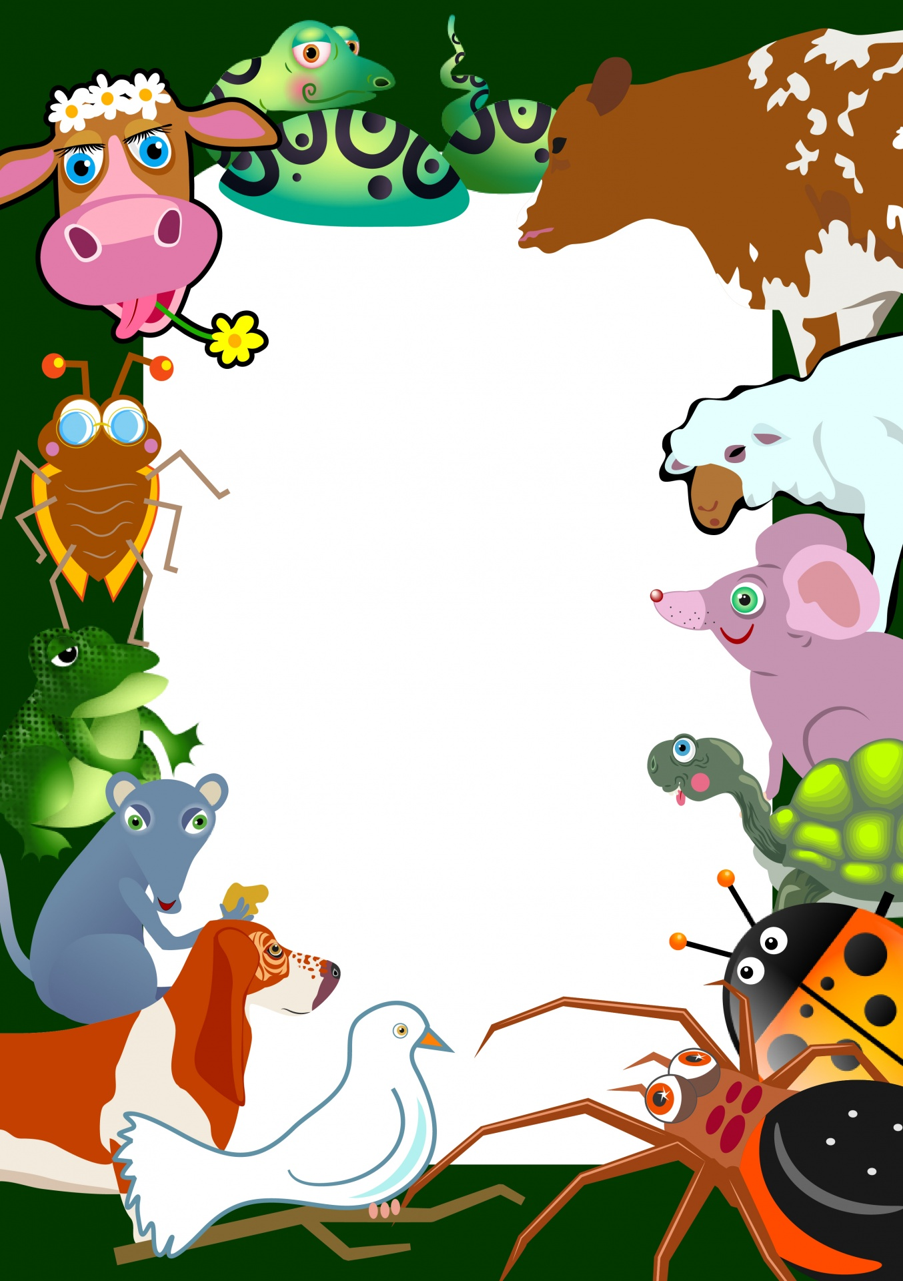
PETS

Slide 2
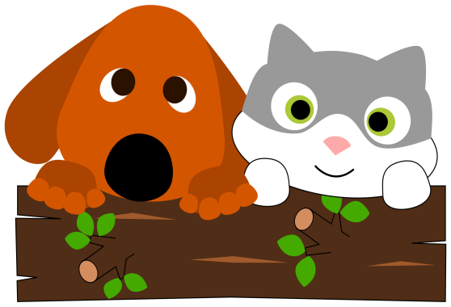
Do you like pets?
What animals do we usually keep as pets?
Where can you get a pet if you want one?
Do you know what an Animal Shelter is?
Do you think it is better to buy or to adopt an animal?
Watch the story of the Good family. They are at an Animal Shelter because they want to adopt an animal.
What animal will they choose?
https://learnenglishkids.britishcouncil.org/short-stories/the-animal-shelter

Slide 3
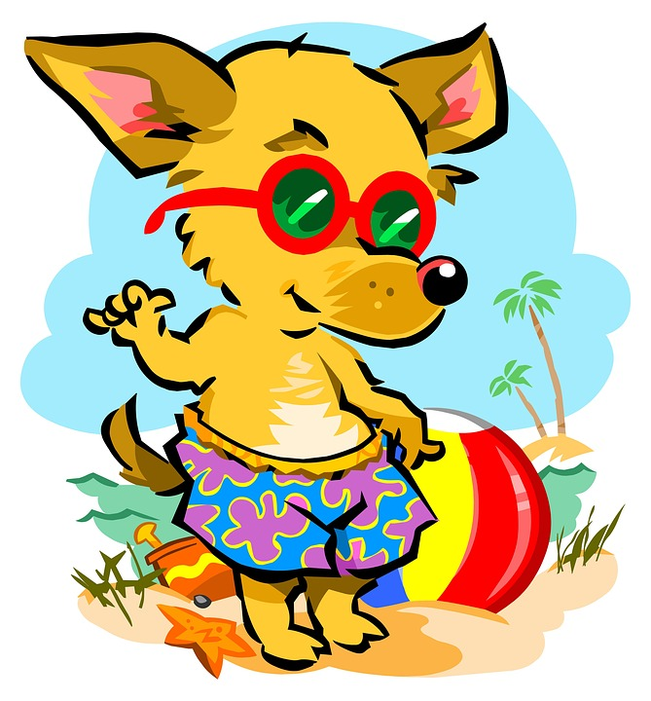
TT
Time to play a game! Read the statements and raise your hand ONLY when the statement is True.

Slide 4
A bird swims in a bowl
A snake sings in a cage
An iguana climbs trees
A sheep eats grass
A dog makes milk
A duck swims in a pond
A cow makes water
A cat likes fish
A tortoise walks slowly
A goldfish climbs trees

Slide 5
ANIMAL RIDDLES
What animal is it? Can you solve the riddle?
https://docs.google.com/forms/d/e/1FAIpQLSfCPQCXcb82RYhq0ILZllKBcbEYBV96yotU4_vhmdgm-gNlkA/viewform

Slide 6
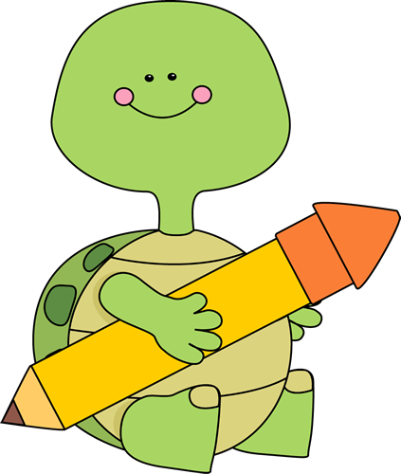
Now write your own riddles for your classmates to solve. The following questions will help you.
http://ebooks.edu.gr/modules/ebook/show.php/DSDIM-D101/693/4597,20867/

Slide 7
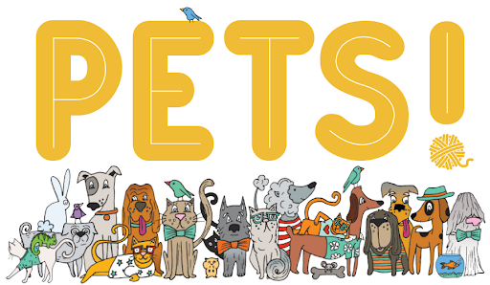
You can post your riddles or leave an answer to your classmates’ riddle on Padlet at:
https://padlet.com/dimipb/Bookmarks

Slide 8
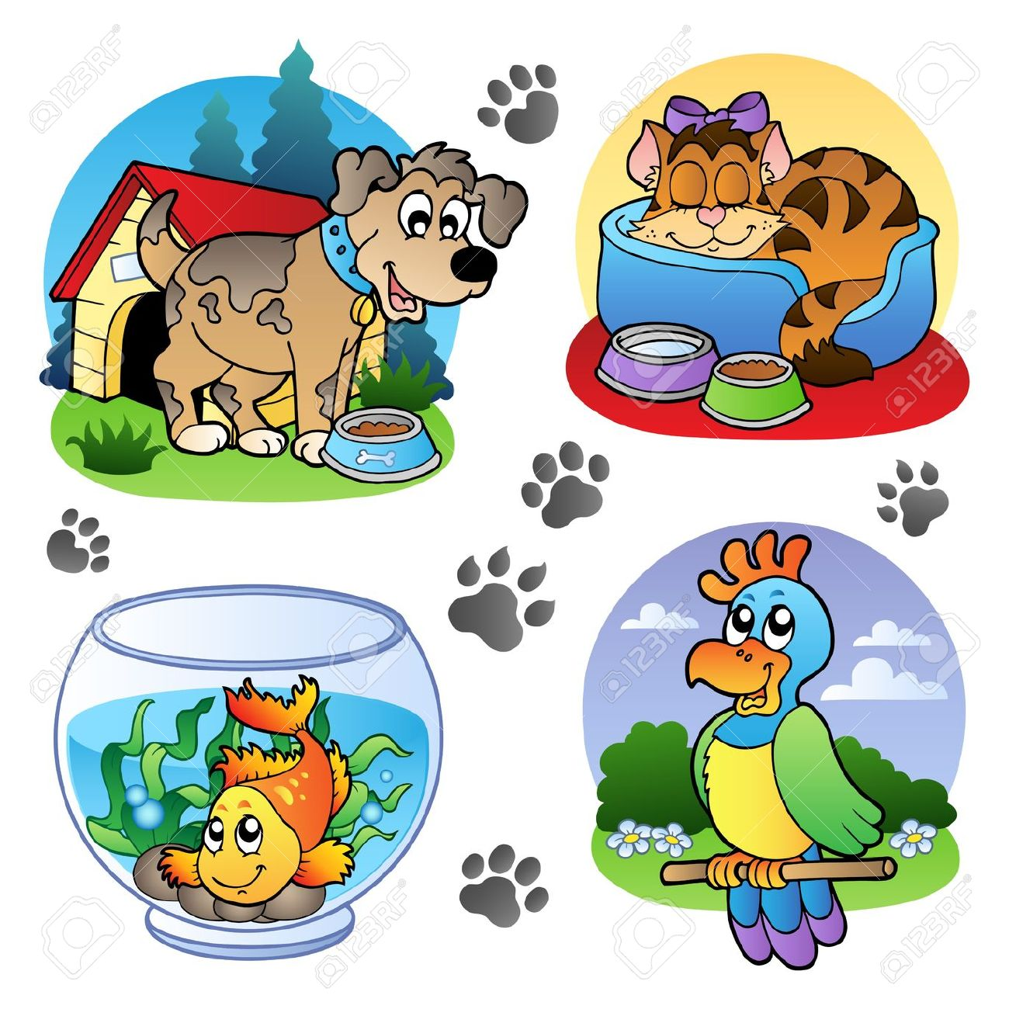

Slide 9
SOURCES
ΔΙΑΔΡΑΣΤΙΚΑ ΣΧΟΛΙΚΑ ΒΙΒΛΙΑ http://ebooks.edu.gr/modules/ebook/show.php/DSDIM-D101/693/4597,21605/
British Council https://learnenglishkids.britishcouncil.org/
GOOGLE https://www.google.gr/
Padlet https://el.padlet.com/

