Slide 1
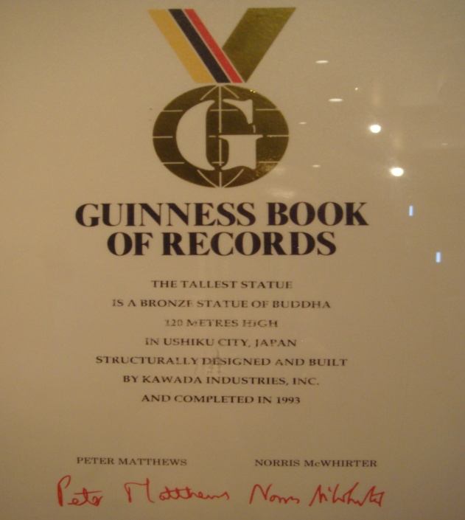

Slide 2
Watch a video from the Guinness World of Records website and note down a title for each of the five world records described .
http://photodentro.edu.gr/v/item/video/8522/872
1. The tallest woman in the world
2. The biggest aircraft pulled
3. The largest palace in the world
4. The heaviest car balanced on the head
5. The longest venomous snake in the world

Slide 3
Watch the video again and choose a, b or c to answer the questions
http://photodentro.edu.gr/v/item/video/8522/872
The tallest woman in the world is …….. years old.
a. 36 b. 44 c. 34
She is …….cm tall.
a. 2.31 b. 2.63 c. 2.36
David Huxley pulled the ……. plane in the world.
a. heaviest b. oldest c. lightest
The largest palace in the world has ……… rooms.
a. 1877 b. 1788 c. 1988
John Evans balanced a ………on his head.
a. motorbike b. Mini c. bus
The longest snake in the world lives in southeast……..
a. Africa b. Australia c. Asia

Slide 4
Find in the text words to match the definitions given below:
§ 1 Someone who entertains people
§ 2 To move something towards yourself
§ 2 To leave your job and stop working because of old age
§ 2 At present, now
§ 3 Home, place of living
§ 4 Kept in a steady position so that it did not fall
§ 5 Poisonous
§ 5 Eat something without chewing it first
http://ebooks.edu.gr/modules/ebook/show.php/DSDIM-E103/440/2920,11567/
Homework Time 1
Before our next meeting you will work on some exercises in our e class. Click on E Class and then on Guinness Book of Records.
Do Ex 1 & Ex 2 Vocabulary
Internet Research: Check here and find the two most interesting
records for you. Write a short paragraph (5-7 lines) to present it
to your classmates. Post your paragraphs on Padlet (Double click
anywhere on the board to write your post)

Slide 5
Here’s yet another amazing record. Read about the Oasis of the Seas
and fill in the gaps.
http://photodentro.edu.gr/v/item/ds/8521/4816
Look at these adjectives: largest, bigger, biggest, latest.
Find examples in the text. What do they mean?
These adjectives compare two or more things /people. Watch the
following video which describes how we compare in English.
https://www.youtube.com/watch?v=13TLUMw6og0&t=172s

Slide 7
Let’s practise what we’ve just learnt!
https://www.youtube.com/watch?v=pm9fq1MbR_I
http://photodentro.edu.gr/v/item/ds/8521/4774
Homework Time 2
Before our next meeting you will work on some exercises in our
e class. Click on E Class and then on Guinness Book of Records.
Watch the videos on how we form the comparisons of adjectives
in English and on the irregular adjectives.
Do Ex 3 Grammar
Do Ex 4: Self Assessment Unit 6

Slide 8
Sources
Διαδραστικά Σχολικά Βιβλία
http://ebooks.edu.gr/modules/ebook/show.php/DSDIM-E103/440/2920,11567/
Google www.google.gr
Guinness World Records https://www.guinnessworldrecords.com/records/hall-of-fame/
Padlet https://padlet.com/dashboard
ΦΩΤΟΔΕΝΤΡΟ http://photodentro.edu.gr/v/item/ds/8521/4816
YouTube www.youtube.com

