Slide 1
MANNERS AND HABITS
What does this mean?
Do you think good manners are important? Why / Why not?
Can you think of some examples of good / bad manners in Greece?

Slide 2
Respect !
Please !
Thank you !
Excuse me !

Slide 3
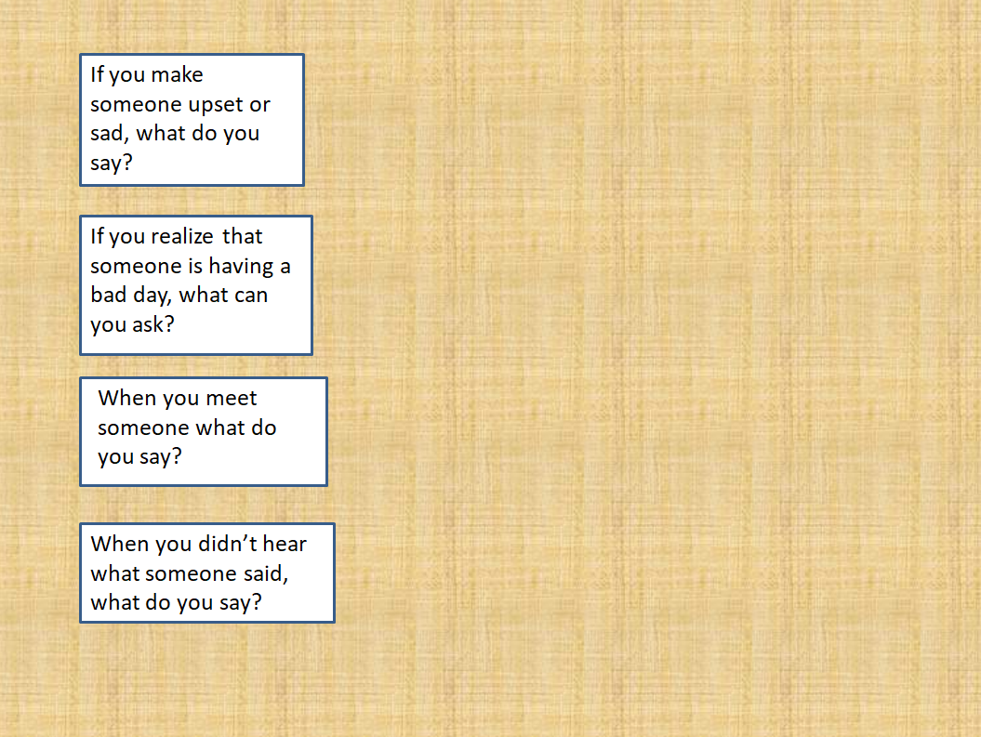
Nice to meet you !
I’m sorry. I didn’t hear you!
I’m sorry !
Are you OK?

Slide 4
CUSTOMS AROUND THE WORLD
http://photodentro.edu.gr/v/item/ds/8521/6702
Do any of the above rules of good manners apply to Greece as well?

Slide 5
PROJECT
What would you advise a foreigner visiting your country who wants to show good manners? Prepare a DOs and DON’Ts list. Find or draw relevant pictures and prepare a poster on Rules of Good Manners in Greece.
(You can create your poster on line here: http://www.readwritethink.org/files/resources/interactives/Printing_Press/)
Here’s another example of what your text could be like. What are the rules of good manners in France. To find out choose the right word to complete the following text.
http://ebooks.edu.gr/modules/ebook/show.php/DSDIM-E103/440/2920,11552/

Slide 6
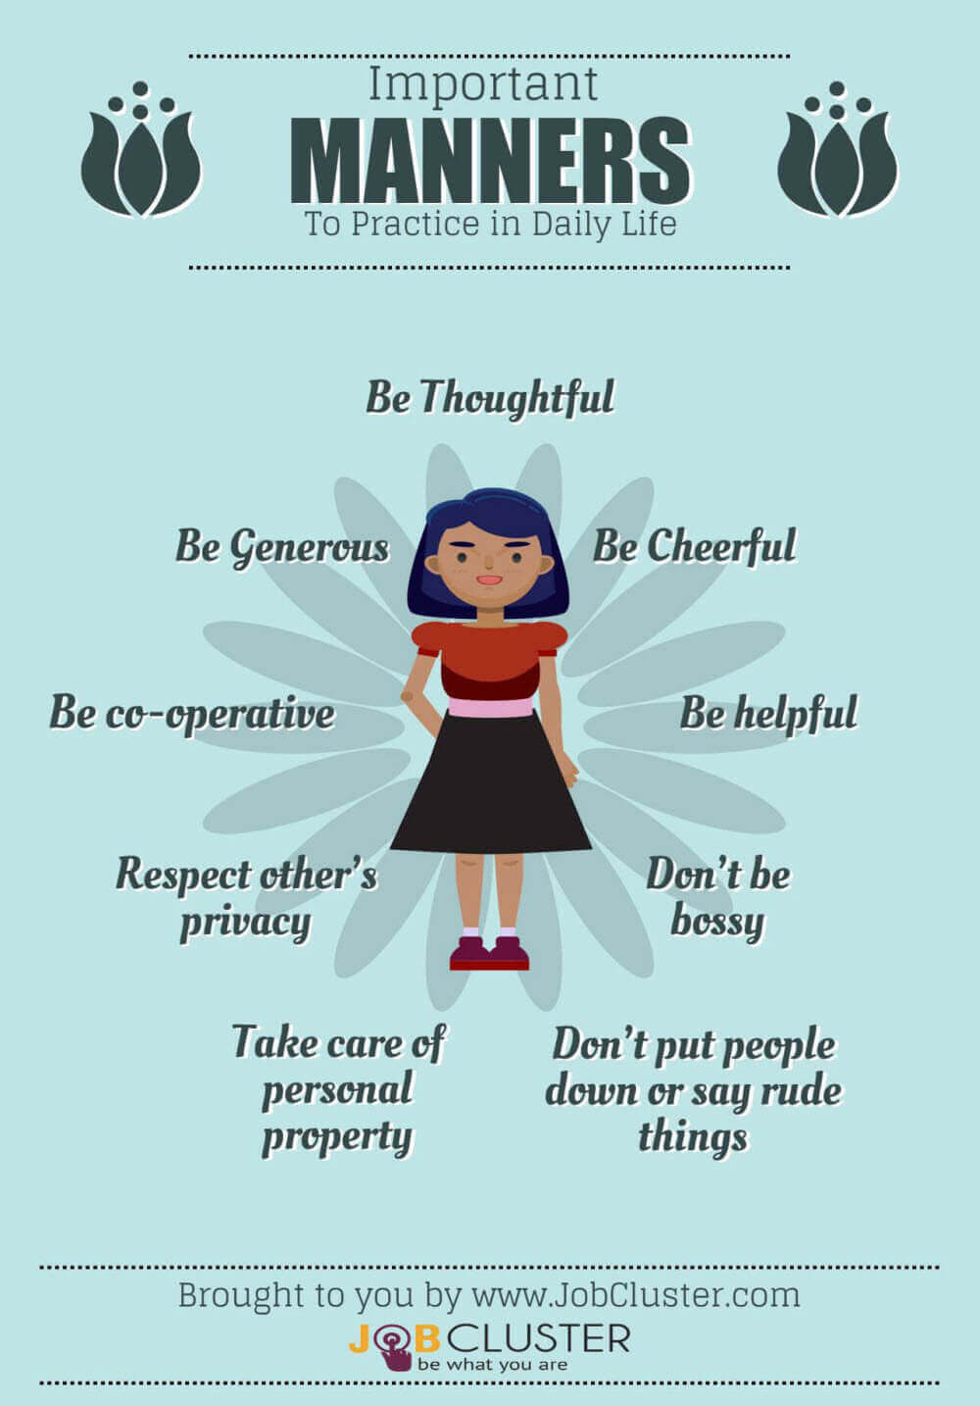

Slide 7
SOURCES
ΔΙΑΔΡΑΣΤΙΚΑ ΣΧΟΛΙΚΑ ΒΙΒΛΙΑ http://ebooks.edu.gr/modules/ebook/show.php/DSDIM-E103/440/2920,11544/
British Council https://learnenglishkids.britishcouncil.org/
GOOGLE https://www.google.gr/
JOBCLUSTER https://www.jobcluster.com/
Photodentro - Φωτόδεντρο http://photodentro.edu.gr/v/item/ds/8521/6702
PICTUREQUOTES http://www.picturequotes.com/
READWRITETHINK ‘Printing Press’ http://www.readwritethink.org/files/resources/interactives/Printing_Press/

