Slide 2
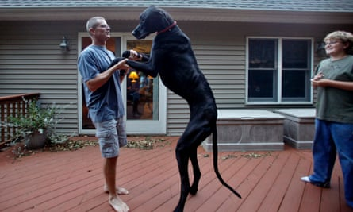
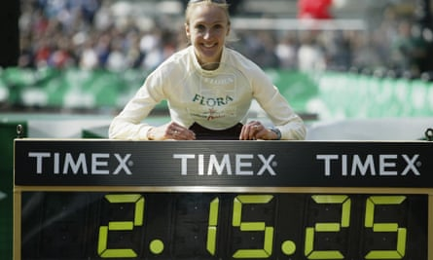
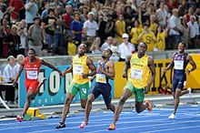
FAMOUS RECORD HOLDERS
Tallest dog ever
Usain Bolt sets a 100 m world record at the 2009 World Championships in Athletics in Berlin
Fastest women’s marathon

Slide 3
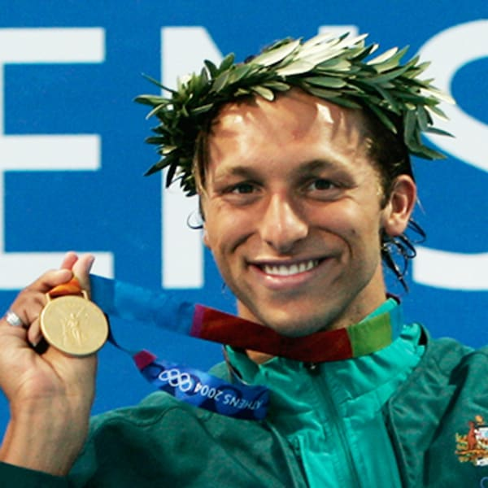
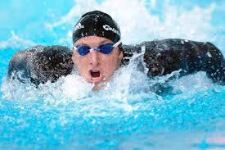
Do you know who this is?
This is Ian Thorpe, nicknamed ‘Thorpedo’, who has been an Olympic Gold Medal
Swimmer and one of the world’s best-ever middle-distance swimmers.

Slide 4
Look at the pictures of different swimming styles and match them with their name.
relay race
butterfly
breaststroke
backstroke
freestyle
Watch the video about Ian Thorpe and answer the following questions:
Where has Thorpe won gold medals?
a) Olympic Games b) World Championships
Which of these races does Thorpe hold record for?
a) 200m freestyle b) 800m freestyle c) 100m freestyle
How many gold medals has Ian Thorpe won?
a) five b) seven c) twenty -two
http://photodentro.edu.gr/v/item/video/8522/786

Slide 5
This is the picture of a popular Broadway show.
What is the name of the show?
Do you know what kind of a show it is?
a) musical b) comedy c) drama d) opera

Slide 6
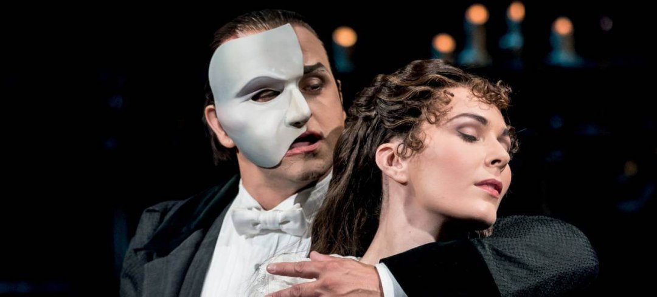
Read the text carefully and note down the answers to the following questions:
1. What record has the Phantom of the Opera broken?
2. How much has the Titanic most probably made compared to the Phantom of the
Opera?
3. Which musical had the record for ‘the longest-running show’ before the
Phantom of the Opera?
http://photodentro.edu.gr/v/item/ds/8521/6711

Slide 7
Here are some synonyms/definitions of words in the texts. Read the definitions/ synonyms and match them to the correct word.
Had a leading position, the most important position
Extraordinary, great
A swimming race between two or more teams during which each member of a team swims part of the total distance
The play with the most performances
Good and bad articles about something
Full of people / spectators
Celebration after the performance
Theatrical plays with songs
http://ebooks.edu.gr/modules/ebook/show.php/DSDIM-F101/441/2928,11608/

Slide 8
Homework Time 1
Before our next meeting you will work on some exercises in our e class. Click on St Class and then on Famous World Records.
Do Ex 1 – Matching
Do Ex 2 - Listening

Slide 9
Let’s talk about experiences. Have you ever had any
of these experiences?
Have you ever gone skiing? →
Have you ever done something silly? →
Have you ever eaten frog legs or Chinese food? →
Have you ever fallen down the stairs? →
Have you ever been on TV? →
Have you ever ridden a horse? →
Have you ever swum in a river? →
Have you ever seen a car accident? →
Have you ever had an electricity blackout
while taking a shower? →
10. Have you ever shaken hands with a monkey? →

Slide 10
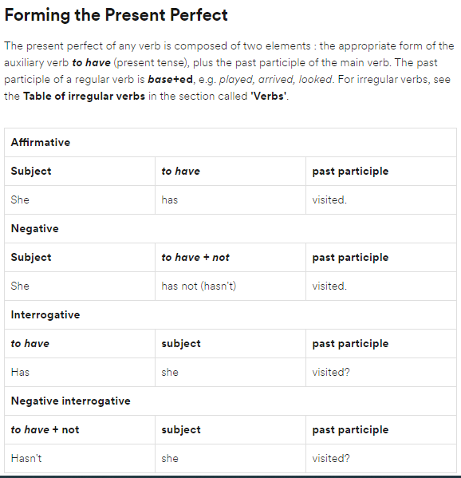
Watch a video with a collection of scenes from popular films and be ready to answer my questions.
https://edpuzzle.com/media/5ec27268b1bc853f58f320d1
Present Perfect (Simple): So what did we learn about the Present Perfect Simple in this video (Form & Use)?

Slide 11
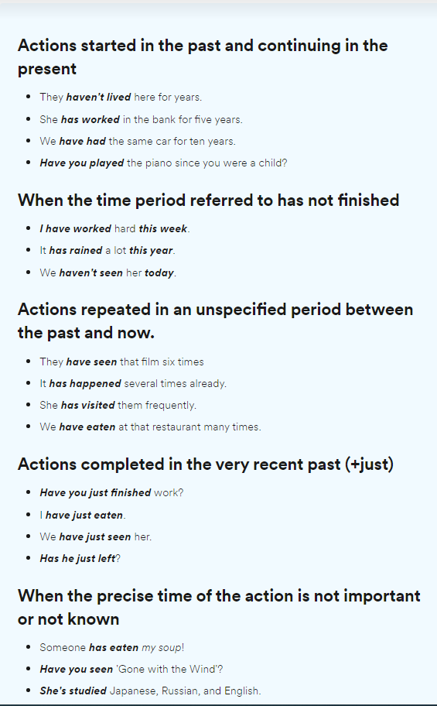

Slide 13
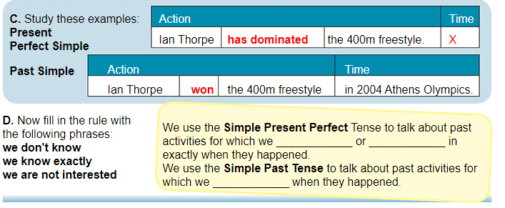
Study the example sentences below. When do we use the Present Perfect Simple and when the Past Simple tense? What do you think? Fill in the rule:
don’t know
we are not interested
know exactly

Slide 15
Time to practise what we’ve learnt so far!!!
https://learnenglish.britishcouncil.org/english-grammar-reference/present-perfect
Homework Time 2
Before our next meeting you will work on some exercises in our e class. Click on St Class and then on Famous World Records.
Do Ex 3 : Grammar is Everywhere (please print the completed text)
Do Ex 4 : Present Perfect Simple vs Past Simple

Slide 16
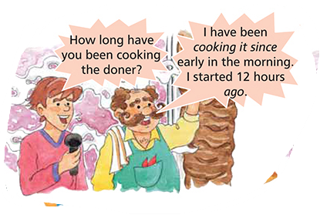
I’ve been waiting for such a long time to see you again!!!
Let’s watch a video about another form of Present Perfect.
Watch the video and be ready to answer some questions.
https://edpuzzle.com/media/5ec8187ae967853f0d0ba418

Slide 18
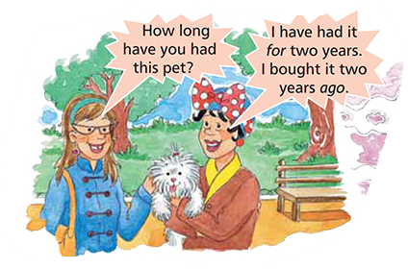
Read the following dialogues and think about the use of for and since.
When do we use them?
for
We use _______ with a period of time.
We use _______ with a point in time (e.g. year, day, month etc)
since

Slide 19
Let’s have some practice!
http://ebooks.edu.gr/modules/ebook/show.php/DSDIM-F101/441/2928,11609/extras/Edugames/U7L2_MC3_PRESENT/MultipleChoice3.html
https://learnenglish.britishcouncil.org/english-grammar-reference/present-perfect
But how do we know whether to use the Present Perfect Simple or
the Present Perfect Continuous? Watch the video for some useful tips.
https://www.youtube.com/watch?v=xBfpZISWnEs&list=PLePCB0Qg9Jw3DH-4IfK_lHL1tCvRtwG6S&index=22&t=0s

Slide 20
Homework Time 3
Before our next meeting you will work on some exercises in our e class. Click on St Class and then on Famous World Records.
Do Ex

Slide 21
British Council https://learnenglish.britishcouncil.org/english-grammar-reference/present-perfect
Διαδραστικά Σχολικά Βιβλία
http://ebooks.edu.gr/modules/ebook/show.php/DSDIM-F101/441/2928,11608/
Edpuzzle https://edpuzzle.com/media/5ec27268b1bc853f58f320d1
ΦΩΤΟΔΕΝΤΡΟ http://photodentro.edu.gr/v/item/video/8522/786
Google https://www.google.gr/
The Guardian
https://www.theguardian.com/culture/2015/aug/21/the-10-best-world-records-paula-radcliffe-zeus-dog
Wikipedia https://en.wikipedia.org/wiki/List_of_world_records_in_athletics
YouTube https://www.youtube.com/watch?v=xBfpZISWnEs&list=PLePCB0Qg9Jw3DH-4IfK_lHL1tCvRtwG6S&index=22&t=0s

