Slide 2
What do you think this quote means?

Slide 3
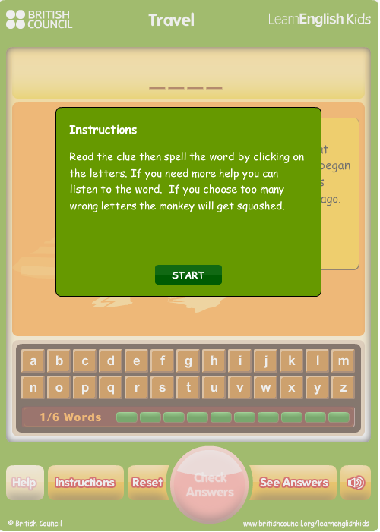
http://ebooks.edu.gr/modules/ebook/show.php/DSDIM-F101/441/2926,11603/
Let’s play with some ‘travel’ words !

Slide 4
Do you like travelling?
Is there a place (city or tourist attraction) that you
would like to visit? Why?
How can you find your way around an area you do not
know?
http://ebooks.edu.gr/modules/ebook/show.php/DSDIM-F101/441/2926,11603/

Slide 5
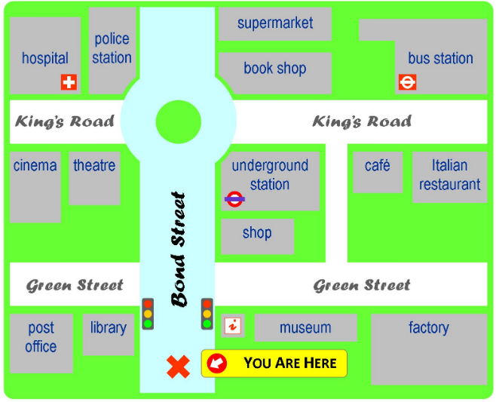
Now let’s play a game. Choose a place on the map below. This is where you are. You want to meet your friends, who are at the traffic lights in Bond Street. Give them directions to where you are so that they come to see you. Good luck !
https://learnenglishteens.britishcouncil.org/skills/listening/elementary-a2-listening/giving-directions

Slide 6
Do you know where Liverpool is?
What do you know about Liverpool?
Look at the following text. What is it?
Where can you find a text like this?
Read it and note down the following information about the places
of interest mentioned in the text:
Location
Admission Fee (adults – children – children under 5)
Opening Hours
Then use your notes to do the Check Your Understanding activities
that follow.

Slide 7
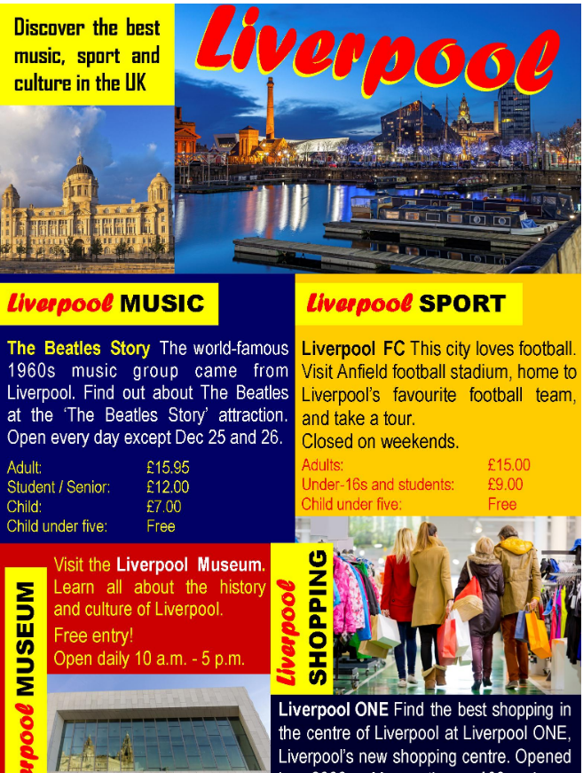
https://learnenglishteens.britishcouncil.org/skills/reading/elementary-a2-reading/my-city

Slide 8
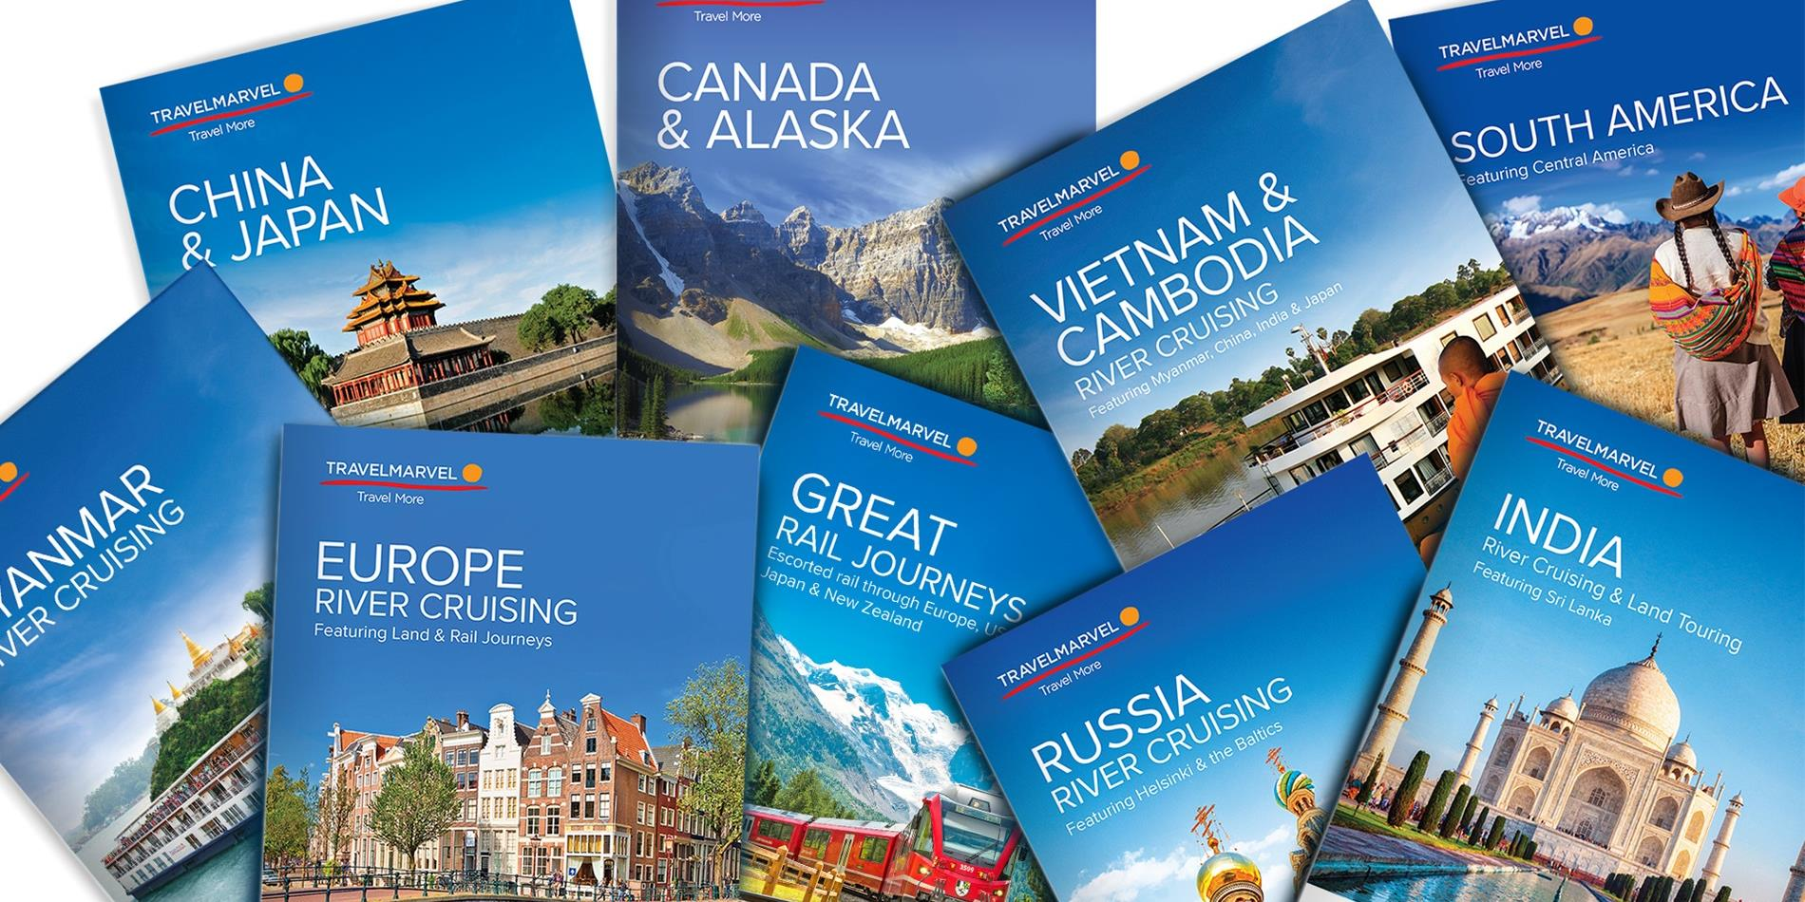
Look at the travel brochure about Liverpool again.
What does it look like?
What information does it include?
How is the information presented (e.g. paragraphs, bulleted lists
etc.)?
What kind of language / vocabulary is used?
https://learnenglishteens.britishcouncil.org/skills/reading/elementary-a2-reading/my-city

Slide 9
Now look through the Transport Museum leaflet and answer the same questions:
What does it look like?
What information does it include?
How is the information presented (e.g. paragraphs, bulleted lists etc.)?
What kind of language / vocabulary is used?
http://ebooks.edu.gr/modules/ebook/show.php/DSDIM-F101/441/2926,11604/

Slide 10
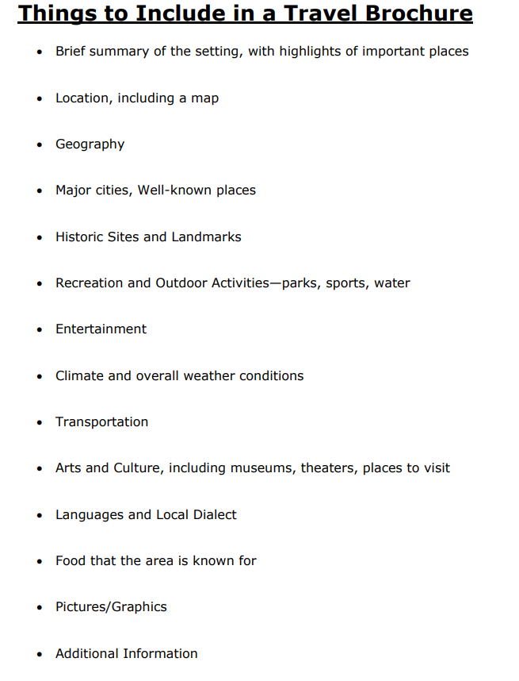
Let’s have a look at what information we can include in a good
travel brochure / leaflet:

Slide 11
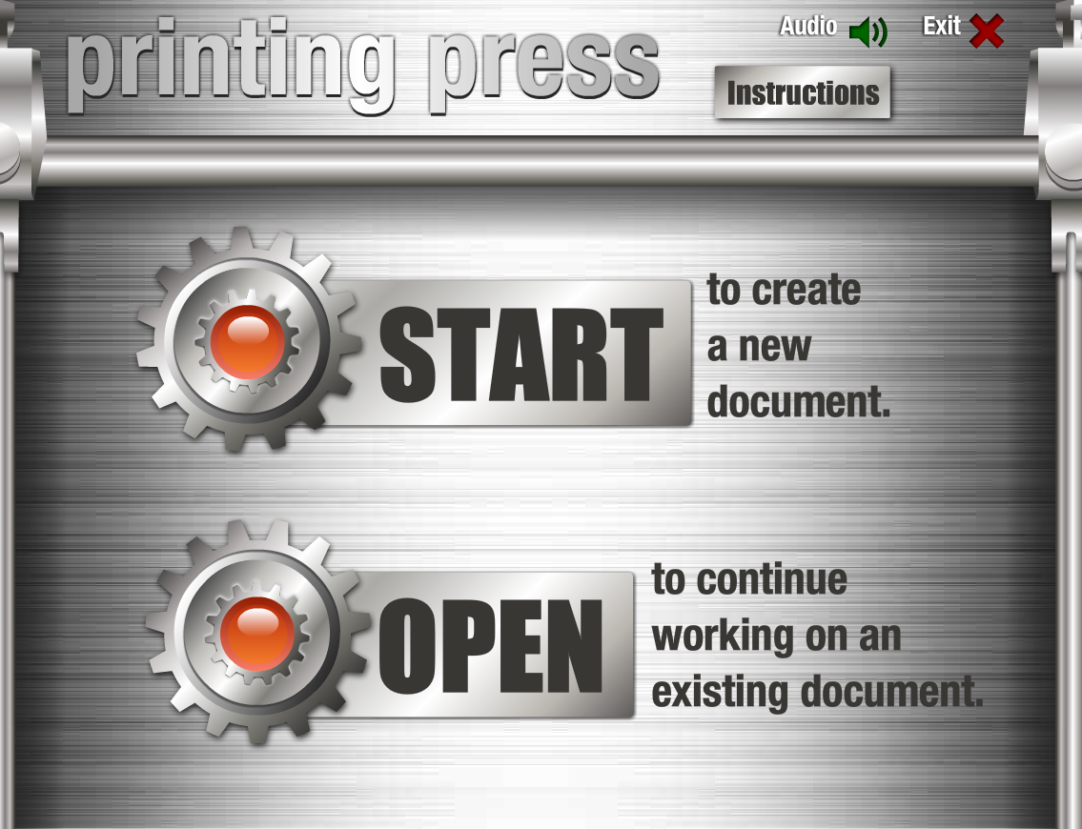
Think of a place of interest (a city, a landmark, a museum etc.) in your country or in another part of the world that you would like to visit. Search the internet for useful information, pictures, maps etc. and prepare a travel brochure / leaflet to promote this place. (You can try the Online Printing Press to create your brochure / leaflet on line!!!)
Online Printing Press
http://www.readwritethink.org/files/resources/interactives/Printing_Press/

Slide 13
Sources
ΔΙΑΔΡΑΣΤΙΚΑ ΣΧΟΛΙΚΑ ΒΙΒΛΙΑ http://ebooks.edu.gr/modules/ebook/show.php/DSDIM-F101/441/2926,11603/
British Council https://learnenglishkids.britishcouncil.org/
GOOGLE https://www.google.gr/
Printing Press http://www.readwritethink.org/files/resources/interactives/Printing_Press/
ReadWriteThink http://www.readwritethink.org/parent-afterschool-resources/activities-projects/design-travel-
brochure-30297.html?main-tab=2#tabs

