Slide 1
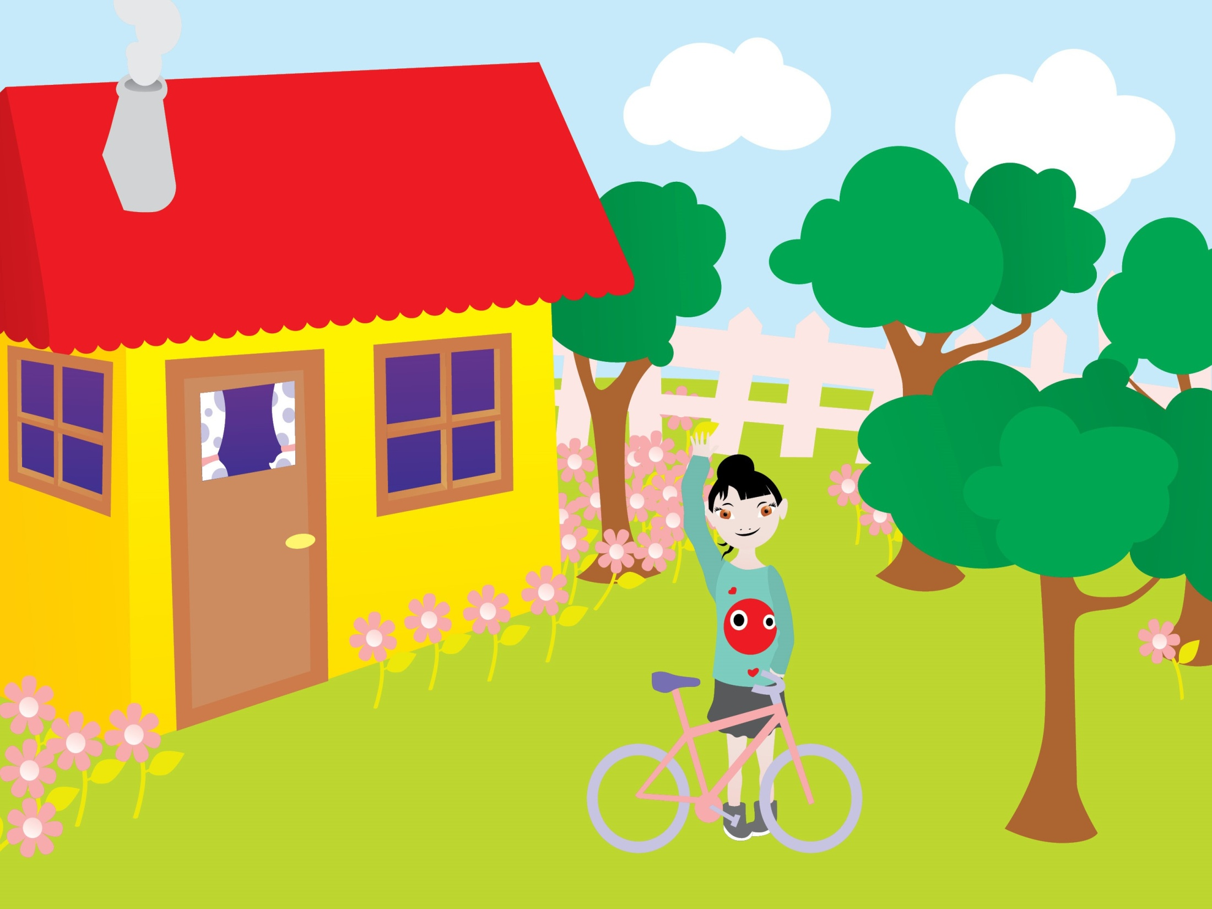

Slide 5
‘This is the way’ Karaoke
https://www.youtube.com/watch?v=S_P2ZRTC_AE

Slide 6
https://www.youtube.com/watch?v=u6Gb5vO246g
https://www.youtube.com/watch?v=u6Gb5vO246g

