Slide 1
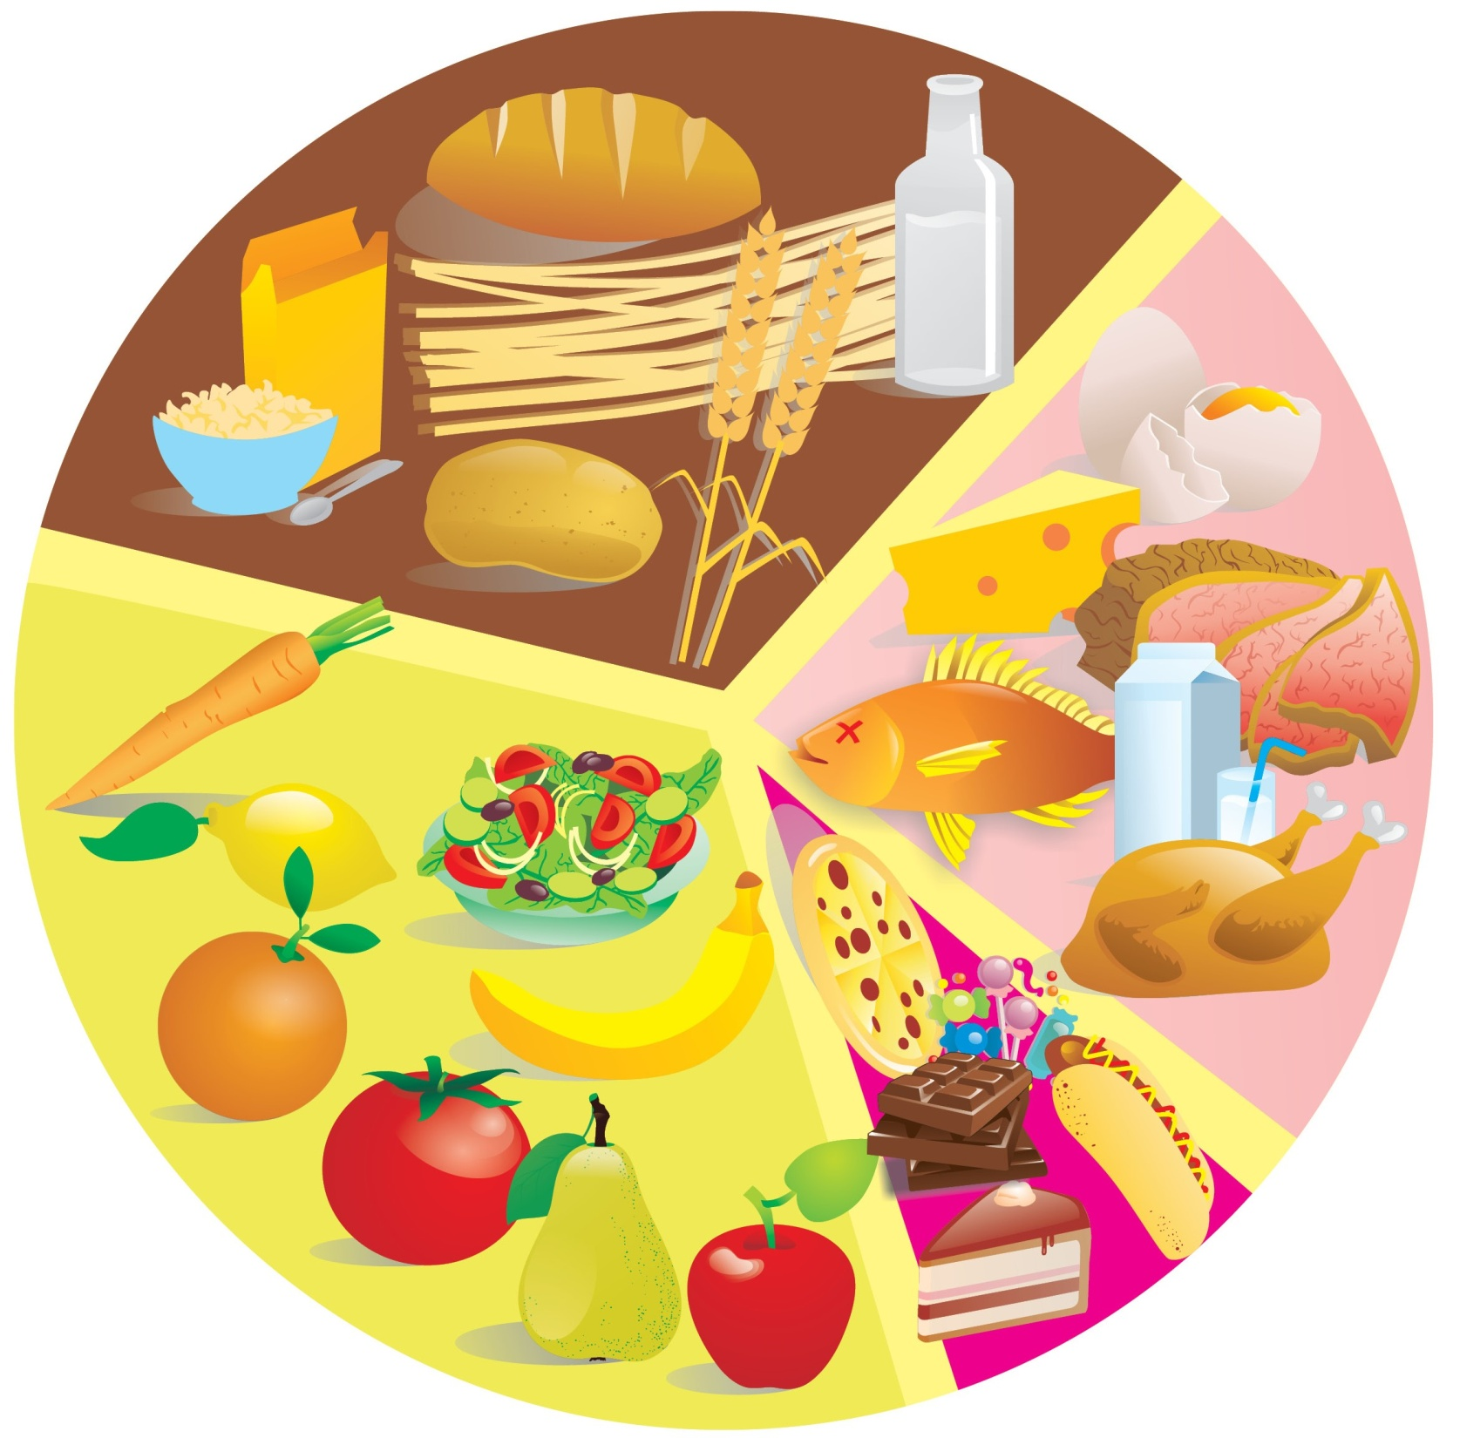

Slide 2
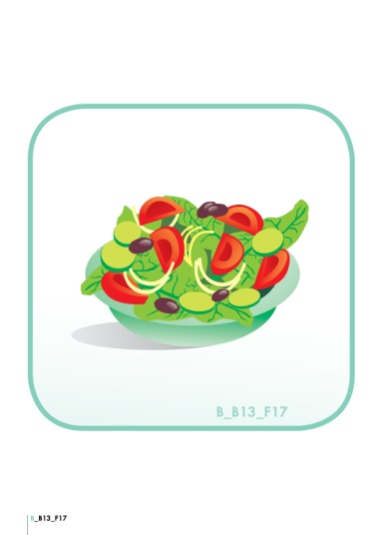
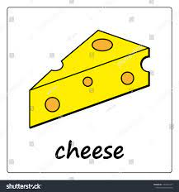
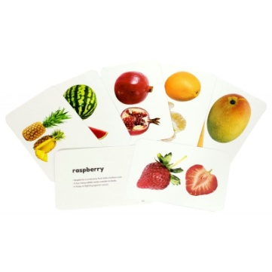
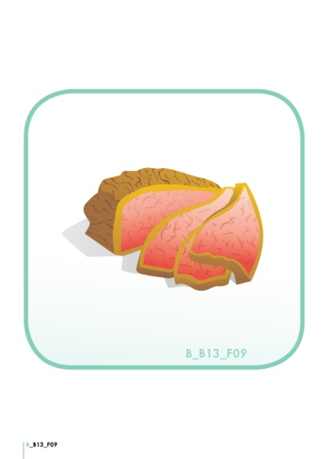
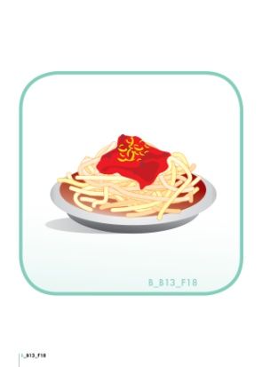
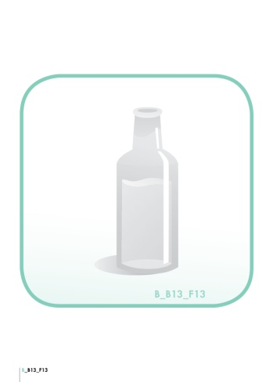
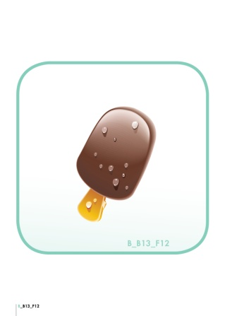
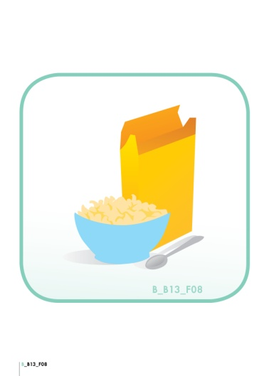
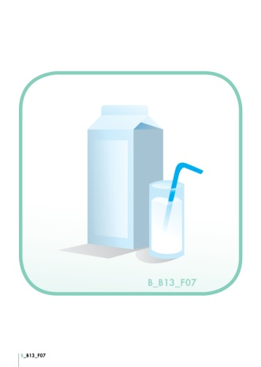
eggs
fruit
salad
spaghetti
water
ice cream
meat
oil
cornflakes
milk
candies
bread
chicken

Slide 3
eggs
fruit
salad
spaghetti
meat
oil
water
ice cream
cornflakes
milk
candies
bread
chicken

Slide 4
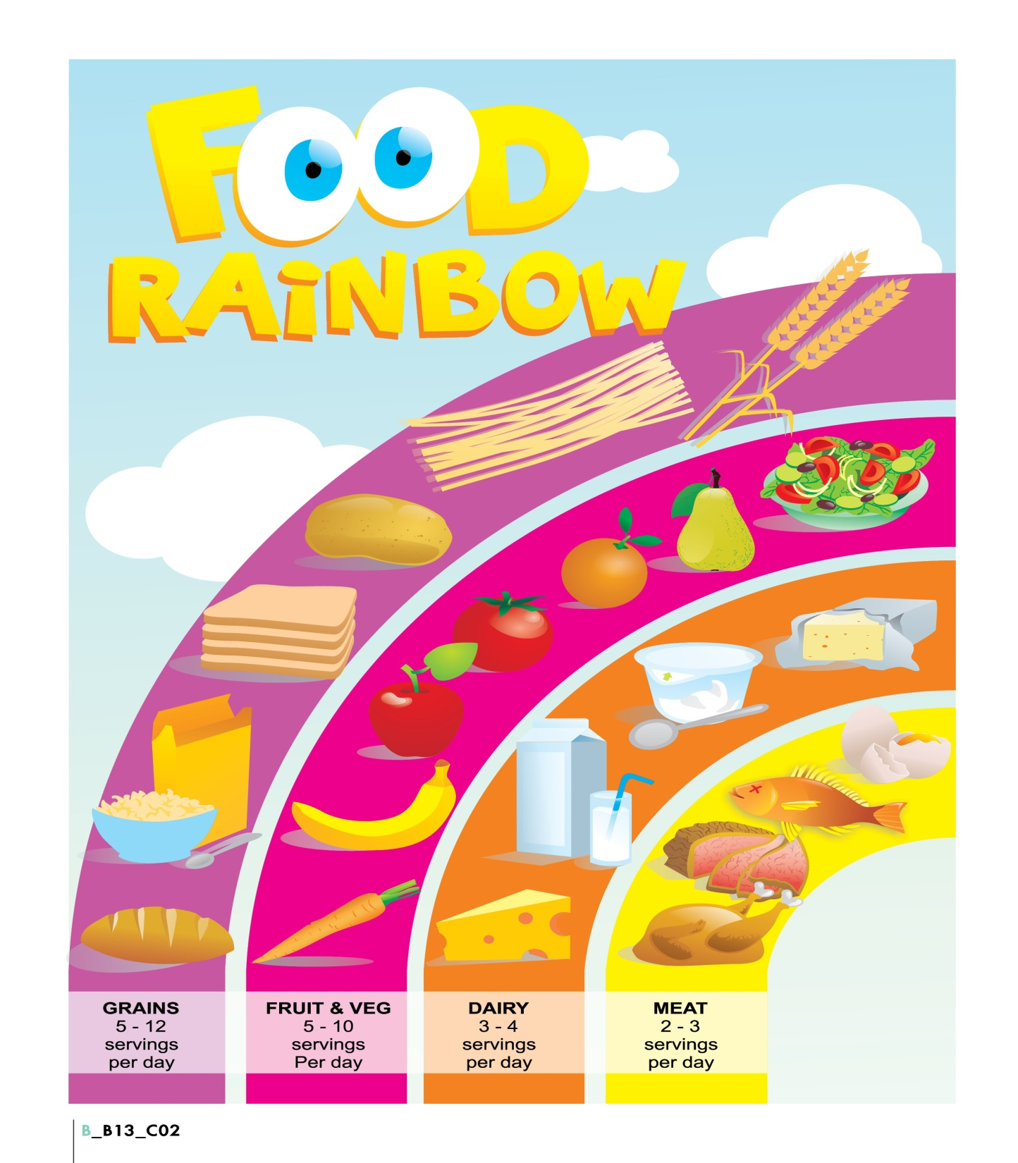
Food Memory Matching Game
https://matchthememory.com/dimiplobfood_match
“Choose your plate” Game
https://www.wartgames.com/themes/foodpyramid.html

Slide 5
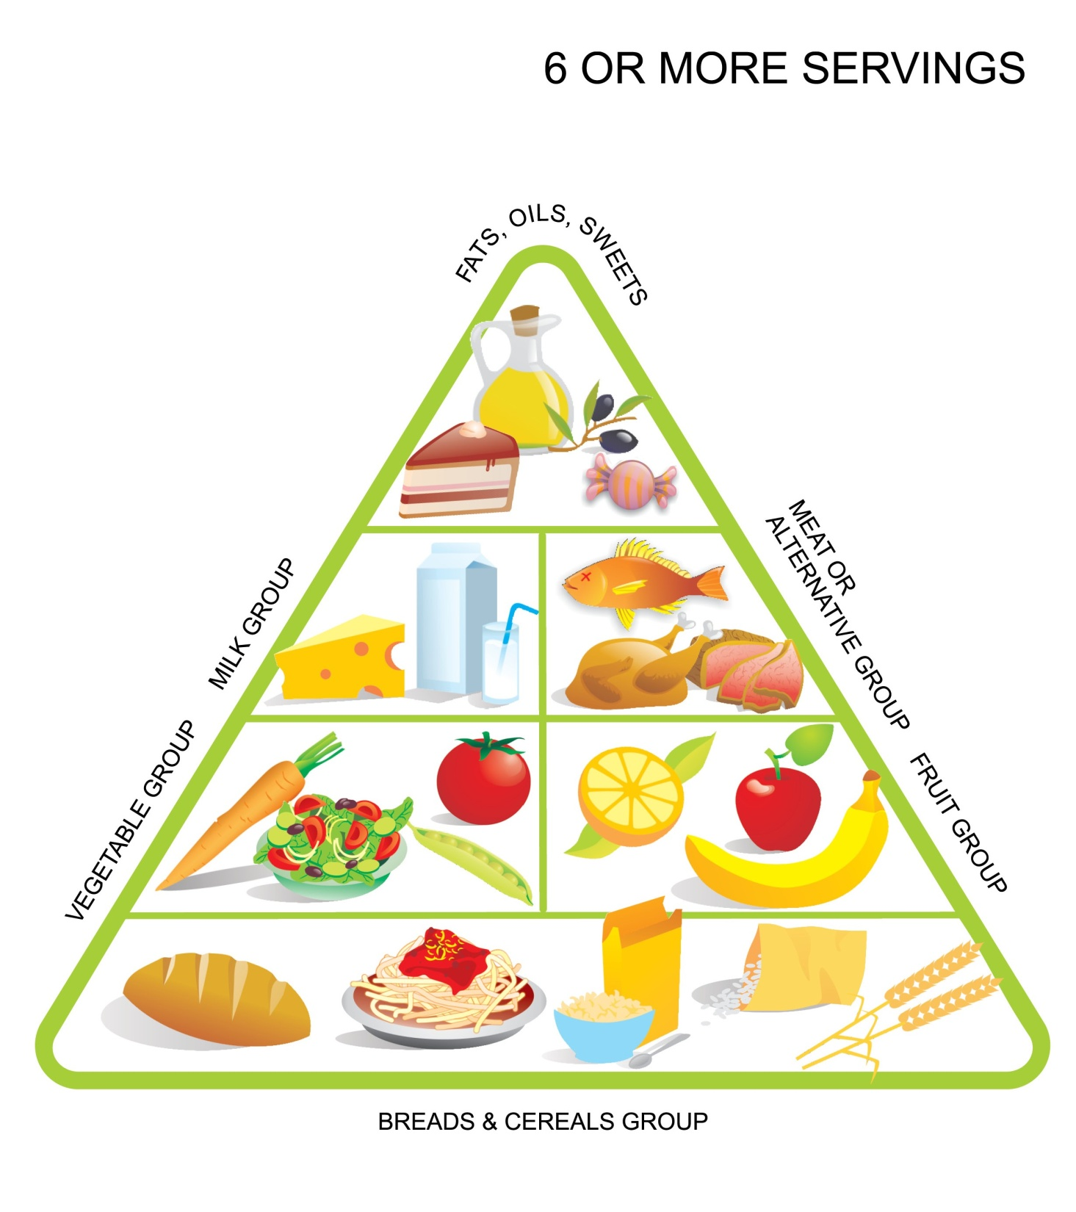
The Mediterranean Diet
http://aesop.iep.edu.gr/node/7049/1901
MyPlate Match Game
https://www.wartgames.com/themes/foodpyramid.html
“Build a food pyramid” Game
https://www.healthyeating.org/products-and-activities/games-activities/myplate
Let’s meet Hansel & Gretel
http://aesop.iep.edu.gr/node/7049/2130

