Slide 1
Across the curriculum: War & Peace Project
September 2011

Slide 2
Teacher: Ploumbis Dimitra
Estimated time: 10-12 teaching sessions
Class: 18 students in the 6th grade of the 2nd Primary School in Bari
Output product (paintings, poems, pictures) displayed to celebrate International Peace,
21st September

Slide 3
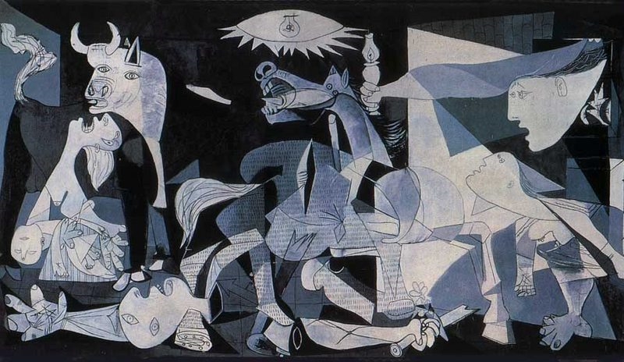
‘Guernica’ by Picasso

Slide 4
What I already know | What I would like to find out

Slide 5
Artist: Year: Title: Type: Dimensions: Present Location:

Slide 6
In January 1937, the famous Spanish painter and sculptor Pablo Picasso (1881-1973) was asked to produce a work of art to be exhibited at the Spanish stand during the International Art Exhibition which would take place in Paris that summer.
On April 26th 1937, when Picasso heard about the bombing of the Spanish town of Guernica by the Germans, he decided to paint a picture to depict the massacre of the unarmed Spanish people. The resulting work of art was a mural-sized monochrome oil-on-canvas painting (349 cm tall and 776 cm wide). Guernica shows the tragedies of war and has become an anti-war symbol. It can be seen in the Museo Reina Sofia in Madrid.

Slide 7
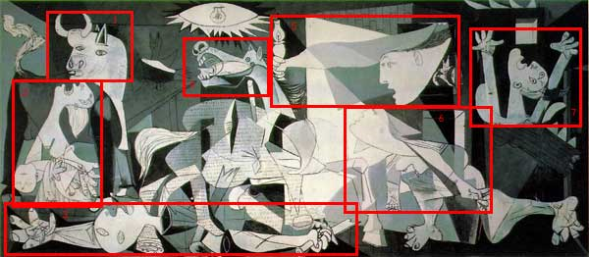
Symbols of war: Discussed the symbolism in the painting Source: <http://library.thinkquest.org>

Slide 8
On war and peace painting
‘It is quite straightforward to present “war” in a painting. Generally, it is fairly obvious what the subject of a “war painting” is: the soldiers, mutilated bodies, smoke rising from bombed out ruins, etc… Peace, however, presents more challenges artistically it seems to me.’ What do you think?
Source:
IG’s Peace Blog <http://igbarb19.wordpress.com>

Slide 9
‘Children of War’
Presented in the 2nd assignment
Estimated time: 2 teaching sessions (90 min)

Slide 10
WORKSHEET 1
Students think individually
Discuss in pairs
Work in groups
Form different groups and
Work with different students

Slide 11
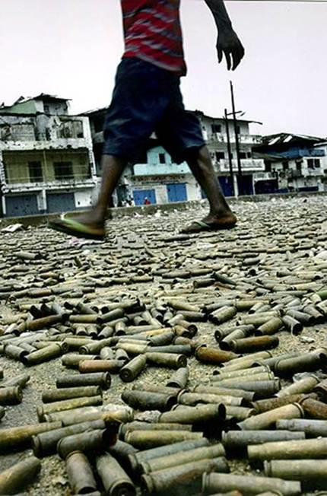
Source: http://tsoumpasphotogallery.ning.com/profiles/blogs/photographies-poy-egrapsan-1

Slide 12
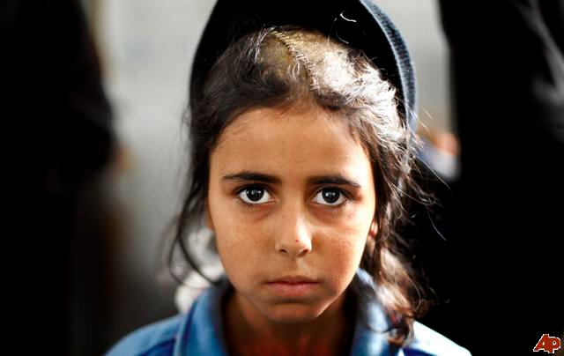
Source: http://newshopper.sulekha.com/aptopix-gaza-children-of-war_photo_643892.htm

Slide 13
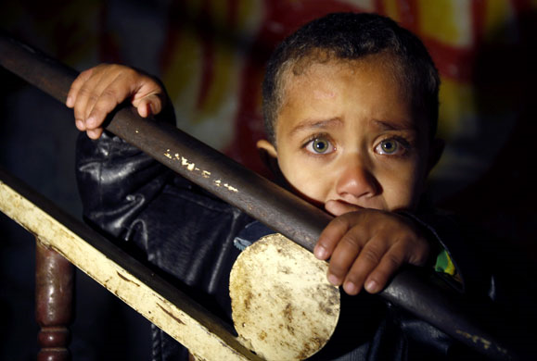
Source: http://virtuesofalquds.blogspot.com/search/label/Children%20of%20Palestine

Slide 14
Semila
By Giota Partheniou
Source:
http://keimena-poihtikianthologia.blogspot.com/2008_03_01_archive.html
Posted on Thursday, 20th March 2008

Slide 15
Το ξέρω Σεμίλα, ο πόλεμος τρόμαξε τη μικρή σου καρδούλα. Το ξέρω Σεμίλα, ο πόλεμος μεγάλωσε τα μάτια σου. Το ξέρω Σεμίλα, μέρες τώρα πεινάς.

Slide 16
Μην κλαις Σεμίλα, θα σου φέρω τον ήλιο μου. Μην κλαις Σεμίλα, θα σου φέρω την αγάπη μου. Μην κλαις Σεμίλα, θα σου φέρω την καρδιά μου.

Slide 17
Χέρι με χέρι θα διώξουμε τον πόλεμο, χέρι με χέρι θα μοιράσουμε το ψωμί. Μην κλαις Σεμίλα.

Slide 18
The students’ poems
Julie
By Eleftheria, Elektra, Xanthi
Julie, I know you live in the war
I know you don’t have a house and
I know you don’t have anybody
But now think
Who is the protagonist of your life?
Who draws the curtains?
Who has the love of our life?
Who?

Slide 19
Who is teaching us
the truth and the lie of our life?
Who is singing as if we were never gonna die
Who is holding the key of your freedom?
YOU!
You have your guns.
Now fight!!!

Slide 20
Arad
By Metaxia Nikolitsi & Joanna Dalla
Don’t cry.
Please, don’t cry Arad!
You aren’t different from me.
You aren’t different from anyone.
Don’t cry Arad!
Tears don’t give solutions.
Don’t cry, Arad!
It’s a forgotten conclusion.
Look up in the sky.
Look at me in the eyes.
Believe me, Arad.

Slide 21
We can help you, don’t cry.
You aren’t alone.
Together we will try.
You can feel good.
You can feel happy.
I will always remember you in my life.
Don’t cry!

Slide 22
Don’t cry, Jamal! By Joanna Karavana & Gregoria Dandoulaki
Don’t cry, Jamal!
The war will be over.
We will help you from here in Vancouver!
Please, don’t cry, Jamal
Don’t cry, Jamal!
Look! The war is nearly over!
Look! Everybody smiles.
Please, don’t cry, Jamal!
Your wish for peace in the world
came true!

Slide 23
Don’t cry
By Panagiotis Tourpetas & John Bouros
Don’t cry, Omar!
By Fivos & Vassilis
Don’t cry, Andreas!
I know they killed your family.
Don’t cry, Andreas!
I am here for you.
Don’t cry, Andreas!
Don’t cry, Omar
The war will end
You will laugh again
and there will be bread.

Slide 24
Naila By Theodora, Christina, Kalliroi, Evangelia
Naila with black
Naila with grey
I love you so much
But you are not OK!
Your heart is black
But I’ll give your smile back
Your clothes are poor
And that’s not cool.

Slide 25
God wanted peace
But we don’t have this.
You are so small
But our love for you is sky tall.
Naila you’re sad.
Naila you cry.
The war is bad.
We know that!

Slide 26

IMAGINE by John Lennon

