Slide 1
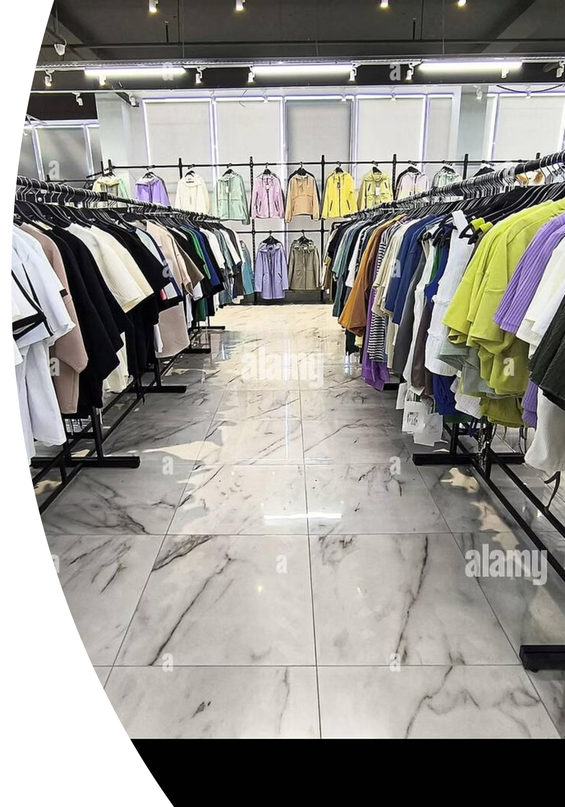
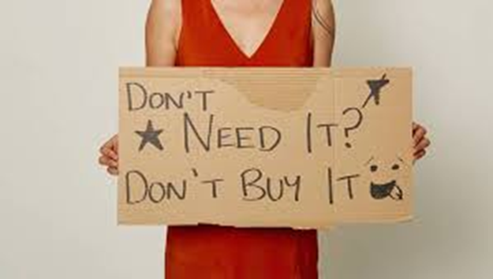
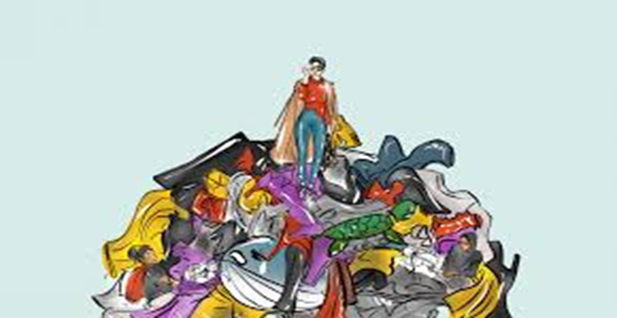
Fast Fashion
What is it and why does it matter?

Slide 2




What is Fast Fashion?
Fast fashion is a modern approach to clothing production that prioritizes speed and affordability. It's designed to quickly capture the latest runway trends and bring them to stores at prices that encourage frequent purchases.
Cheap Clothes
New Trends Very Often
Garments are priced remarkably low, making fashion accessible to nearly everyone regardless of budget constraints.
Fresh styles hit stores every week, sometimes even daily, keeping pace with rapidly changing fashion preferences.
Clothes Made Quickly
Big Fashion Brands
Production cycles are accelerated dramatically, with garments moving from design concept to store shelves in just weeks.
Major retail companies like Zara, H&M, and Shein dominate the fast fashion marketplace with global reach.

Slide 3

Why Do People Buy Fast Fashion?
1
Low Prices
Budget-friendly pricing allows shoppers to buy multiple items without financial strain, making fashion feel more accessible than ever.
2
Trendy Designs
Fast fashion brands quickly replicate high-fashion runway looks, giving consumers access to current styles almost immediately.
3
Social Media Influence
Influencers and celebrities constantly showcase new outfits online, creating desire for the latest trends and driving purchase decisions.
4
Easy to Buy Online
One-click shopping and fast delivery make purchasing effortless, with new clothes arriving at your doorstep within days.

Slide 4

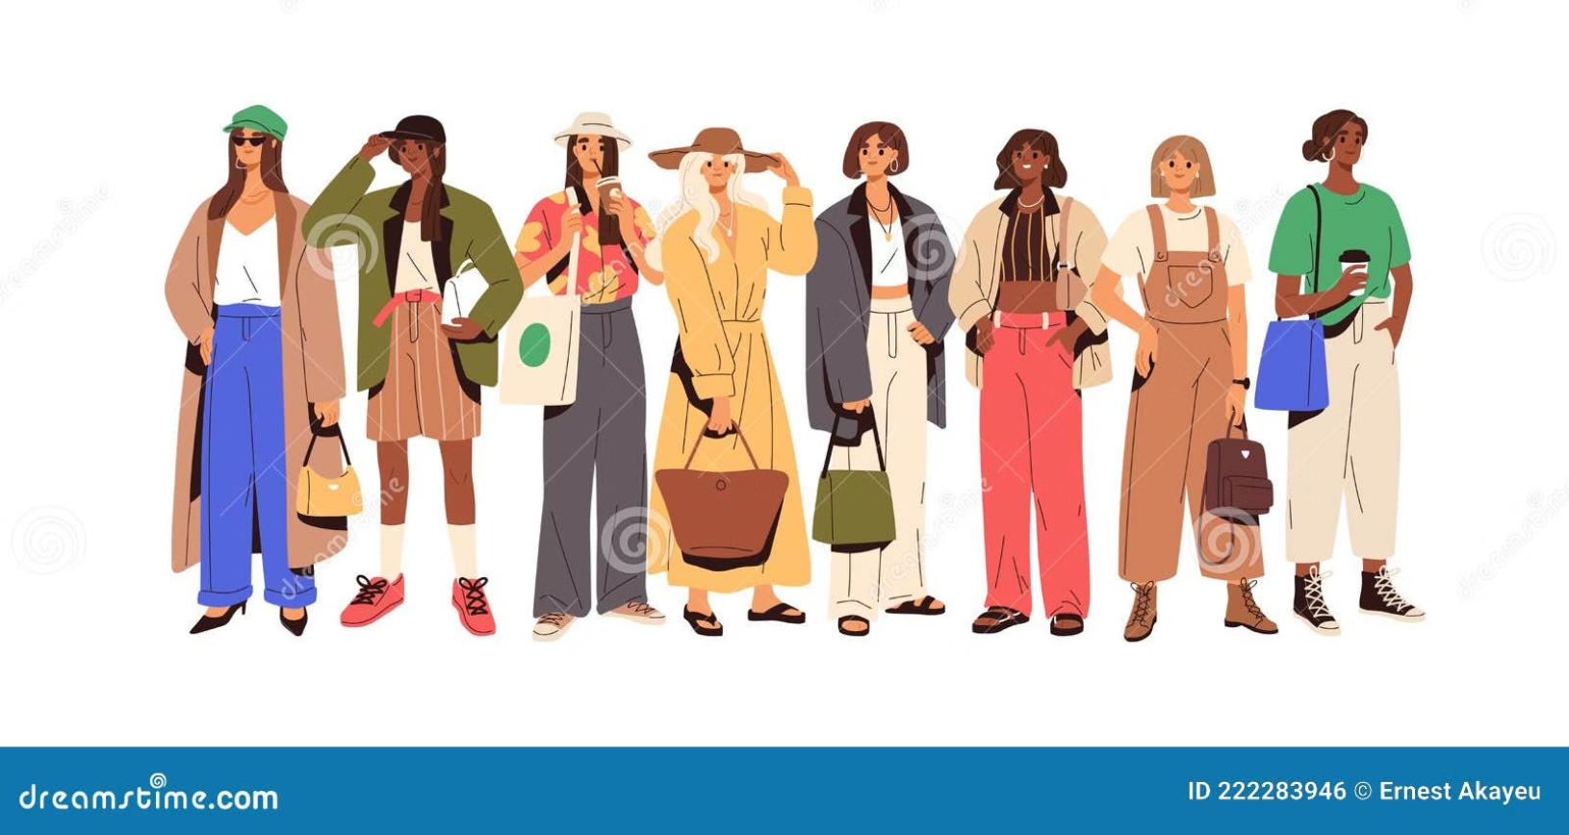
THE BRIGHT SIDE
Advantages of Fast Fashion
Affordable Clothes
Fashion becomes democratized when everyone, regardless of income level, can participate in current trends and express personal style.
Many Choices
Massive variety in styles, colors, sizes, and designs means there's truly something for every taste and body type.
Fashion for Everyone
From children to seniors, fast fashion retailers offer trendy options across all age groups and demographics.

Slide 5

CRITICAL ISSUES
Disadvantages of Fast Fashion
While fast fashion offers affordability and accessibility, it comes with significant hidden costs to our planet and its people.
1
Pollution
Manufacturing facilities release toxic chemicals into air and water systems, contaminating ecosystems.
2
Waste of Clothes
Low-quality garments are discarded after just a few wears, creating mountains of textile waste.
3
Poor Working Conditions
Factory environments are often unsafe, with inadequate ventilation, lighting, and safety measures.
4
Child Labour
Children in developing countries may be exploited in garment factories instead of attending school.
5
Low Quality Clothes
Cheap materials and rushed production result in garments that tear, fade, and fall apart quickly.

Slide 6
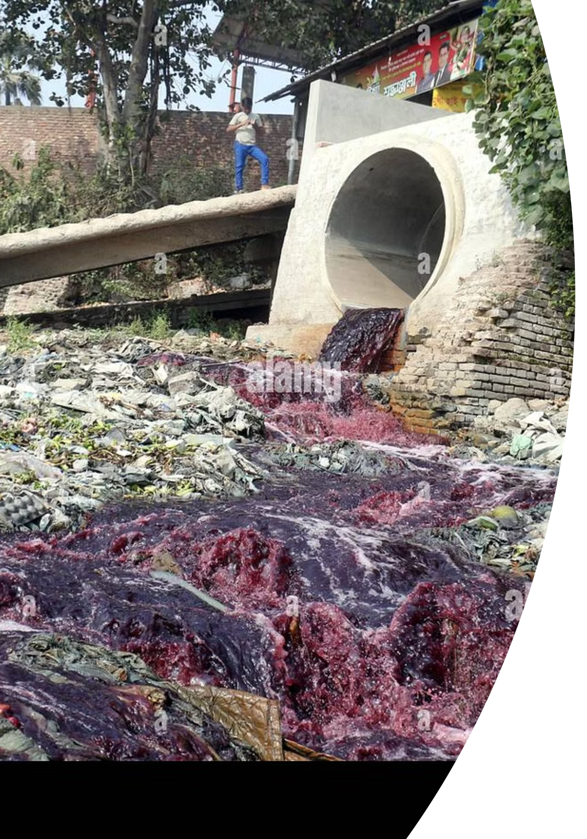
Effects on the Environment
Fast fashion's environmental impact is staggering, making it one of the world's most polluting industries after oil.
Water Pollution
Untreated dyes and chemicals from textile factories flow directly into rivers, poisoning drinking water and killing aquatic life.
Air Pollution
Manufacturing processes release greenhouse gases and toxic fumes, contributing to climate change and respiratory problems.
Too Much Waste
Over 92 million tons of textile waste are produced annually, with most ending up in landfills where they take decades to decompose.
Use of Chemicals
Harmful synthetic dyes and treatments contain substances that are toxic to humans and persist in the environment for years.

Slide 7

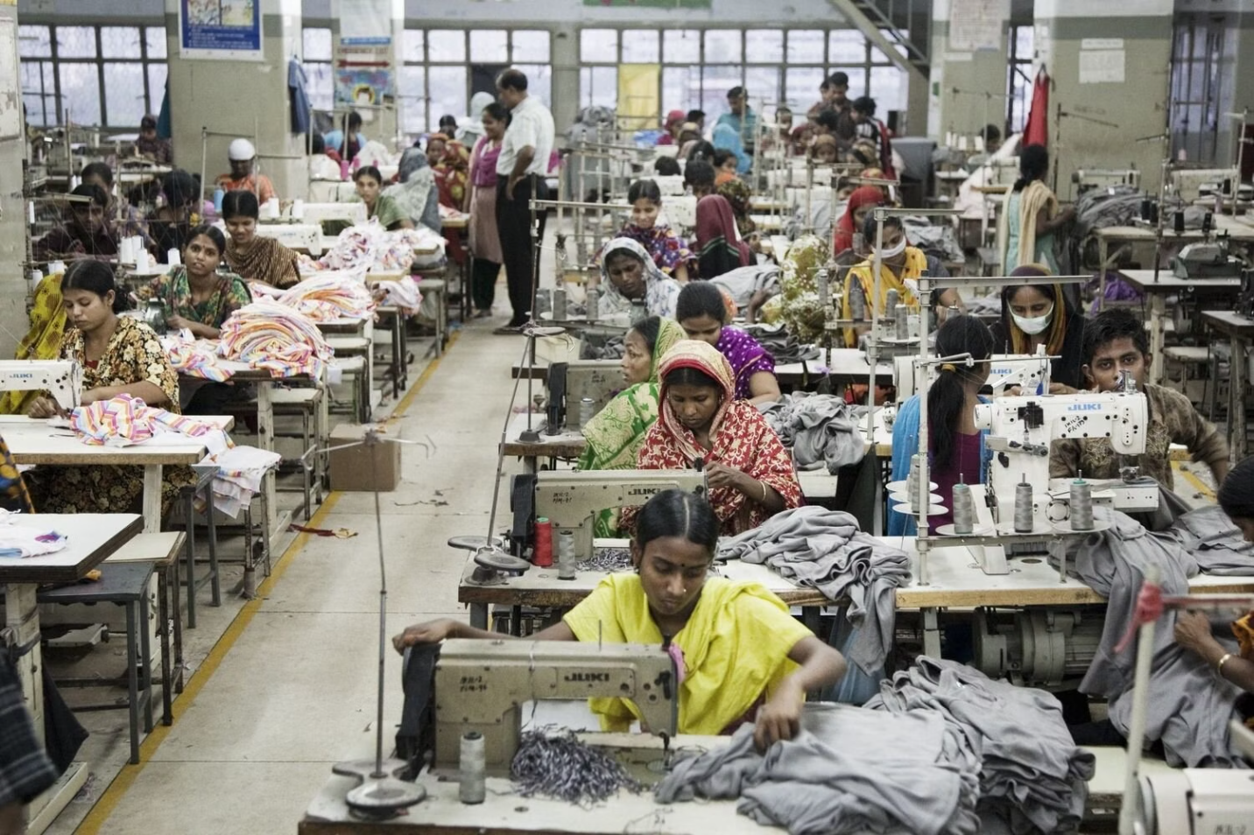



Effects on People
Low Pay
Garment workers earn wages far below living standards, often less than $3 per day, struggling to afford basic necessities.
Unsafe Factories
Buildings lack proper safety codes, fire exits, and structural integrity, putting workers' lives at risk daily.
Real Impact: The 2013 Rana Plaza factory collapse in Bangladesh killed over 1,100 workers, highlighting the human cost of fast fashion's race to the bottom.
Long Working Hours
Workers frequently labor 14-16 hours a day, seven days a week, with minimal breaks and no overtime compensation.

Slide 8




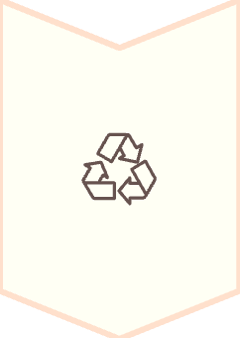

TAKE ACTION
What Can We Do?
Each of us has the power to create positive change through our clothing choices. Small actions add up to make a real difference.
Buy Less Clothes
Practice mindful shopping by purchasing only what you truly need and will wear regularly.
Choose Sustainable Brands
Support companies committed to ethical production, fair wages, and environmentally friendly materials.
Recycle or Reuse Clothes
Donate, swap, or repurpose garments to extend their life and keep them out of landfills.
Buy Second-Hand Clothes
Thrift stores and online resale platforms offer unique pieces while reducing demand for new production.

Slide 9
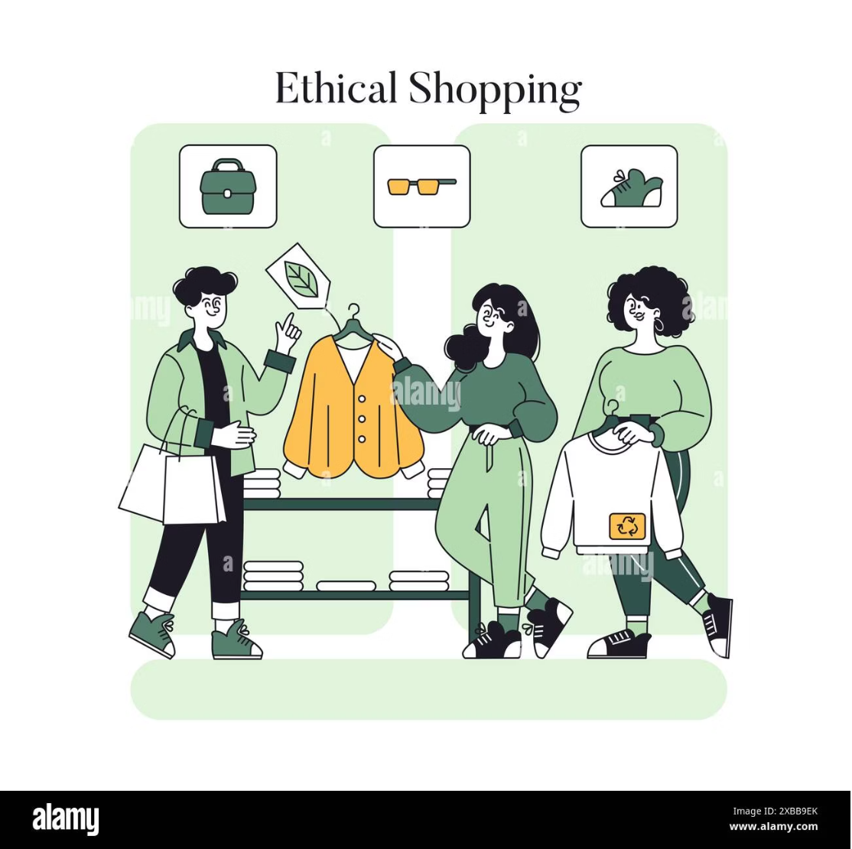
The Power of Your Choices
Every purchase you make is a vote for the kind of world you want to live in. The fast fashion industry thrives on our buying habits, but we have the power to demand better.
60%
2,700L
Clothing Discarded
Water Used
within one year of purchase
to make one cotton t-shirt
$500B
Value Lost
annually from clothing waste
When we shift toward conscious consumption, we send a powerful message to brands that sustainability matters more than speed.

Slide 10
Test Your Knowledge
Let's review what we've learned about fast fashion and its impact on our world.
Which of these are good solutions to the fast fashion problem?
✓ Buy less clothes
✓ Buy second-hand
Correct! Reducing overall consumption is one of the most impactful changes we can make.
Correct! Purchasing pre-owned clothing extends garment lifecycles and reduces waste.
✓ Choose sustainable brands
✓ Recycle and reuse
Correct! Supporting ethical companies encourages the industry to adopt better practices.
Correct! Giving clothes a second life keeps them out of landfills and conserves resources.
Remember: Every small action counts. Together, we can transform the fashion industry into one that values people and planet over profit and speed.

