Slide 1

European Day of Languages
QUIZ

Slide 2

1. How many living languages are there estimated in the world today?
  Around 500
  Around 2000
  Around 6000
  Around 3500

Slide 3
There are between 6000 and 7000 languages in the world - spoken by six billion people divided into 189 independent states.

Slide 4

2. What is generally considered to be the first form of written language?
  Cuneiform script
  Egyptian hieroglyphs
  Cyrillic alphabet
  Phoenician script

Slide 5
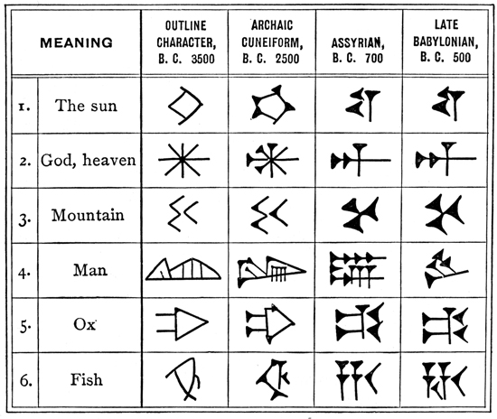
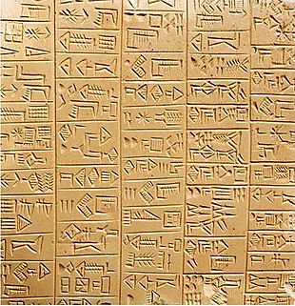
Cuneiform was used for over 3000 years throughout the Near East by such cultures as the Sumerians, Babylonians,
Assyrians, and Hittites.
Sumerian cuneiform

Slide 6

3. The official language of Azerbaijan is called?
a. Azerbaijanian
b. Azerbaijanic
c. Azeri
d. Azerban

Slide 7
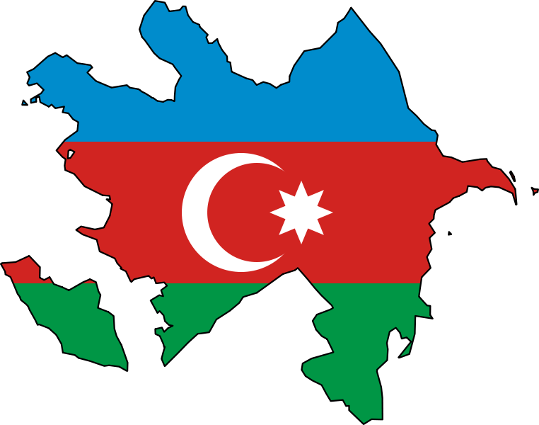
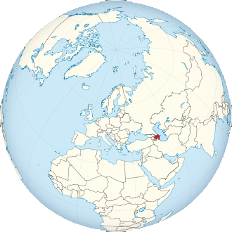
The official language of Azerbaijan is called Azeri.

Slide 8

4. Where do sign languages come from?
a. They have been copied from the great apes living in Africa.
b. They were invented by the French Abbé de l'Epée between 1760 and 1789.
c. They emerged naturally where deaf people were gathered together and are present also in some indigenous populations.
d. They have been created in the language laboratory from the Gallaudet University (USA).

Slide 9
The Abbé de l'Epée is the first person who recognized the importance of using a sign language for the instruction of deaf children and is credited to have brought together the deaf community in an institution that later became Institut Saint Jacques (which still exists in Paris).

Slide 10

5. In which country is the language Cymraeg spoken?
a. In the Faroe Islands
b. In Wales
c. In Scotland
d. In Ireland

Slide 11
Cymraeg (Welsh) is the name of the Celtic language spoken in Wales.
Wales has two official languages, Welsh and
English. Welsh is a Celtic language established in
the 6th century and is closely related to Cornish
and Breton and is one of Europe’s oldest living
languages. Welsh is currently spoken by over
20% of the population, approximately 720,000
people. Wales is called Cymru in Welsh.

Slide 12

6. Sign language is universal. - true or false?
a. true
b. false

Slide 13
False. There are many varieties and there can actually be more than one signed language in a country, just as for oral languages.
For example, there are two sign languages in Belgium (French Belgian Sign Language and Flemish Sign Language) or in Spain (Spanish Sign Language and Catalan Sign Language).
Also, there are different sign languages in countries that have the same spoken language, such as in the UK and Ireland. This is due to historical developments that are different to the ones experienced in spoken languages.

Slide 14

7. Which is the country with the highest number of languages spoken on its territory?
a. Russia
b. China
c. Germany
d. Norway

Slide 15
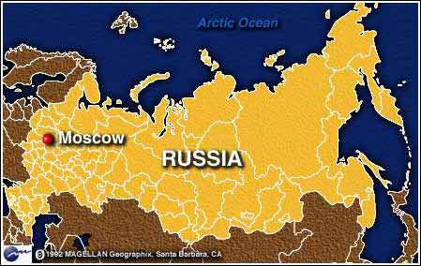
Russia (148 million inhabitants) has by far the highest number of languages spoken on its territory: from 130 to 200 depending on the criteria.

Slide 16

8. How many words does the active vocabulary of a person contain?
a. 30.000 words
b. 50.000 words
c. 150.000 words
d. 9.000 words

Slide 17
The words educated people use – their active vocabulary – can reach some 50,000 words; the words they know but do not use – their passive vocabulary – is somewhat larger. In everyday conversation, people often make use of a small number of words, but with great frequency.
It has been estimated that a 21-year-old has already uttered some 50 million words.

Slide 18

9. Which affirmation is true?
a. Romanian and Bulgarian are Romance languages.
b. Danish and Faroese are Slavic languages.
c. Hungarian and Estonian belong to the Uralic language family.
d. Latvian and Lithuanian belong to the Baltic language family.

Slide 19
The families in Europe with the most member-languages and the most speakers are the Germanic, Romance, and Slavic.
Germanic languages are Danish, Norwegian, Icelandic, Swedish. Slavic languages are Bulgarian, Russian, Ukrainian,
Belarusian, Polish, Sorbian, Czech and
Romance languages are Romanian, Occitan, French and Sardinian.
Notes:
True: c+d

Slide 20

10. The tongue twister
Fisker Frits fisker friske fisk
is in:
a. Norwegian
b. Danish
c. Icelandic
d. Finnish

Slide 21
It‘s a tongue twister from Denmark!
Compare Danish to German:
Fischers Fritz fischt frische Fische
Fisker Frits fisker friske fisk

Slide 22

11. Which of the following languages are written from right to left?
a. Maltese
b. Hebrew
c. Arabic
d. Japanese

Slide 23
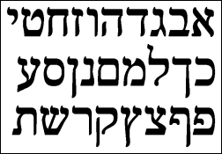
Hebrew and Arabic are written from right to left.
Japanese traditionally, is written from top to bottom (and then right to left).
Maltese is written from left to right.

Slide 24
Thank you for participating!
And the winner is……

