Slide 1
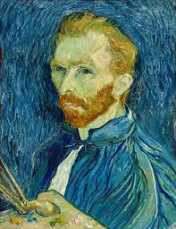
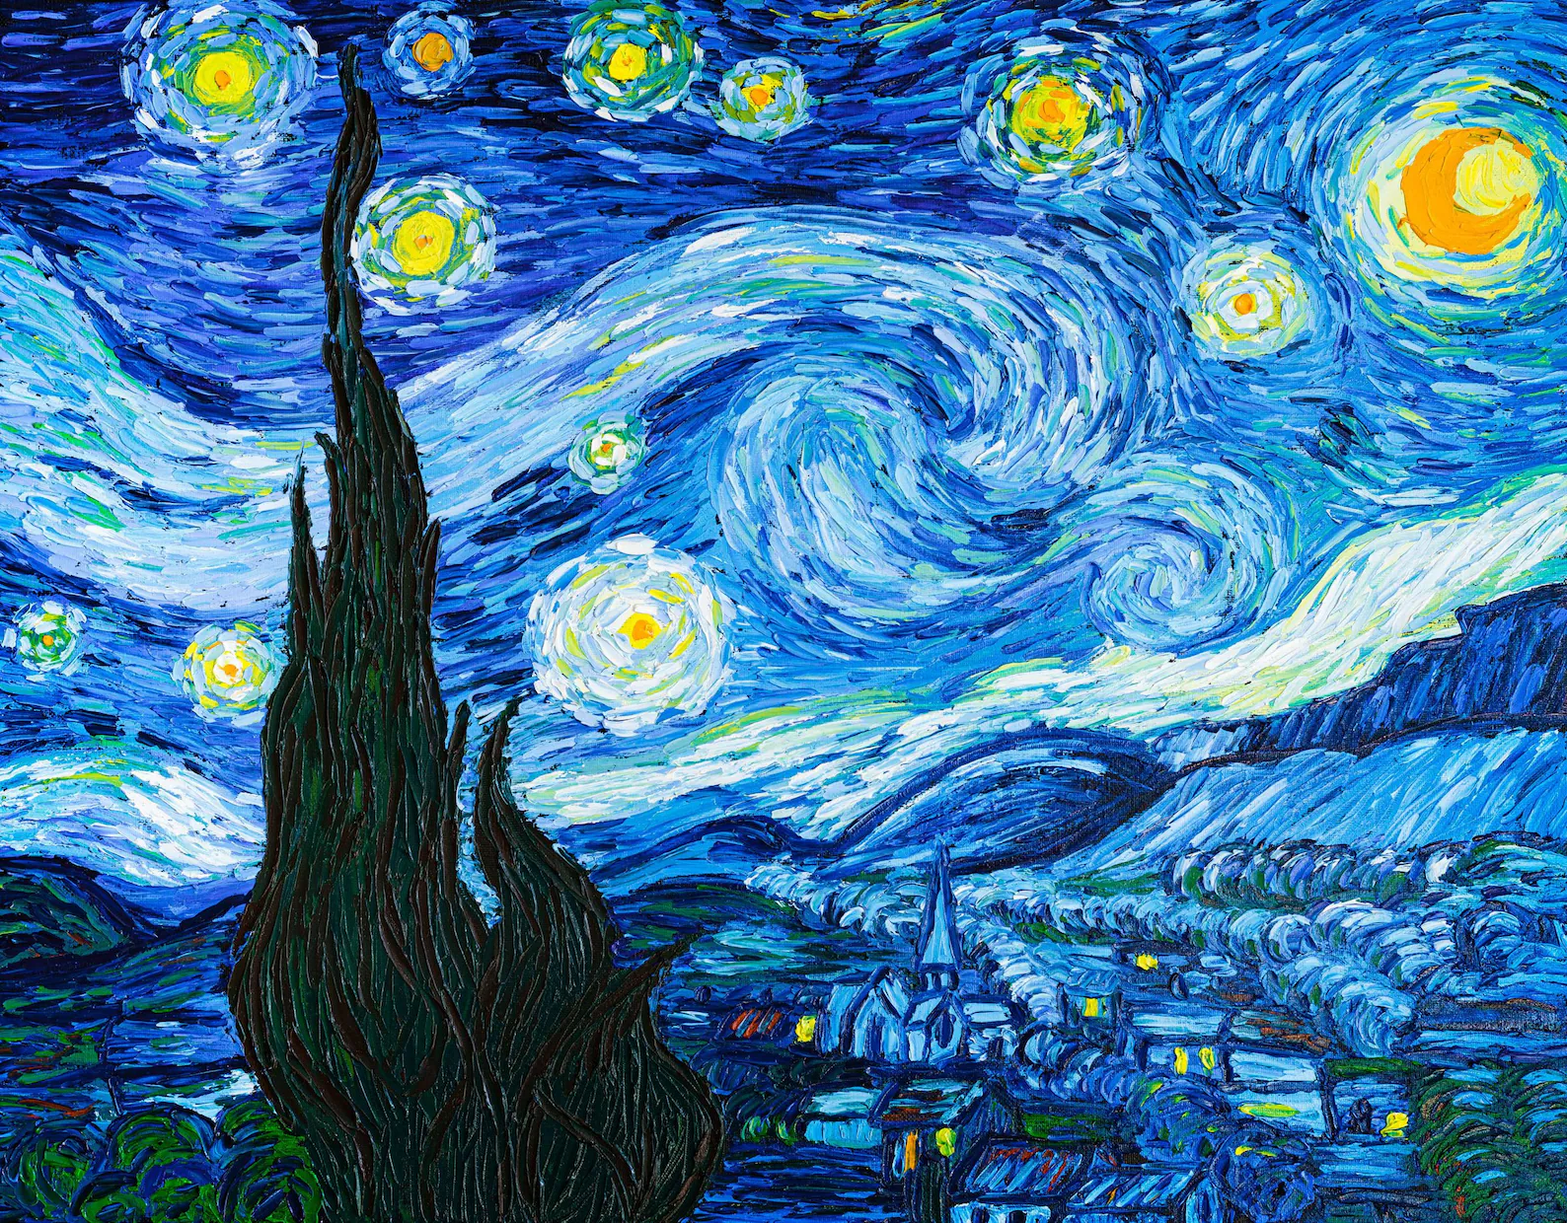
VINCENT VAN COGH
HIS LIFE AND PAINTINGS

Slide 2
In this unit, you are going to learn about Van Gogh’s life and his famous paintings, by watching a film about his life and reading the textbook.
Then, you are going to work in groups and find the new words using the wordreference and the educational tool Quizlet.

Slide 3
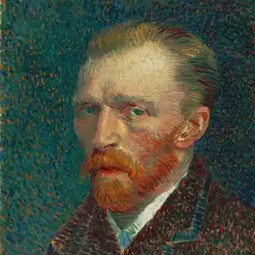
You are going to make your own vocabulary quiz.
In the end, you are going to work in groups on any aspect of Van Gogh’s life that has impressed you the most!

