Slide 1
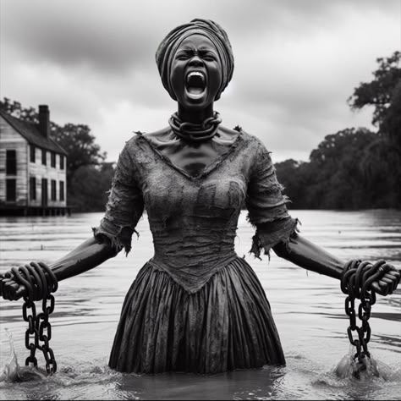
THE HISTORY OF SLAVERY

Slide 3
Slavery, a practice as old as human civilization, has been a pervasive institution throughout history, affecting countless individuals across various cultures and regions. From ancient societies to the transatlantic slave trade and its profound legacy, the history of slavery is one marked by profound human suffering, resistance, and eventual abolition movements. Slavery can be traced back to some of the earliest human societies. In ancient civilizations such as Mesopotamia, Egypt, Greece, and Rome, slavery was an integral part of the economic and social structure. In Mesopotamia, for instance, slaves were often prisoners of war or individuals who fell into debt. These slaves worked in homes, fields, or temples and were often used in large-scale construction projects.The ancient Greeks, who are often celebrated for their contributions to philosophy, politics, and arts, were also deeply reliant on slavery. In Athens, slaves made up a significant portion of the population, serving as domestic workers, laborers, and even in some instances, skilled artisans. The Roman Empire, one of the largest empires in history, was similarly dependent on slavery, with slaves playing crucial roles in agriculture, mining, and the upkeep of the vast empire. During the medieval period, slavery did not disappear, although its nature and forms evolved. In Europe, while serfdom became more prominent, slavery persisted in other regions, including the Islamic world and parts of Africa. The trans-Saharan slave trade brought African slaves to the Middle East and North Africa, where they were used as household servants, soldiers, and laborers.In Europe, the Vikings captured people from the British Isles, Ireland, and other regions to serve as slaves, while the Byzantine Empire also had a significant slave population, which played a key role in sustaining the empire's economy. One of the most brutal and widespread forms of slavery emerged in the 16th century with the transatlantic slave trade. European colonial powers, particularly Portugal, Spain, Britain, France, and the Netherlands, began to forcibly transport millions of Africans to the Americas to work on plantations producing sugar, tobacco, cotton, and other cash crops. This trade became a central part of the global economy and spanned more than three centuries.The conditions faced by enslaved Africans during this period were unimaginable. They were captured, often through violent means, in their home countries, and forced into the brutal Middle Passage, a harrowing journey across the Atlantic where many died from disease, starvation, or abuse. Upon arrival in the Americas, they were sold at slave markets and subjected to harsh labor conditions, often under the threat of violence and punishment. The institution of slavery in the Americas was racially based, with Africans and their descendants enslaved for generations, leading to lasting societal inequalities. Despite the pervasive nature of slavery, enslaved people were never completely subjugated. Resistance took many forms, from small acts of defiance to full-scale revolts. One of the most famous revolts was the Haitian Revolution (1791-1804), where enslaved Africans overthrew French colonial forces and established the first independent black republic. Such acts of resistance challenged the institution of slavery, and over time, the moral and philosophical arguments against it gained strength.The abolition of slavery began in the late 18th and early 19th centuries, fueled by the Enlightenment ideals of liberty and human rights. Abolitionists like William Wilberforce in Britain, Harriet Tubman and Frederick Douglass in the United States, and Toussaint L'Ouverture in Haiti fought tirelessly for the end of slavery. In the United States, the Civil War (1861–1865)

Slide 4
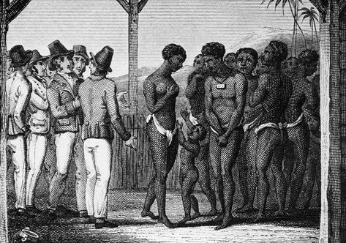
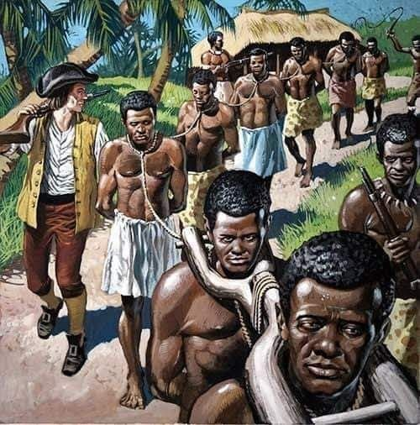
was partly fought over the issue of slavery, culminating in the Emancipation Proclamation in 1863 and the passage of the 13th Amendment in 1865, which abolished slavery in the country.In the British Empire, the Slavery Abolition Act of 1833 brought an end to slavery in most parts of the empire, while France abolished slavery in its colonies in 1848. Other nations followed suit, and by the end of the 19th century, slavery was formally abolished in most parts of the world. Although slavery was formally abolished in the 19th century, its legacy remains a powerful force in the modern world. The descendants of enslaved people continue to grapple with the social, economic, and psychological effects of this history. Racism, inequality, and systemic discrimination are some of the direct consequences of slavery's enduring legacy, particularly in the United States, where the effects of slavery persist in the form of segregation, mass incarceration, and other forms of racial injustice.Globally, while the formal institution of slavery has been eradicated, modern forms of slavery—such as human trafficking, forced labor, and child slavery—still exist. Millions of people worldwide are still subjected to conditions of slavery, often hidden from view, despite international laws and organizations working to eliminate it. The history of slavery is a dark chapter in human history, marked by exploitation, brutality, and immense human suffering. Yet it is also a story of resistance, resilience, and the fight for justice. The abolition of slavery, though a monumental achievement, did not end the struggle for equality and human rights, as its legacy continues to shape societies around the world. As we reflect on this history, it is essential to remember the lessons of the past and continue working towards a world free of exploitation and injustice.

Slide 5
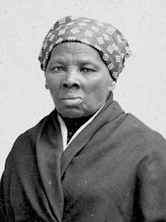
The MOST known people that fought for black peoples lives
Harriet Tubman (born Araminta Ross, c. March 1822 – March 10, 1913) was an American abolitionist and social activist.After escaping slavery, Tubman made some 13 missions to rescue approximately 70 enslaved people, including her family and friends, using the network of antislavery activists and safe houses known collectively as the Underground Railroad. During the American Civil War, she served as an armed scout and spy for the Union Army. In her later years, Tubman was an activist in the movement for women's suffrage.Born into slavery in Dorchester County, Maryland, Tubman was beaten and whipped by enslavers as a child. Early in life, she suffered a traumatic head wound when an irate overseer threw a heavy metal weight, intending to hit another slave, but hit her instead. The injury caused dizziness, pain, and spells of hypersomnia, which occurred throughout her life. After her injury, Tubman began experiencing strange visions and vivid dreams, which she ascribed to premonitions from God. These experiences, combined with her Methodist upbringing, led her to become devoutly religious.In 1849, Tubman escaped to Philadelphia, only to return to Maryland to rescue her family soon after. Slowly, one group at a time, she brought relatives with her out of the state, and eventually guided dozens of other enslaved people to freedom. Tubman (or "Moses", as she was called) travelled by night and in extreme secrecy, and later said she "never lost a passenger". After the Fugitive Slave Act of 1850 was passed, she helped guide escapees farther north into British North America (Canada), and helped newly freed people find work. Tubman met John Brown in 1858, and helped him plan and recruit supporters for his 1859 raid on Harpers Ferry.When the Civil War began, Tubman worked for the Union Army, first as a cook and nurse, and then as an armed scout and spy. For her guidance of the raid at Combahee Ferry, which liberated more than 700 enslaved people, she is widely credited as the first woman to lead an armed military operation in the United States. After the war, she retired to the family home on property she had purchased in 1859 in Auburn, New York, where she cared for her aging parents. She was active in the women's suffrage movement until illness overtook her and was admitted to a home for elderly African Americans, which she had helped establish years earlier. Tubman is commonly viewed as an icon of courage and freedom.

Slide 6
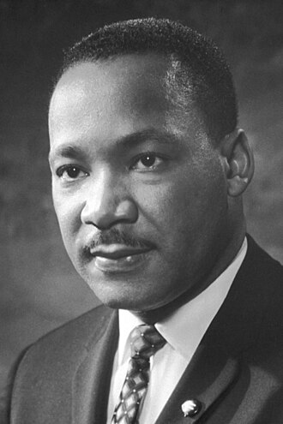
Martin Luther King Jr.
Martin Luther King Jr. (born Michael King Jr.; January 15, 1929 – April 4, 1968) was an American Baptist minister, activist, and political philosopher who was one of the most prominent leaders in the civil rights movement from 1955 until his assassination in 1968. He advanced civil rights for people of color in the United States through the use of nonviolent resistance and nonviolent civil disobedience against Jim Crow laws and other forms of legalized discrimination.A black church leader, King participated in and led marches for the right to vote, desegregation, labor rights, and other civil rights. He oversaw the 1955 Montgomery bus boycott and later became the first president of the Southern Christian Leadership Conference (SCLC). As president of the SCLC, he led the unsuccessful Albany Movement in Albany, Georgia, and helped organize some of the nonviolent 1963 protests in Birmingham, Alabama. King was one of the leaders of the 1963 March on Washington, where he delivered his "I Have a Dream" speech on the steps of the Lincoln Memorial, and helped organize two of the three Selma to Montgomery marches during the 1965 Selma voting rights movement. The civil rights movement achieved pivotal legislative gains in the Civil Rights Act of 1964, the Voting Rights Act of 1965, and the Fair Housing Act of 1968. There were several dramatic standoffs with segregationist authorities, who often responded violently.King was jailed several times. Federal Bureau of Investigation (FBI) director J. Edgar Hoover considered King a radical and made him an object of the FBI's COINTELPRO from 1963 forward. FBI agents investigated him for possible communist ties, spied on his personal life, and secretly recorded him. In 1964, the FBI mailed King a threatening anonymous letter, which he interpreted as an attempt to make him commit suicide.On October 14, 1964, King won the Nobel Peace Prize for combating racial inequality through nonviolent resistance. In his final years, he expanded his focus to include opposition towards poverty and the Vietnam War.In 1968, King was planning a national occupation of Washington, D.C., to be called the Poor People's Campaign, when he was assassinated on April 4 in Memphis, Tennessee. James Earl Ray, a fugitive from the Missouri State Penitentiary, was convicted of the assassination, though the King family believes he was a scapegoat. After a 1999 wrongful death lawsuit ruling named unspecified "government agencies" among the co-conspirators, a Department of Justice investigation found no evidence of a conspiracy. The assassination remains the subject of conspiracy theories. King's death was followed by national mourning, as well as anger leading to riots in many U.S. cities. King was posthumously awarded the Presidential Medal of Freedom in 1977 and the Congressional Gold Medal in 2003. Martin Luther King Jr. Day was established as a holiday in cities and states throughout the United States beginning in 1971; the federal holiday was first observed in 1986. The Martin Luther King Jr. Memorial on the National Mall in Washington, D.C., was dedicated in 2011.

Slide 7
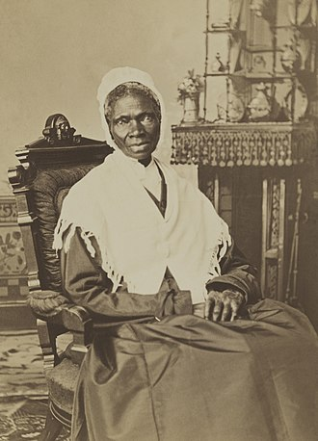
Sojourner Truth
Sojourner Truth (/soʊˈdʒɜːrnər, ˈsoʊdʒɜːrnər/ born Isabella Baumfree c. 1797 – November 26, 1883) was an American abolitionist and activist for African-American civil rights, women's rights, and alcohol temperance.Truth was born into slavery in Swartekill, New York, but escaped with her infant daughter to freedom in 1826. After going to court to recover her son in 1828, she became the first black woman to win such a case against a white man.She gave herself the name Sojourner Truth in 1843 after she became convinced that God had called her to leave the city and go into the countryside "testifying to the hope that was in her."Her best-known speech was delivered extemporaneously, in 1851, at the Ohio Women's Rights Convention in Akron, Ohio. The speech became widely known during the Civil War by the title "Ain't I a Woman?", a variation of the original speech that was published in 1863 as being spoken in a stereotypical Black dialect, then more commonly spoken in the South. Sojourner Truth, however, grew up speaking Dutch as her first language.Sojourner Truth examining the Bible with Abraham LincolnDuring the Civil War, Truth helped recruit black troops for the Union Army; after the war, she tried unsuccessfully to secure land grants from the federal government for formerly enslaved people (summarized as the promise of "forty acres and a mule"). She continued to fight on behalf of women and African Americans until her death. As her biographer Nell Irvin Painter wrote, "At a time when most Americans thought of slaves as male and women as white, Truth embodied a fact that still bears repeating: Among the blacks are women; among the women, there are blacks."A memorial bust of Truth was unveiled in 2009 in Emancipation Hall in the U.S. Capitol Visitor Center. She is the first African American woman to have a statue in the Capitol building. In 2014, Truth was included in Smithsonian magazine's list of the "100 Most Significant Americans of All Time".

Slide 8
THE END
(PERFECT SINCE DAY ONE)
ΑΓΓΕΛΟΣ ΣΠΑΝΙΔΗ Γ’4

