Slide 3
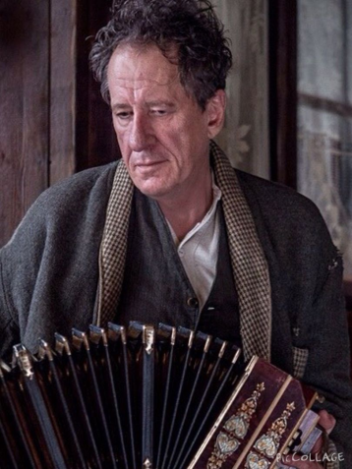
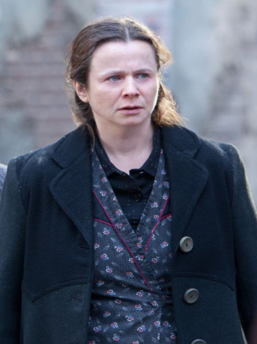
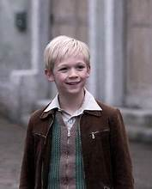
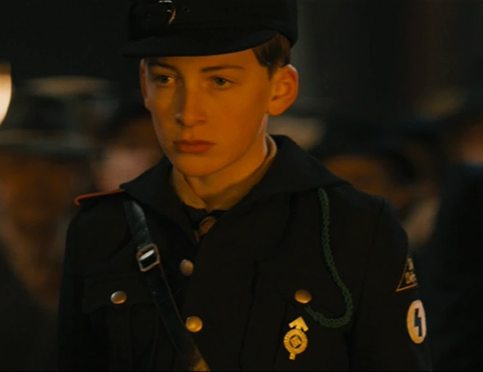
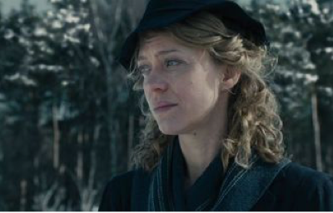
Liesel Meminger
Hans Hubermann
Rosa Hubermann
Max Vanderberg
Rudy Steiner
Franz Deutscher
Ilsa Hermann
Paula Meminger

Slide 4
laundry business and dealing with the financial burdens of World War II. While Hans is more idealistic and compassionate, Rosa’s pragmatism and strength balance their relationship. Rosa’s practicality allows them to survive in a world that is increasingly dangerous for Jews and dissidents.
One of the most significant ways Rosa demonstrates her loyalty and courage is through her protection of Max Vandenburg, the Jewish man whom the Hubermanns hide in their basement during the war. The risks they take by sheltering Max, especially with the Gestapo prowling for Jews, are enormous. Rosa, despite her complaints and frustrations, plays a vital role in ensuring Max’s safety, providing him with food and a place to stay even as the family faces mounting pressure from the war and from the Nazis. Her relationship with Max is one of quiet mutual respect and understanding, as she silently bears the immense strain of their secret.
Rosa’s courage is not always loud or obvious, but it’s steady and unwavering. She endures daily hardships—the threat of Nazi persecution, the grief of living in a war-torn world, and the constant fear for the lives of those she loves. Her role as a mother and protector, though uncelebrated, is crucial to the survival of her family.
While Rosa can be blunt and scolding, her character also provides moments of humor and warmth in the story. Her verbal sparring with Hans, often filled with sarcasm, is one of the lighter aspects of the novel, and it reveals the deeply intertwined affection between the two. Her tough-love approach to Liesel and Hans shows that, though she might not express her emotions conventionally, she is at the emotional center of the household.
In conclusion, Rosa Hubermann is a character of immense emotional depth. Though she is tough, scornful, and even abrasive, she is also one of the most loving, loyal, and courageous figures in The Book Thief. Her evolution from an intimidating figure to a fierce protector reflects the complexity of human relationships in times of crisis, and her presence helps to ground the story in themes of sacrifice, family, and the quiet heroism found in everyday actions.
Rosa Hubermann is a pivotal character in The Book Thief, a novel by Markus Zusak. She is Liesel Meminger's foster mother, a blunt, tough, and fiercely protective woman. Though she often appears harsh and abrasive, with a sharp tongue and a no-nonsense attitude, Rosa's love for Liesel and her family runs deep. She serves as a stabilizing force during the turbulent years of World War II in Nazi Germany. Despite her rough exterior, Rosa demonstrates immense loyalty and courage, especially when protecting Liesel and hiding Max Vandenburg, a Jewish man, in their basement. Her character is complex and multifaceted, combining moments of comic relief with profound emotional depth, showing that love and sacrifice can come in unexpected forms. Rosa is described as a middle-aged, stocky woman with a broad face and a no-nonsense demeanor. She has a gruff, somewhat intimidating presence, often scowling or frowning, with a voice that matches her appearance: sharp, loud, and demanding. She wears her hair in a tightly-wound bun, and her facial expressions rarely suggest warmth, though this is just a facade for the deeper affection she holds for her family. Despite her outward toughness, she can also have moments of vulnerability, especially when she's alone or in private with those she cares about.
When Liesel is placed with the Hubermanns after the death of her brother and the disappearance of her mother, Rosa’s stern manner makes Liesel’s transition difficult. Rosa is strict with Liesel, often berating her, but the two develop a strong, if unspoken, bond. Rosa acts as a mother figure in her own way—her affection for Liesel is shown in actions rather than words, from making sure Liesel has food and clothes to, later in the story, sacrificing her own safety to protect her.
Rosa is married to Hans Hubermann, the kinder, gentler of the two, who teaches Liesel to read and acts as a calming influence. However, Rosa’s role in their partnership is equally vital. She helps keep their household afloat, running a small

Slide 5
THE
END
ΣΠΑΝΙΔΗΣ ΑΓΓΕΛΟΣ Γ’4

