Slide 1
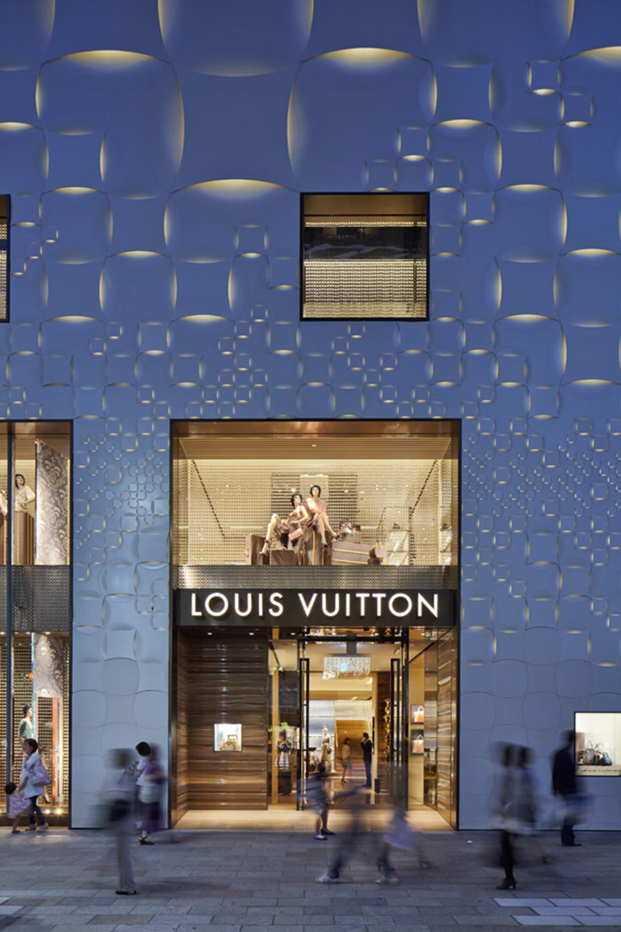
The Legacy of Louis Vuitton
Dive into the captivating history and global influence of the iconic luxury brand, Louis Vuitton. From its humble beginnings as a luggage maker to its status as a high-fashion powerhouse, this presentation will explore the key milestones that have shaped the Louis Vuitton legacy.
by Stathis Kotsopoulos

Slide 2
Founding and Early History
1854: The Beginning
Early Innovations
Louis Vuitton opens his first luggage workshop in Paris, pioneering flat-topped trunks to prevent water damage.
Vuitton's trunks are recognized for their quality craftsmanship and unique designs, establishing the brand's reputation.

Slide 3
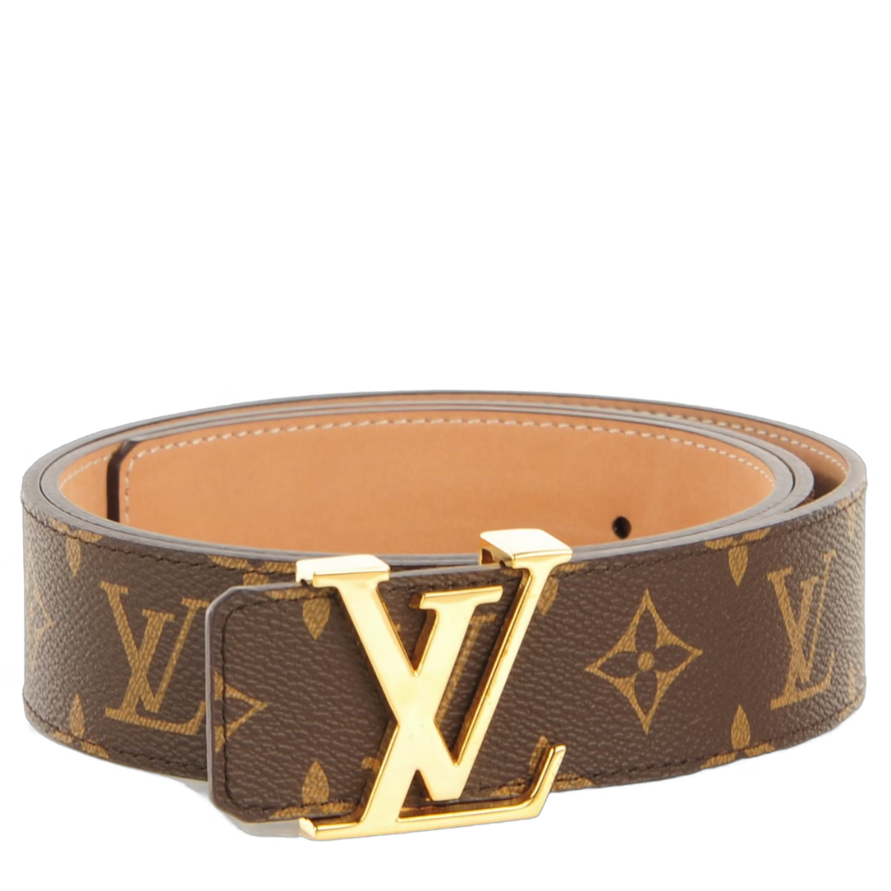
The Iconic Monogram Canvas
1896: Monogram Creation
Signature Design
The interlocking L and V pattern, along with the quatrefoils and flowers, become the brand's signature.
The iconic LV monogram canvas is introduced, becoming an instantly recognizable symbol of luxury.

Slide 4
Expanding into Accessories and Fashion
1901: Handbags
1997: Marc Jacobs
Louis Vuitton begins producing leather handbags, expanding beyond its core luggage business.
Louis Vuitton appoints Marc Jacobs as its first Artistic Director, further elevating the brand's fashion credentials.
1
2
3
1930s: Ready-to-Wear
The brand introduces its first ready-to-wear clothing line, solidifying its position in the fashion industry.

Slide 5
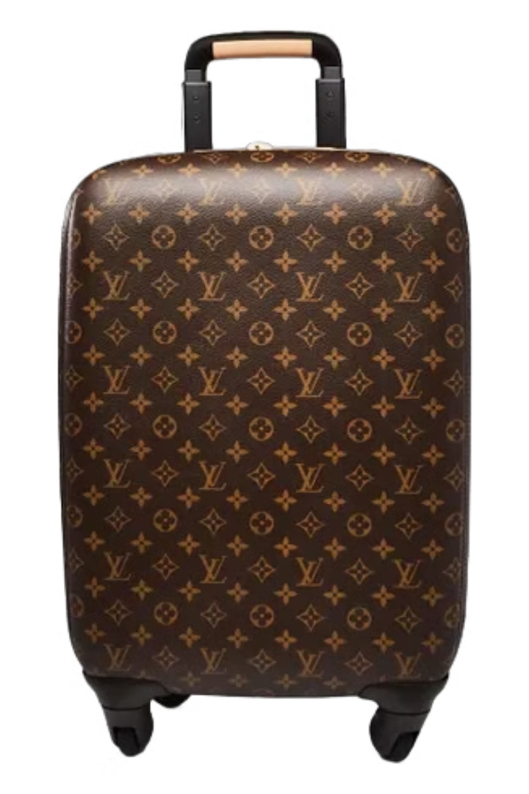
Innovations in Luggage Design
Locks
Louis Vuitton's innovative luggage locks become a signature feature, ensuring the security of travelers' belongings.
Zippers
The brand introduces zipper closures on its luggage, improving functionality and convenience for customers.
Wheels
Louis Vuitton pioneers the use of wheels on luggage, making it easier for travelers to navigate airports and city streets.

Slide 6
Louis Vuitton's Global Expansion
1914: First International Store
2000s: Luxury Dominance
Louis Vuitton opens its first international store in London, marking the beginning of the brand's global expansion.
Louis Vuitton solidifies its position as a leading luxury brand, with stores in major cities around the world.
1
2
3
1980s: Rapid Growth
The brand rapidly expands its retail presence worldwide, establishing a strong global footprint.

Slide 7
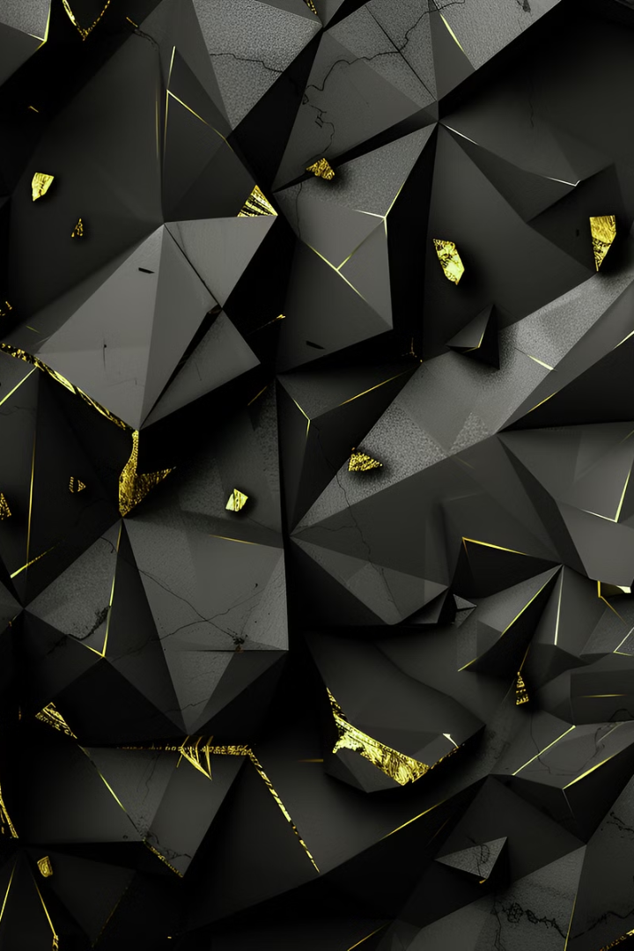
The Luxury Brand's Allure and Exclusivity
Perceived Quality
Aspirational Status
Louis Vuitton is renowned for its exceptional craftsmanship, high-quality materials, and attention to detail.
Owning a Louis Vuitton product is often seen as a symbol of wealth, success, and social status.
Limited Availability
The brand's exclusivity is maintained through carefully controlled distribution and limited product availability.

Slide 8
Collaborations and Diversification
Collaborations
Product Diversification
Louis Vuitton has partnered with renowned artists, designers, and brands to create exclusive, limited-edition collections.
The brand has expanded beyond its core luggage and handbag offerings, diversifying into various product categories like accessories, fragrances, and watches.

Slide 9
Sustainability and Environmental Initiatives
Sustainable Materials
1
Louis Vuitton is committed to using more eco-friendly materials in its products, such as recycled polyester and organic cotton.
Responsible Manufacturing
2
The brand has implemented initiatives to reduce waste and energy consumption in its production processes.
Environmental Advocacy
3
Louis Vuitton supports various environmental conservation and climate change mitigation efforts.

Slide 10
The Future of the Louis Vuitton Brand
150+
$18B
5%
Global Presence
Financial Performance
Sustainability Goals
Louis Vuitton has over 150 stores worldwide, with plans for continued international expansion.
The brand's parent company, LVMH, reported revenue of over $18 billion in 2022, showcasing its financial strength.
Louis Vuitton aims to reduce its carbon emissions by 5% annually, as part of its commitment to sustainability.

