Slide 1
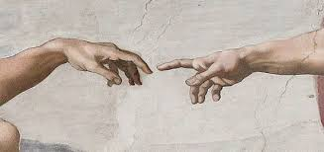
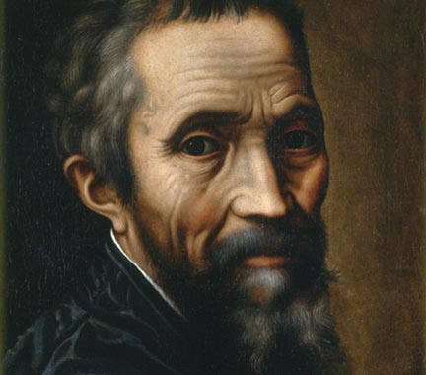
ΜΙΧΑΗΛ ΑΓΓΕΛΟΣ

Slide 2
Michelangelo di Lodovico Buonarroti Simoni , known simply as Michelangelo , was an Italian sculptor, painter, architect and poet of the High Renaissance born in the Republic of Florence, who exerted an unparalleled influence on the development of Western art. His artistic versatility was of such a high order that he is often considered a contender for the title of the archetypal Renaissance man, along with his rival, the fellow Florentine, Leonardo da Vinci.Several scholars have described Michelangelo as the greatest artist of his age and even as the greatest artist of all time.

Slide 3
Apprenticeships, 1488–1492
As a young boy, Michelangelo was sent to Florence to study grammar under the Humanist Francesco da Urbino. However, he showed no interest in his schooling, preferring to copy paintings from churches and seek the company of other painters. During Michelangelo's childhood, a team of painters had been called from Florence to the Vatican to decorate the walls of the Sistine Chapel. Among them was Domenico Ghirlandaio, a master in fresco painting, perspective, figure drawing and portraiture who had the largest workshop in Florence.^{[15]} In 1488, at age 13, Michelangelo was apprenticed to Ghirlandaio.^{[19]} The next year, his father persuaded Ghirlandaio to pay Michelangelo as an artist, which was rare for someone of fourteen. When in 1489, Lorenzo de' Medici, de facto ruler of Florence, asked Ghirlandaio for his two best pupils, Ghirlandaio sent Michelangelo and Francesco Granacci.

Slide 4
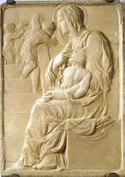
From 1490 to 1492, Michelangelo attended the Platonic Academy, a Humanist academy founded by the Medici. There, his work and outlook were influenced by many of the most prominent philosophers and writers of the day, including Marsilio Ficino, Pico della Mirandola and Poliziano.At this time, Michelangelo sculpted the reliefs Madonna of the Steps (1490–1492) and Battle of the Centaurs (1491–1492), the latter based on a theme suggested by Poliziano and commissioned by Lorenzo de Medici. Michelangelo worked for a time with the sculptor Bertoldo di Giovanni. When he was seventeen, another pupil, Pietro Torrigiano, struck him on the nose, causing the disfigurement that is conspicuous in the portraits of Michelangelo.
The Madonna of the Stairs (1490–1492), Michelangelo's earliest known work in marble

Slide 5
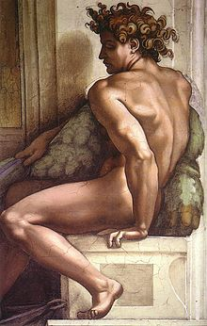
Personal habits
Michelangelo was a devout Catholic whose faith deepened at the end of his life. His poetry includes the following closing lines from what is known as poem 285 (written in 1554); "Neither painting nor sculpture will be able any longer to calm my soul, now turned toward that divine love that opened his arms on the cross to take us in.
Michelangelo was abstemious in his personal life, and once told his apprentice, Ascanio Condivi: "However rich I may have been, I have always lived like a poor man." Condivi said he was indifferent to food and drink, eating "more out of necessity than of pleasure"^{[72]} and that he "often slept in his clothes and ... boots."^{[72]} His biographer Paolo Giovio says, "His nature was so rough and uncouth that his domestic habits were incredibly squalid, and deprived posterity of any pupils who might have followed him."This, however, may not have affected him, as he was by nature a solitary and melancholy person, bizzarro e fantastico, a man who "withdrew himself from the company of men."
Ignudo fresco from 1509 on the Sistine Chapel ceiling

Slide 6
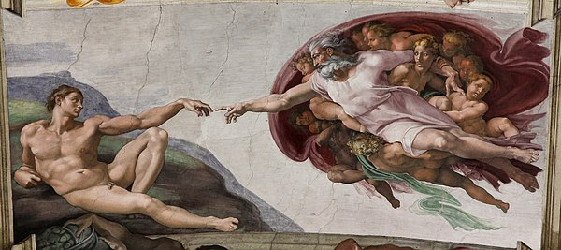
The Creation of Adam
The Creation of Adam (Italian: Creazione di Adamo) is a fresco painting by Italian artist Michelangelo, which forms part of the Sistine Chapel's ceiling, painted c. 1508–1512. It illustrates the Biblical creation narrative from the Book of Genesis in which God gives life to Adam, the first man. The fresco is part of a complex iconographic scheme and is chronologically the fourth in the series of panels depicting episodes from Genesis.
The painting has been reproduced in countless imitations and parodies. Michelangelo's Creation of Adam is one of the most replicated religious paintings of all time.
Several hypotheses have been put forward about the meaning of The Creation of Adam's highly original composition, many of them taking Michelangelo's well-documented expertise in human anatomy as their starting point.

Slide 7
Final years
In his old age, Michelangelo created a number of Pietàs in which he apparently reflects upon mortality. They are heralded by the Victory, perhaps created for the tomb of Pope Julius II but left unfinished. In this group, the youthful victor overcomes an older hooded figure, with the features of Michelangelo.
The Pietà of Vittoria Colonna is a chalk drawing of a type described as "presentation drawings", as they might be given as a gift by an artist, and were not necessarily studies towards a painted work. In this image, Mary's upraise arms and upraised hands are indicative of her prophetic role. The frontal aspect is reminiscent of Masaccio's fresco of the Holy Trinity in the Basilica of Santa Maria Novella, Florence.
In the Florentine Pietà, Michelangelo again depicts himself, this time as the aged Nicodemus lowering the body of Jesus from the cross into the arms of Mary his mother and Mary Magdalene. Michelangelo smashed the left arm and leg of the figure of Jesus. His pupil Tiberio Calcagni repaired the arm and drilled a hole in which to fix a replacement leg which was not subsequently attached. He also worked on the figure of Mary Magdalene.

Slide 8
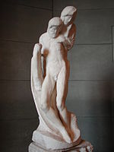
The last sculpture that Michelangelo worked on (six days before his death), the Rondanini Pietà could never be completed because Michelangelo carved it away until there was insufficient stone. The legs and a detached arm remain from a previous stage of the work. As it remains, the sculpture has an abstract quality, in keeping with 20th-century concepts of sculpture.
Michelangelo died in Rome in 1564, at the age of 88 (three weeks before his 89th birthday). His body was taken from Rome for interment at the Basilica of Santa Croce, fulfilling the maestro's last request to be buried in his beloved Florence.

