Slide 1
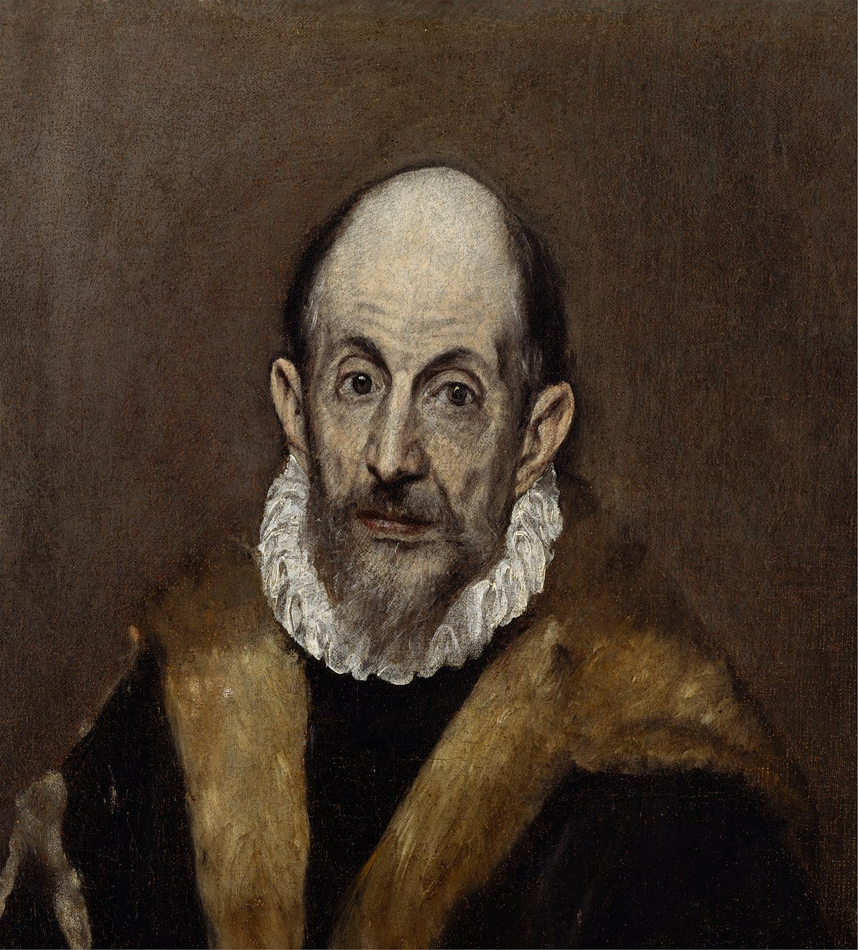
EL GRECO
ANASTASOPOULOU jOANNA
Babayoyi elessa
Spyridakou – Kanelli Lydia
Teacher : amvrazi vassiliki
SUBJECT : ENGLISH

Slide 2
El Greco is one of the best-known artists in the entire history of Western art, as his unique, romantic and awe-inspiring works have influenced a great number of painters over the past five centuries.
Even though his Byzantine-inspired style was very specific and personal, his work had an impact on Realist, Impressionist, Cubist, and Abstract painters, as well, including Picasso, Van Gogh, Cezanne, Botticelli, Vermeer and Jackson Pollock. All of them praised the masterpieces of the Greek painter.
The brilliant Greek painter is also known as the “Grandfather of Expressionism.”
1540 1550 1560 1570 1580 1590 1600 1610 1620 1630 1640

Slide 3
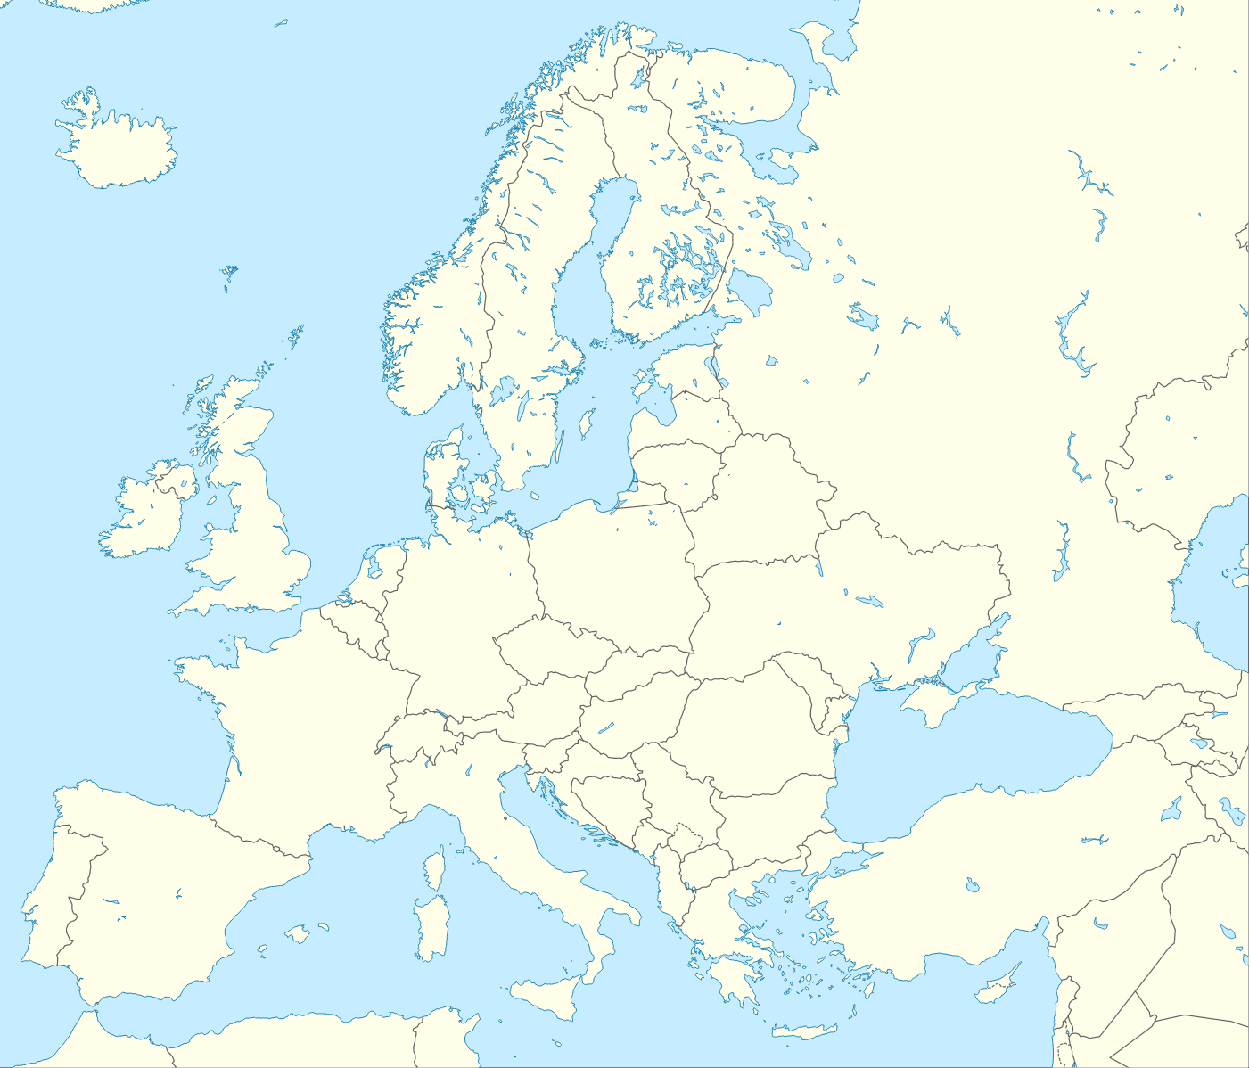
Biography
El Greco (“The Greek”), also known as Domenikos Theotokopoulos, was born on October 1, 1541 in either the village of Fodele or Candia (the Venetian name of Chandax, present day Herakion in Crete.
He came from a prosperous , urban family. Specifically, his father was a merchant and tax collector. However, nothing is known about his mother.
El Greco moved to Rome from Venice after a time, remaining from 1570 to 1576, staying in the palace of one of the most influential and wealthy individuals in Rome.
In 1572, El Greco joined the painters’ academy and established a workplace, but success would prove elusive, as El Greco had criticized Michelangelo’s artistic abilities, which likely led to him being ostracized by the Roman art establishment.
He left Rome for Spain in 1576. From Madrid, he moved to Toledo, where he finally began to find the success history would remember and where he would paint his masterpieces…
Madrid
Venice
Rome
Toledo
Heraklion

Slide 4
Childhood/ Education / Early training

Slide 5
Little is known of his childhood, other than the fact that he chose to be an artist at a very young age.
In his hometown, Theotokópoulos trained as an icon painter. The portraiture style was a popular means of depicting religious subjects in a static, devotional way. By the time the young artist was 22 years of age, he had become a master of this post-Byzantine type of art.
In the years following his studies, he was hired to paint alter pieces for the local Orthodox churches.

Slide 6
At the age of 26, Theotokópoulos traveled to Venice to pursue his artistic dreams, following in the footsteps of the artists that came before him. In Venice he found the inspiration he needed, surrounded not only by Byzantine art but also by the Italian Renaissance.
He began studying elements of Renaissance painting, especially perspective and figural construction, to learn how to depict complex narratives. However, as a young foreign painter his work was not well received.

Slide 7
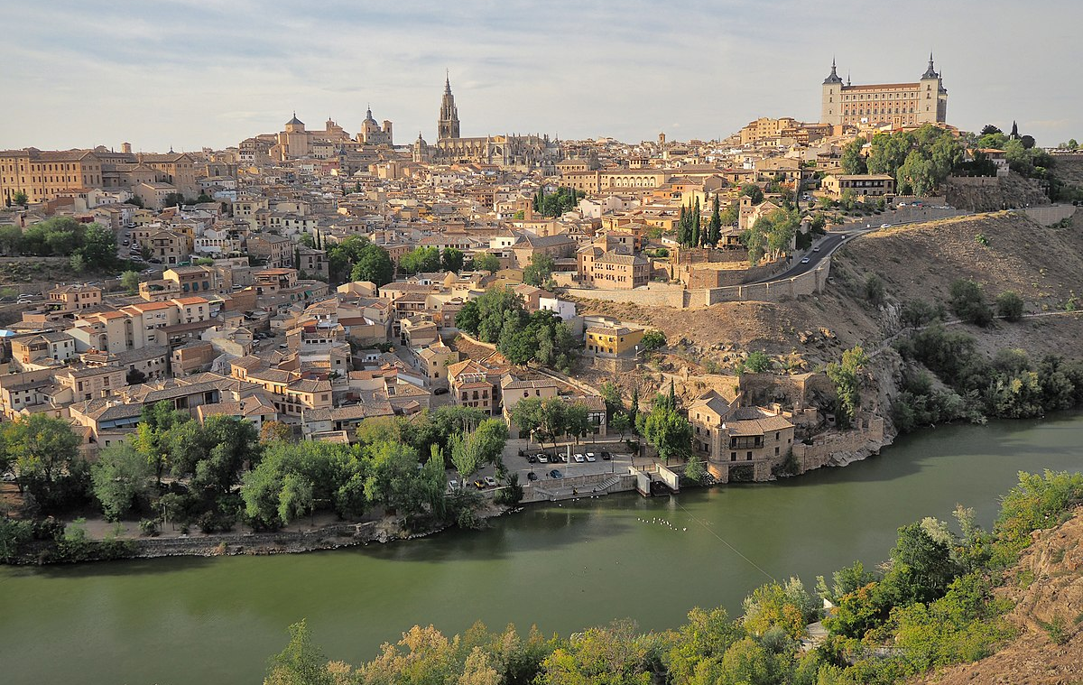
Toledo
Many scholars believe that El Greco's time in Toledo was central to the development of his mature style and showcased his ability to adapt it according to his surroundings.
Harold Wethey asserts that "although Greek by descent and Italian by artistic preparation, the artist became so immersed in the religious environment of Spain that he became the most vital visual representative of Spanish mysticism"

Slide 8
Mannerism
Although El Greco was technically considered a Mannerist, many of his early works are very reminiscent of Byzantine art, by which he was heavily influenced.
In works such as The Burial of the Count of Orgaz, the artist's elongated figures, dissonant use of light, brilliant colors, artificiality and lack of depth are typical elements of the Mannerist style.

Slide 9
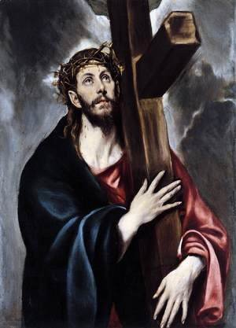
Religious paintings
El Greco was also heavily influenced by the fine churchmen and influential members of Toledan society and God when creating his religious paintings.

Slide 10
The use of light
Another characteristic of El Greco's mature style is the use of light. As Jonathan Brown notes, "each figure seems to carry its own light within or reflects the light that emanates from an unseen source"

Slide 11
Art

Slide 12
Christ healing the Blind
El Greco painted this masterpiece of dramatic storytelling either in Venice or in Rome, where he worked after leaving Crete in 1567 and before moving to Spain in 1576.
Date: 1570
Oil on canvas

Slide 13
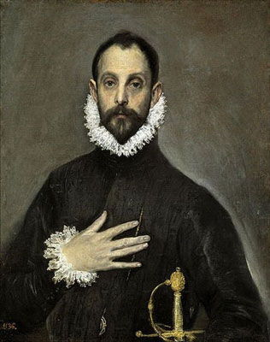
The Nobleman With his Hand on his Chest
This painting is a portrait of a nobleman or knight around the age of 30, whose real name is unknown. He is dressed in traditional Spanish clothing holding a sword in one hand while the other is poised over his heart.
Date: 1580
Oil on canvas

Slide 14
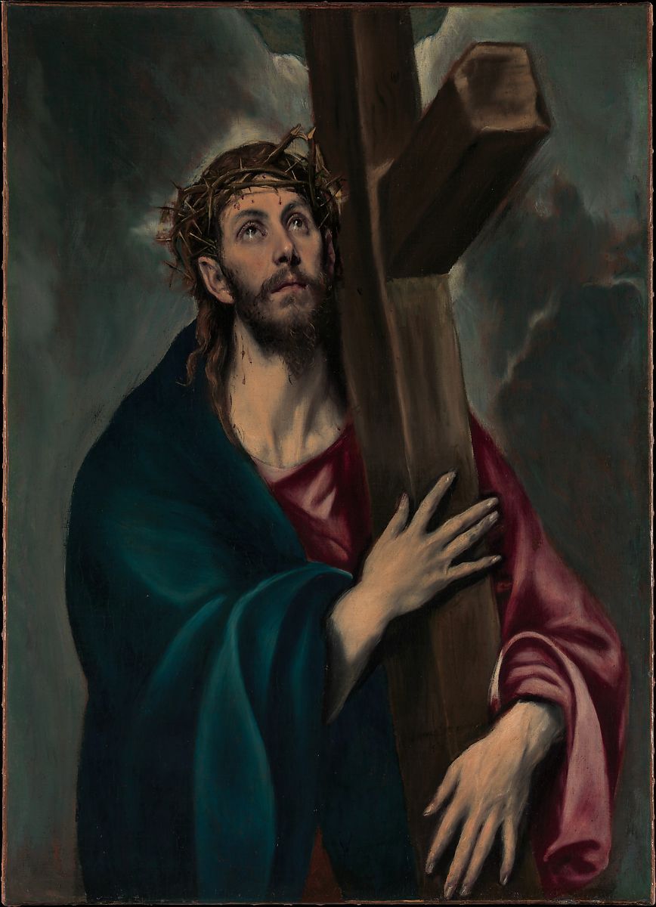
Christ carrying the Cross
During his long career in Spain, El Greco produced numerous paintings of Christ carrying the cross.
His earliest version of the subject, is not a narrative scene: no other figures are represented and the setting is not recognizable.
Instead, it is a devotional image of haunting immediacy and resonant with pathos. Christ's willing sacrifice for mankind is expressed through his gentle embrace of the cross and his heavenward gaze.
Date: 1577–87
Oil on canvas

Slide 15
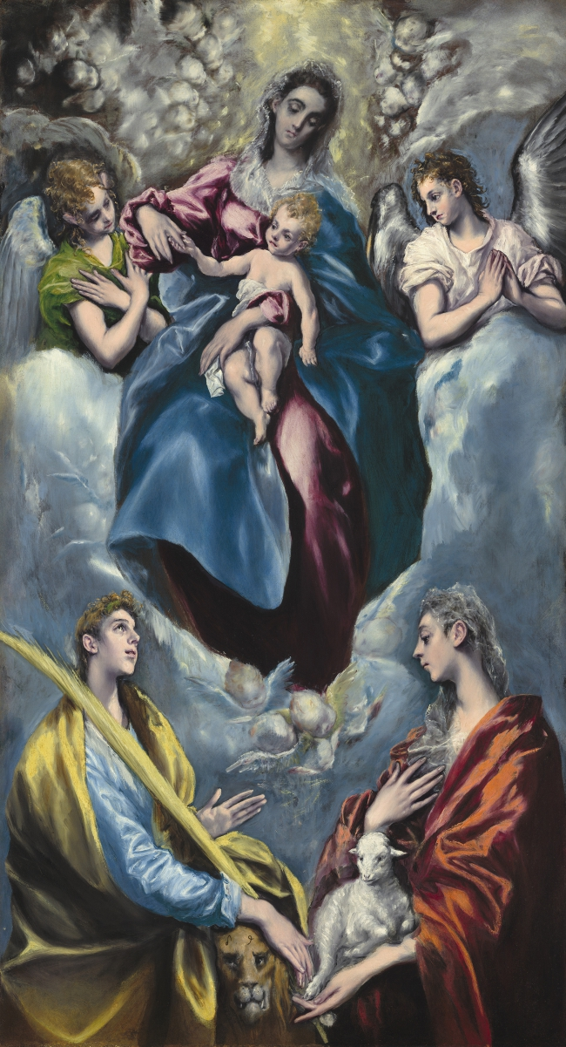
Madonna and Child with Saint Martina and Saint Agnes
Madonna and Child with Saint Martina and Saint Agnes depicts Mary and the baby Jesus seated on clouds in heaven, accompanied by Saint Agnes holding a lamb on the bottom right and Saint Martina on the bottom left.
Date: 1597 - 1599
Oil on canvas

Slide 16
View of Toledo
In this, his greatest surviving landscape, El Greco portrays the city he lived and worked in for most of his life.
Date: 1599–1600
Oil on canvas

Slide 17
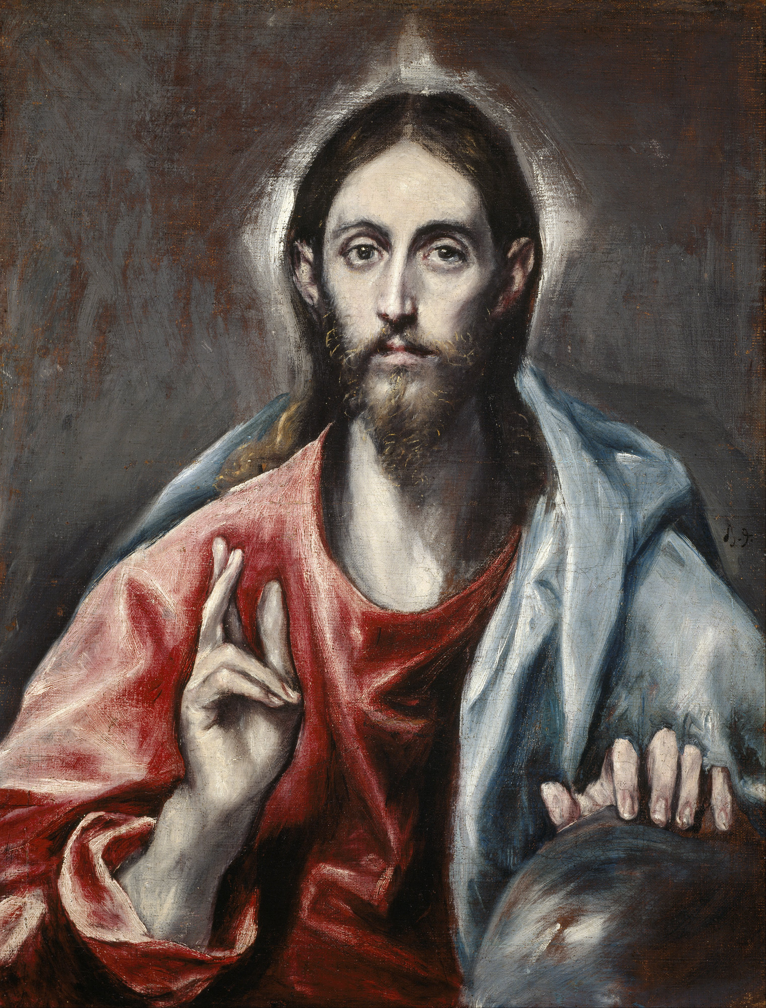
Christ blessing
This painting depicts Christ holding one hand on a blue globe and gesturing to heaven with the other. There is a white light shining either from behind him or from within him, acting as a halo against the black dark background.
Date : 1600
Oil on canvas

Slide 18
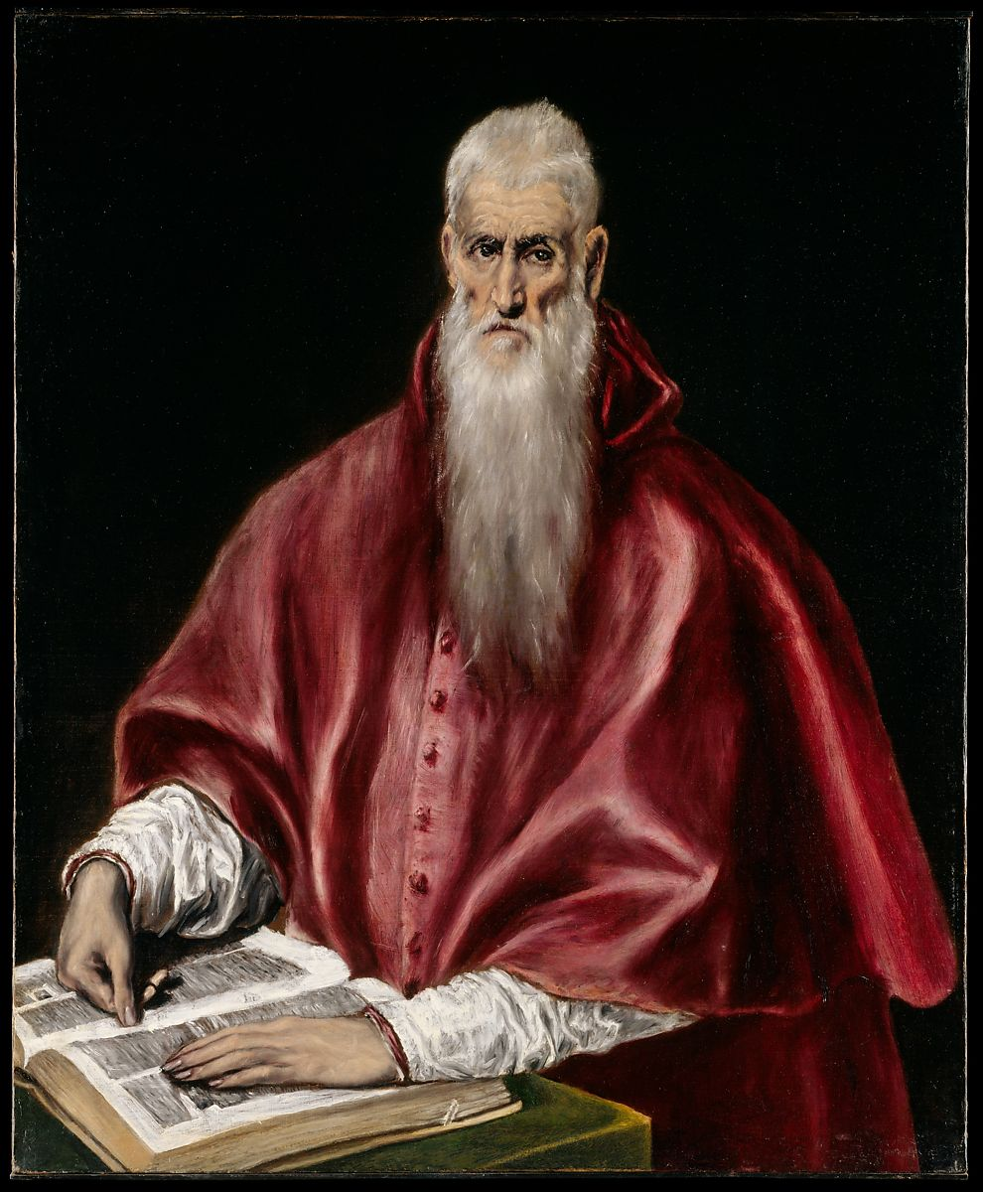
Saint Jerome as Scholar
El Greco executed at least five paintings of Saint Jerome. In this version, from the last years of the painter's life, the saint is shown in the red vestments of a cardinal, seated before an open book.
Date: 1610
Oil on canvas

Slide 19
Death & Legacy

Slide 20
He passed away on the 7th of April 1614 (aged 73) due to an illness, and the date of his death is one of the very few certain facts which we have respecting him. The record informs us that he made no will, that he received the sacraments, and was buried in the church of Santo Domingo.
El Greco is generally considered one of the leading figures of the Spanish Renaissance that defined the 15th and 16th centuries. He is now considered to be one of the "select members of the modern pantheon of great painters," as claimed by art historian Keith Christiansen, and is regarded as a true visionary artist that lived well ahead of his time.

Slide 21
His work found great appreciation in the 19th century, when a group of collectors, writers, and artists, especially the Romantic artists that admired his passionate eccentricity, brought it into a new light.
Fascinated by his imagination, sense of personal visual style, and overall composition, El Greco's work established a foundation for the development of Cubism, a movement in which artists began to abandon a single viewpoint perspective to play with geometric shapes and interlocking planes.
El Greco’s later works are marked by exaggerated, and often distorted, figures, stretching beyond the realities of the human body (which is what modern viewers generally have found so appealing). Among them are The Adoration of the Shepherds (1599), Concert of Angels (1610) and The Opening of the Fifth Seal (1614). Fifth Seal, in particular, went on to spark great debate, as it has been suggested that it was an influence on Pablo Picasso’s Les Demoiselles d'Avignon, often considered the first cubist painting.

Slide 22
He exerted a major influence on Pablo Picasso, who studied some of his works intensively and saw in El Greco's language a 'modern' approach to art. Picasso's painting entitled Portrait of a Painter, after El Greco (1950) can be interpreted as a tribute to the early master.
In a broad way, El Greco can be further seen as a precursor to the canon of modern art, leading the path away from traditional naturalistic approaches into a new artistic dialogue which emphasized culling from emotion, inner drama, and bold new renditions of color and free flowing figuration.
We can see a direct link to El Greco in many Expressionist landscapes that utilized a more organic approach to color and form like in the works of Vincent van Gogh.

Slide 23
Works of art mentioned

Slide 24
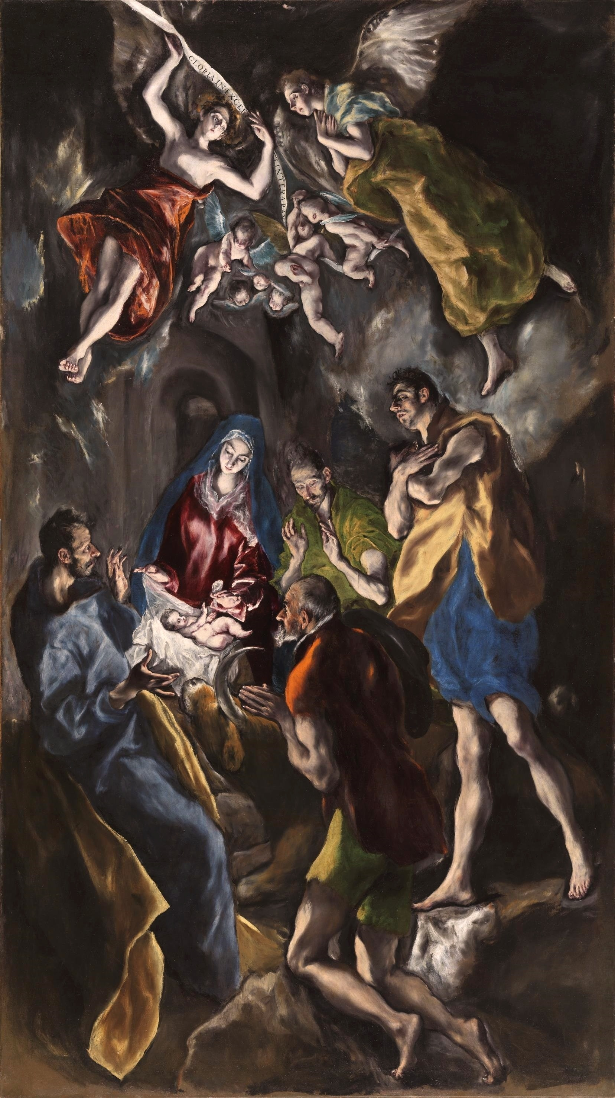
The Adoration of the Shepherds

Slide 25
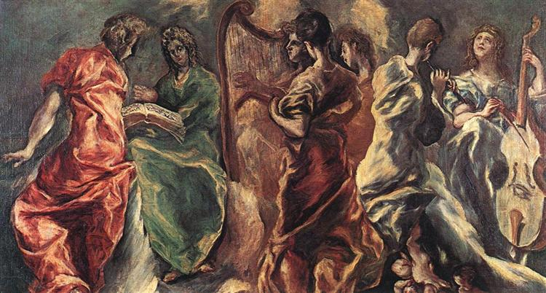
Concert of Angels

Slide 26
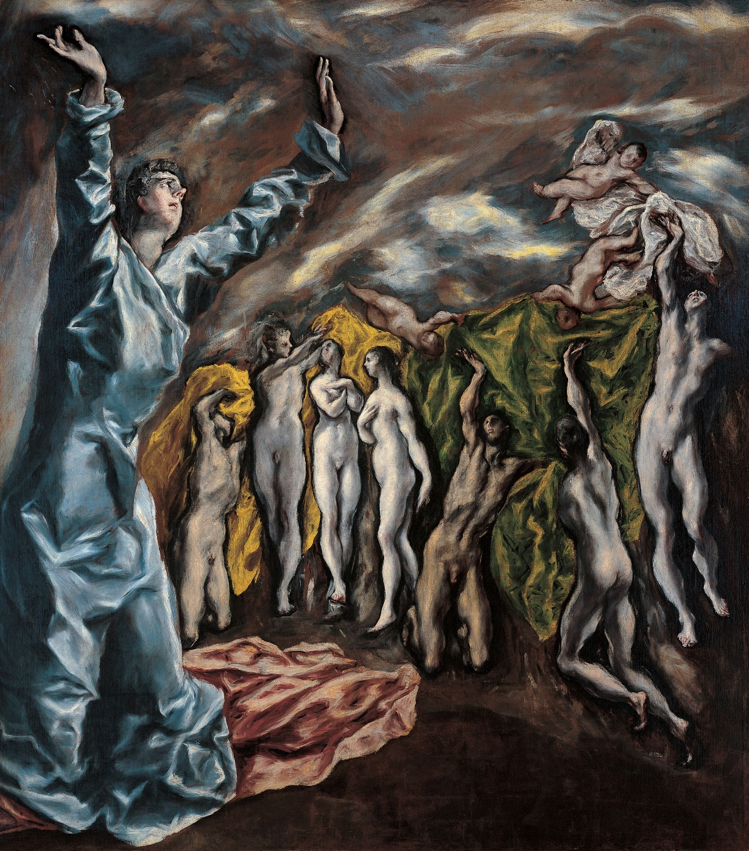
The Opening of the Fifth Seal

Slide 27
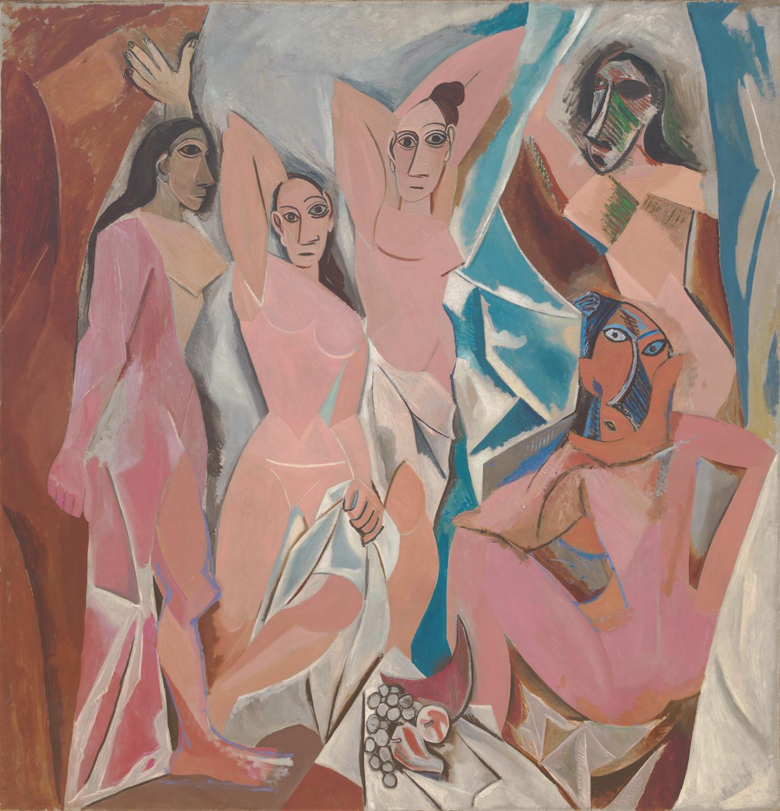
Les Demoiselles d'Avignon

Slide 28
“I paint because the spirits whisper madly inside my head”

Slide 29
Useful material
References
https://greekreporter.com/2019/11/08/el-greco-the-greek-who-changed-the-art-world/
https://www.greeka.com/crete/chania/history/famous-people/el-greco-chania/
https://www.metmuseum.org/toah/hd/grec/hd_grec.htm
https://www.britannica.com/biography/El-Greco/Later-life-and-works
https://www.theartstory.org/artist/el-greco/life-and-legacy/
https://artandcrafter.com/artists/el-greco-biography/
https://www.el-greco-foundation.org/biography.html
https://www.nga.gov/features/slideshows/el-greco-spanish-1541-1614.html
https://greekherald.com.au/culture/el-greco-the-renaissance-painter-with-a-rebellious-streak/
https://www.theartstory.org/artist/el-greco/artworks/
https://www.artble.com/artists/el_greco
https://www.nndb.com/people/687/000084435/
https://www.biography.com/artist/el-greco
El Greco: The complete works
El Greco paintings

