Slide 1
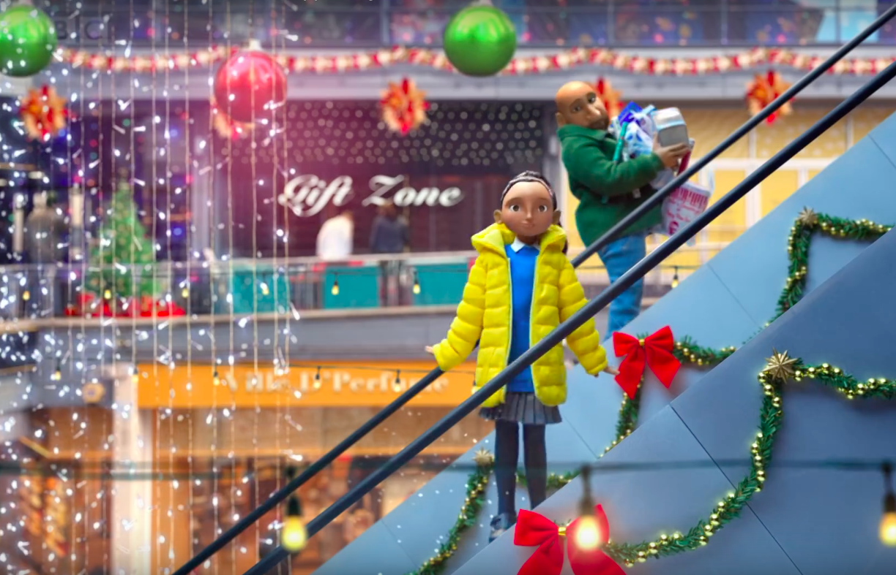

Slide 2
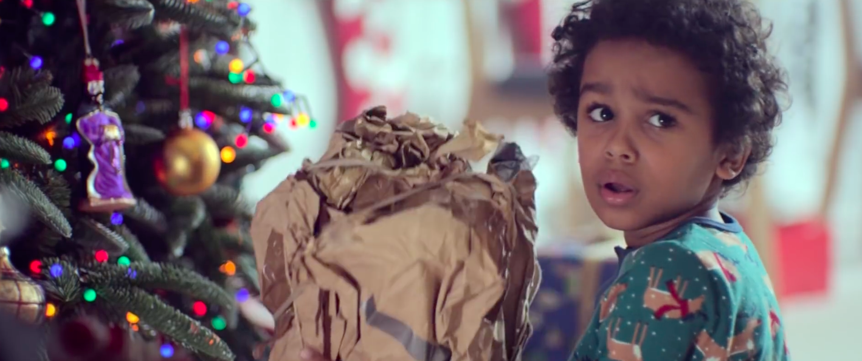

Slide 4
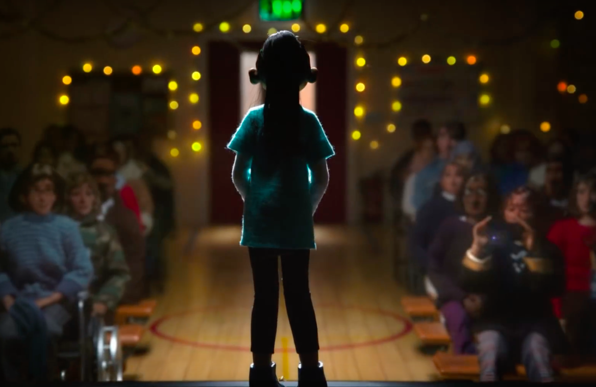
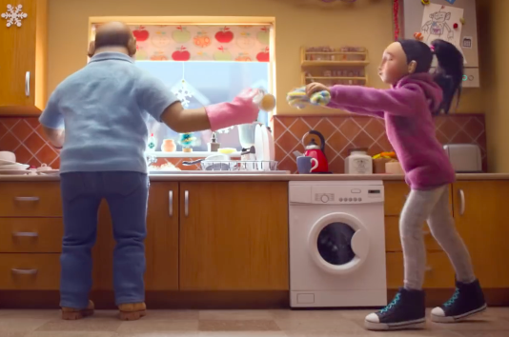
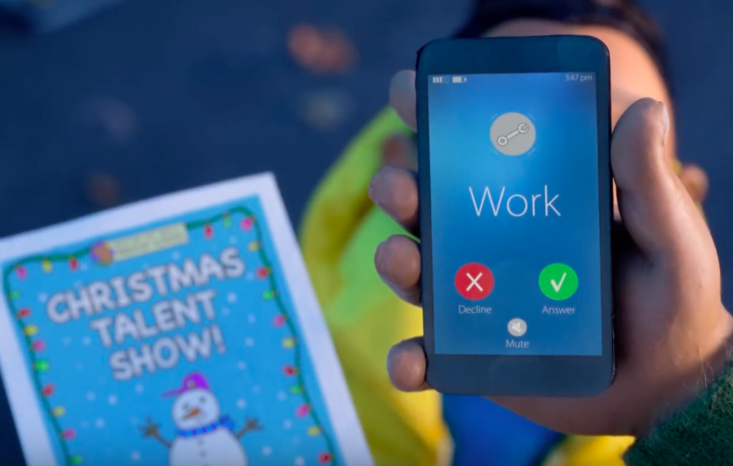
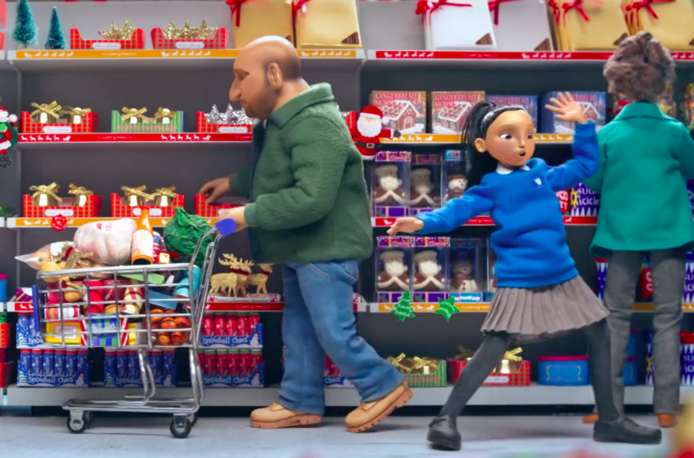
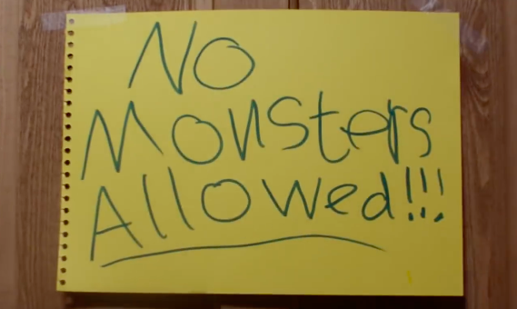
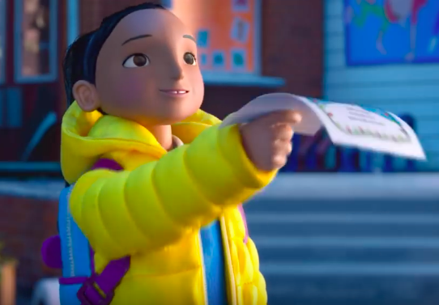
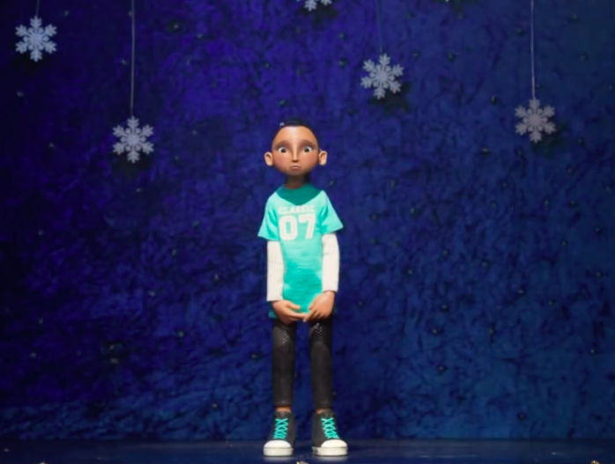

Slide 6
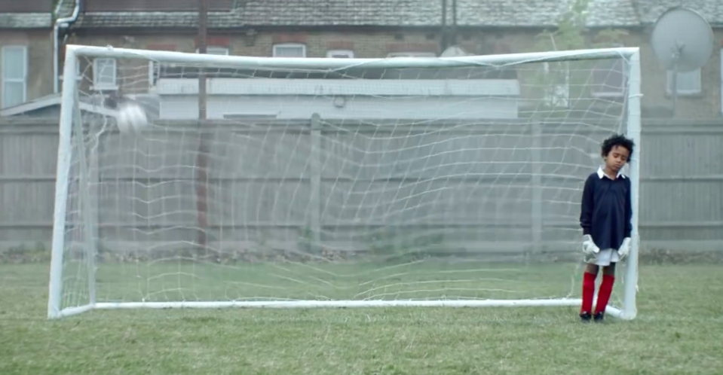

Slide 7
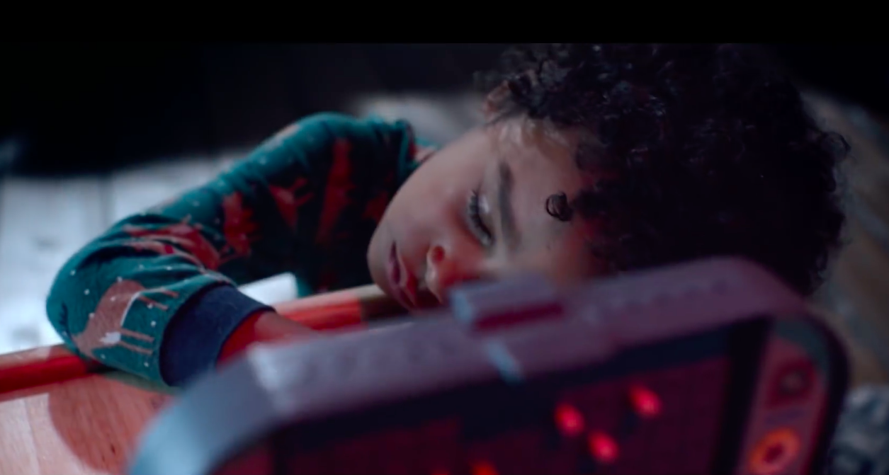

Slide 8
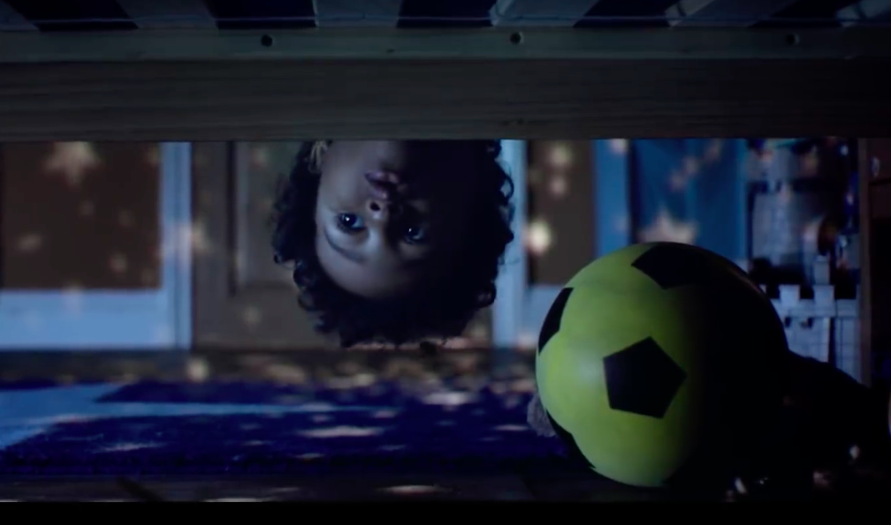

Slide 9
Fill the gaps in the sentences below.
There was a ____________ engine and a ____________ bus under the bed.
The boy took a pair of furry pink ____________ from his sister’s room.
A ____________ Scalextric car hit the monster in the ____________.
The boy dozed off ____________ times during the day.
The monster gave the boy a shoulder ride, and the boy gave the monster a ________ ride.
The monster ____________ the boy into bed just after 1am.

Slide 10
Answers
There was a fire engine and a double-decker bus under the bed.
The boy took a pair of furry pink earmuffs from his sister’s room.
A red Scalextric car hit the monster in the eye.
The boy dozed off three times during the day.
The monster gave the boy a shoulder ride, and the boy gave the monster a piggyback ride.
The monster tucked the boy into bed just after 1am.

Slide 11
If you know the person, you’ll find the present.
We all stand together.
For gifts that brighten their world
Closer this Christmas
Christmas is for sharing.
Take more chances. Dance more dances.
Christmas together
Light up your life.
Monsters don’t sleep under your bed; they sleep inside your head.
Which is the best slogan for each clip?

