Slide 1
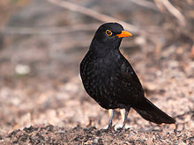
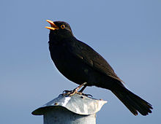
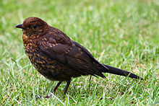
BLACKBIRDS

Slide 2
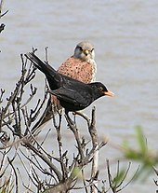
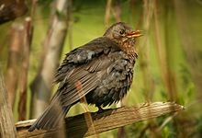

Slide 3
From Wikipedia https://en.wikipedia.org/wiki/Common_blackbird
The common blackbird (Turdus merula) is a species of true thrush. It is also called the Eurasian blackbird (especially in North America, to distinguish it from the unrelated New World blackbirds),^{[2]} or simply the blackbird where this does not lead to confusion with a similar-looking local species. It breeds in Europe, Asiatic Russia, and North Africa, and has been introduced to Australia and New Zealand.^{[3]} It has a number of subspecies across its large range; a few of the Asian subspecies are sometimes considered to be full species. Depending on latitude, the common blackbird may be resident, partially migratory, or fully migratory.

Slide 4
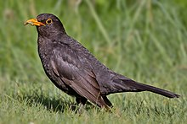
Female and Male Blackbird

Slide 5
Blackbirds in Popular Culture * Nursery Rhymes Sing a song of sixpence, A pocket full of rye; Four and twenty blackbirds baked in a pie! When the pie was opened the birds began to sing, Oh, wasn't that a dainty dish to set before the king?

