Slide 1
RELATIVE CLAUSES

Slide 2
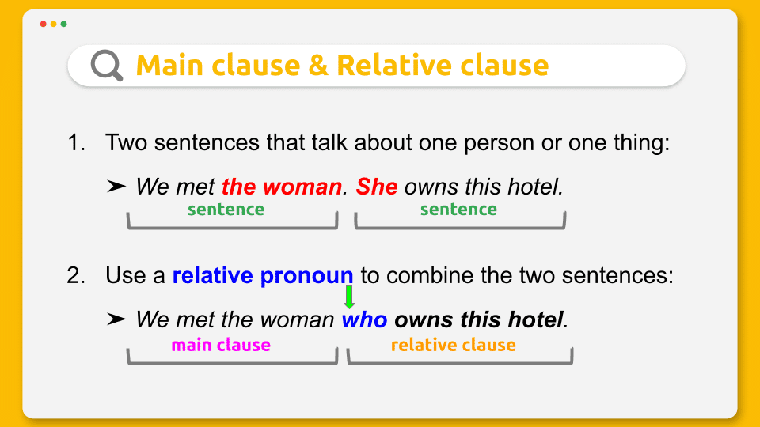

Slide 3
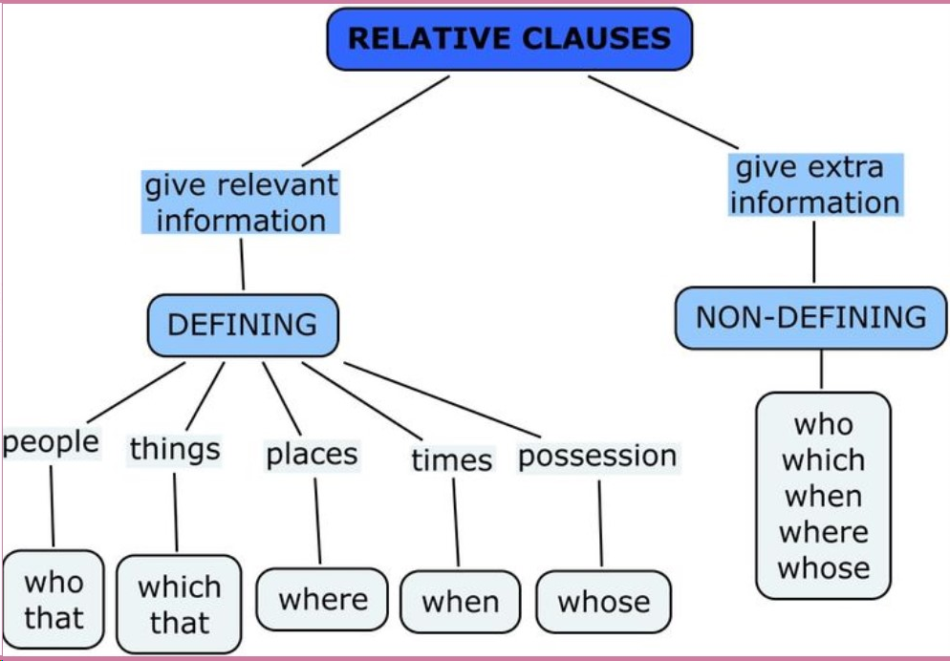

Slide 4
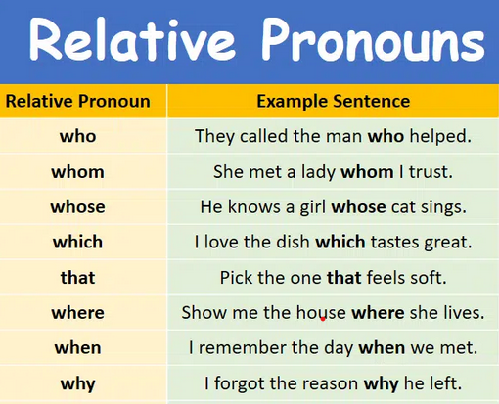

Slide 5
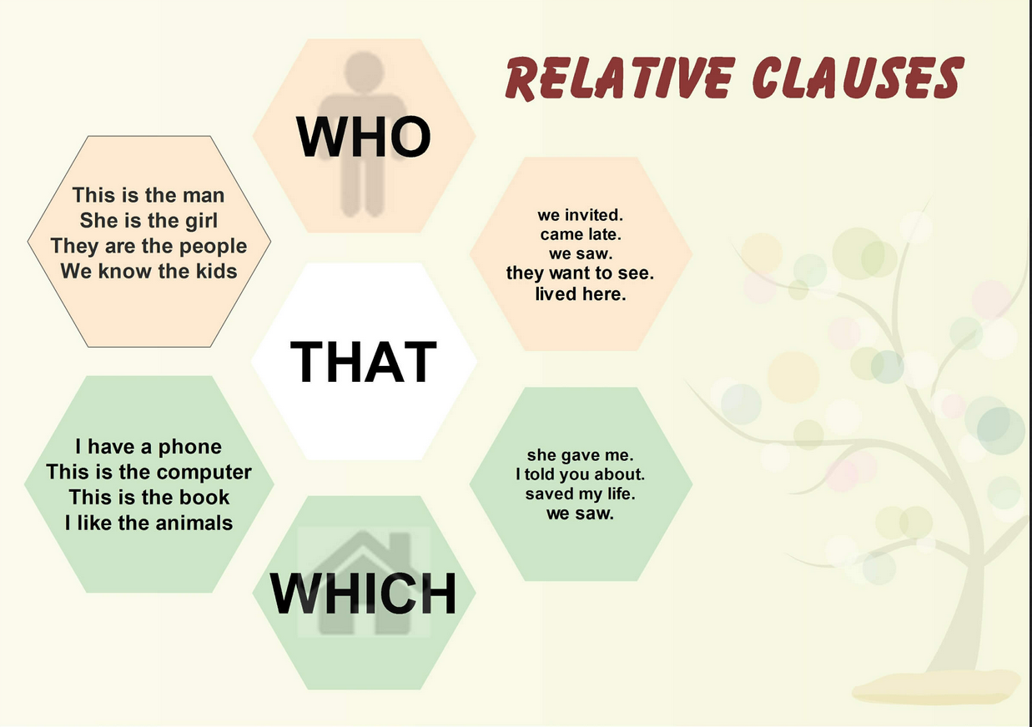

Slide 6
Put the correct relative pronoun.
1. I have a friend………………speaks four languages.
2. The Internet is a place……………you can get cheap technology products.
3. E-mails………………..advertise things are called "spam".
4. A "technophobe" is someone………………is scared of technology.
5. We should only buy products………………can be recycled.
6. That's the shop………………………I bought those shoes.
7. I can't find the CD…………………….I borrowed from you.
8. Do you remember the park……………….we met?

Slide 7
Combine the sentences by using a relative pronoun.
1.The police arrested the man. He murdered his wife.
2. I can't remember the name of the street. I lost my passport there.
3. Where are the shoes? I bought them yesterday.
4. The book is very interesting. I borrowed it from the library.
5.That man is a politician. I forgot his name.
6. I'll show you the church. I got married there.
7. The actor is very famous. I met him a few days ago.
8. My friend invited many people. His house is huge.

