Slide 1
DIA DE LOS MUERTOS
Kappas Aggelos
G3

Slide 2
DIA DE LOS MUERTOS
The Day of the Dead (Spanish: Día de (los) Muertos)[2][3] is a holiday traditionally celebrated on November 1 and 2, though other days, such as October 31 or November 6, may be included depending on the locality.
The multi-day holiday involves family and friends gathering to pay respects and remember friends and family members who have died. These celebrations can take a humorous tone, as celebrants remember amusing events and anecdotes about the departed.
It is widely observed in Mexico, where it largely developed, and is also observed in other places, especially by people of Mexican heritage. The observance falls during the Christian period of Allhallowtide.
Some argue that there are Indigenous Mexican or ancient Aztec influences that account for the custom, though others see it as a local expression of the Allhallowtide season that was brought to the region by the Spanish; the Day of the Dead has become a way to remember those forebears of Mexican culture. The Day of the Dead is largely seen as having a festive characteristic.

Slide 3
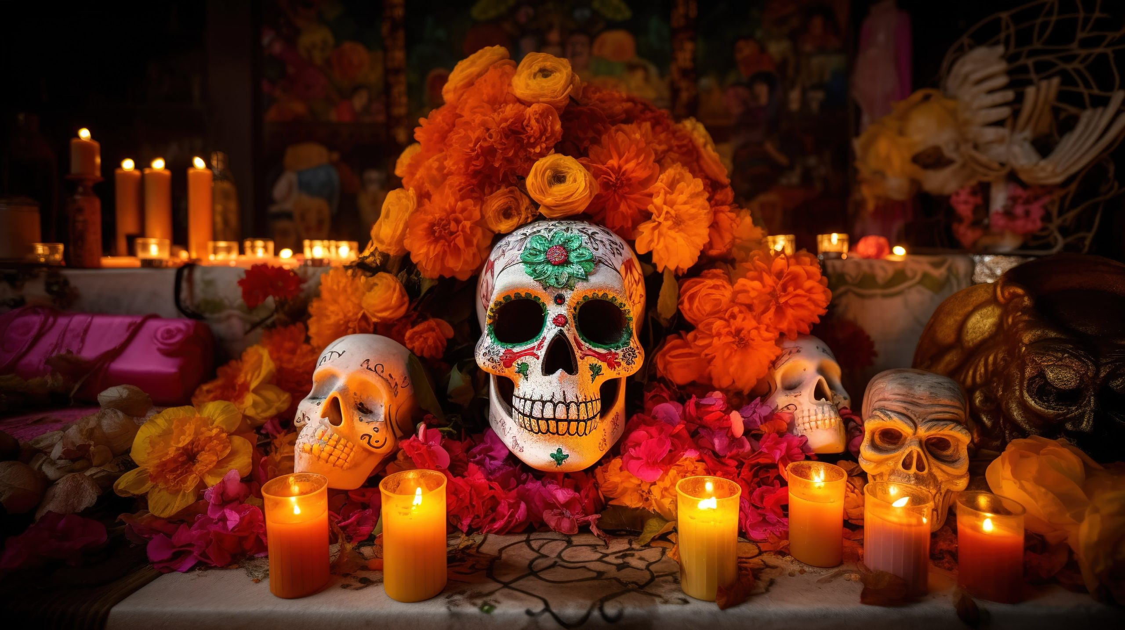
HOW IT STARTED
The celebration arises from rituals performed by Indigenous peoples in what is now Mexico and Central America. In particular, the Aztecs would meet with a goddess named Miccaihuitl as part of a death ritual that involved making offerings to the goddess and the deceased. The Aztecs believed the dead were not gone. Instead they had an intimate relationship with the living, and offerings were made to maintain a reciprocal relationship.
Common features to the celebration are the candy skulls, papel picados (vibrant paper flags), candles, marigolds and a type of bread called pan de muerto. But the holiday is centered on ancestors. Families create ofrendas, or altars, with photographs, foods, possessions or items that call to mind aspects of their ancestors’ personalities to honor them and keep their memories alive.

Slide 4
ORIGINS
The origin of the day of the dead comes from a mix of culture. Aztec and Christian are the main influence of it. In some countries people use sugar skull painting for Halloween but it is not the same celebration.
Everyone is welcomed to join in on the celebration, but nearly everyone in Mexico celebrates it. The Day of the Dead is a holiday celebrated all throughout Mexico. It is a day to celebrate, remember and prepare special foods in honor of those who have died. The traditional food is the bread of the dead (pan de muertos). People paint there faces to match Caleveras.
The famous decoration is the sugar skulls, Marigolds, and candles. People believe the spirit of the dead goes and visits their families from October 31 (aka Halloween) then leaves on November 2. The Day of the Dead is held every year on the 2nd of November in Mexico. This Mexican holiday is celebrated because families do it to honor their loved ones who have passed.

Slide 5
CALAVERA
A common symbol of the holiday is the skull (in Spanish calavera), which celebrants represent in masks, called calacas (colloquial term for skeleton), and foods such as chocolate or sugar skulls, which are inscribed with the name of the recipient on the forehead. Sugar skulls can be given as gifts to both the living and the dead.[35] Other holiday foods include pan de muerto, a sweet egg bread made in various shapes from plain rounds to skulls, often decorated with white frosting to look like twisted bones.

Slide 6
THE END

