Slide 1
British Philhellenes
George Finlay (1799 –1875) was a Scottish historian who lived in Greece and worked as a correspondent of London Times. He wrote History of Greece.
Frank Abney Hasting (1794 –1828) was a British naval officer. He took part in the battle of Itea and the battle of Navarino
Lord Byron
Percy Bysshe Shelley (1792 -1822) was a famous romantic poet. He wrote Hellas and in the preface he says, “We are all Greeks. Our laws, our literature, our religion, our arts have their root in Greece.”
Thomas Gordon (1788 – 1841), a British army officer and historian, took part in a number of battles and wrote the History of the Greek Revolution)

Slide 2
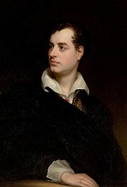
LORD BYRON
George Gordon Byron ( 22 January 1788- 19 April 1824) known simply as Lord Byron was an English poet and a politician. He is regarded as one of the greatest English poets.
Αυτή η φωτογραφία από Άγνωστος συντάκτης με άδεια χρήσης CC BY-SA

Slide 3
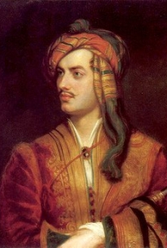
LORD BYRON
He travelled across Europe. Later in life he joined the Greek War of Independence fighting the Ottoman Empire and died of disease leading a campaign during that war , for which Greeks honor him as a national hero. He died in 1824 at the age of 36 from a fever he contracted after the first and second Siege of Missolonghi.
Αυτή η φωτογραφία από Άγνωστος συντάκτης με άδεια χρήσης CC BY-SA-NC

Slide 4
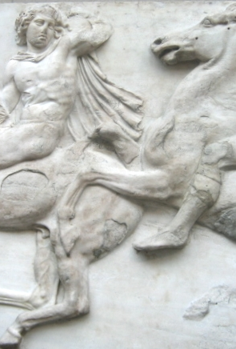
LORD BYRON
Lord Byron was a bitter opponent of Lord Elgin’s removal of the Parthenon marbles. He denounced Elgin’s actions in his poem THE CURSE OF MINERVA
Αυτή η φωτογραφία από Άγνωστος συντάκτης με άδεια χρήσης CC BY-SA

Slide 5
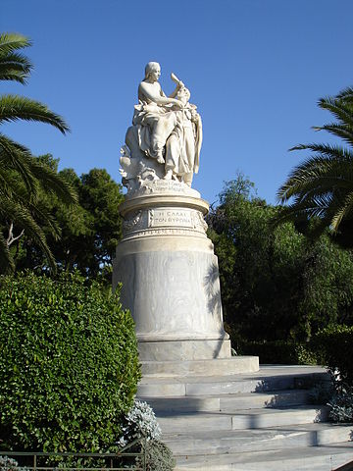
LORD BYRON
Vyronas ( ΒΎΡΩΝΑΣ) is a suburb of Athens named after the famous poet .

Slide 6
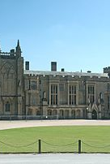

Lord Byron’s house
Αυτή η φωτογραφία από Άγνωστος συντάκτης με άδεια χρήσης CC BY-SA

Slide 7
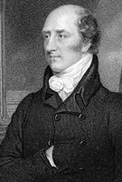
GEORGE CANNING
A square in Athens is named after his name (πλατεία Κάνιγγος) in appreciation of his support toward the Greek War of Independence.
Αυτή η φωτογραφία από Άγνωστος συντάκτης με άδεια χρήσης CC BY-SA

Slide 8
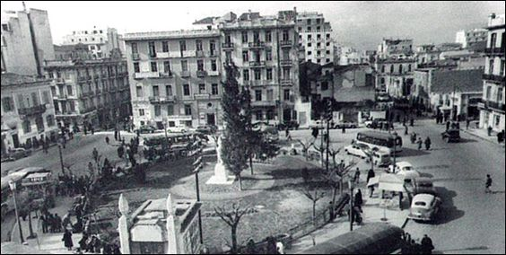
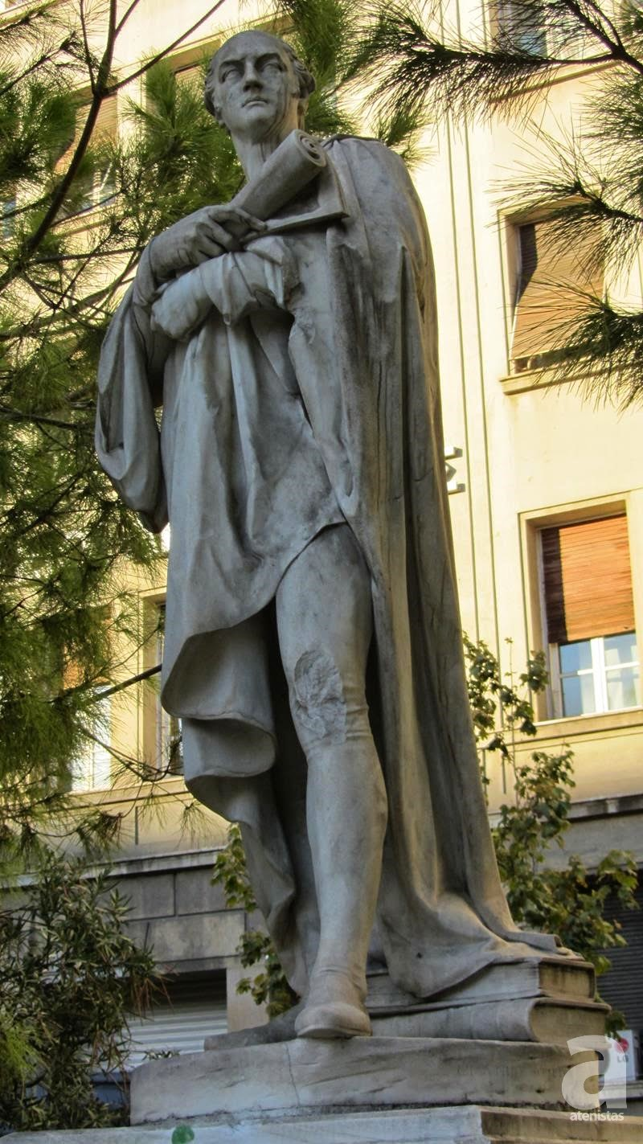

Slide 9
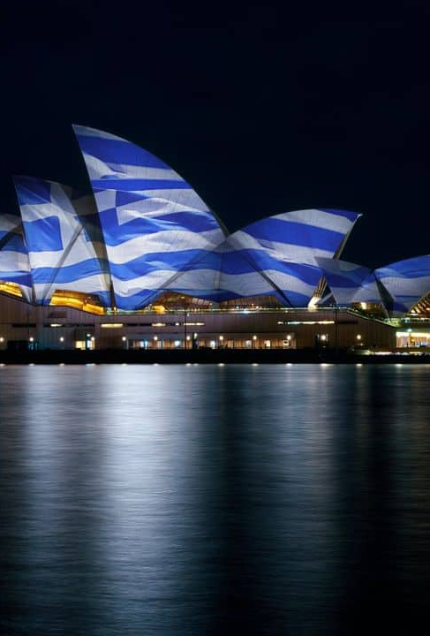
AUSTRALIA
The Sydney Opera House in Australia will be lit on March 25th to commemorate the 200 years of Greek Independence.

