Slide 1

Zero Food Waste Campaign
2nd Junior High School of Chalkida proudly presents:
🌍 "Be a Food Hero – Waste Zero!"
2S
by 2nd Junior High School

Slide 2
How the Food Hero Challenge Works
Launch a 5-day “Be a Food Hero” Challenge at school.
Daily tasks for students and families like meal planning and creative leftovers.
Track actions in a “Food Hero Journal” or app.
Share lessons and award certificates or badges.
Showcase creative ideas and recipes in newsletters or blogs.

Slide 3
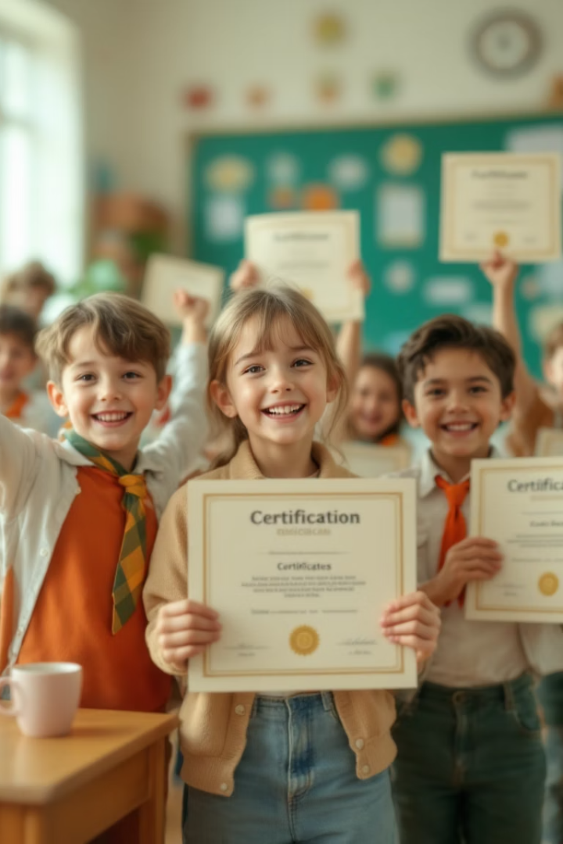
Why the Challenge Will Succeed
Active Participation
Doing tasks leads to real behavior change, not just listening.
Family Involvement
Students spread awareness at home where waste mostly occurs.
Gamification
Fun challenges motivate and make the message memorable.
Recognition
Rewarding effort builds a caring, engaged community.

Slide 4

How This Reduces Food Waste
Awareness
Mindful Consumption
Encourages mindful food habits in the household.
Promotes planning to avoid spoilage and overbuying.
Creative Reuse
Encourages leftover use, smart storage, and shopping.

Slide 5

Get Involved: Resources Available
Would you like a printable Food Hero Challenge guide?
We also offer posters to support your school’s campaign.
Contact us to get your materials and join the zero waste movement!

