Slide 1
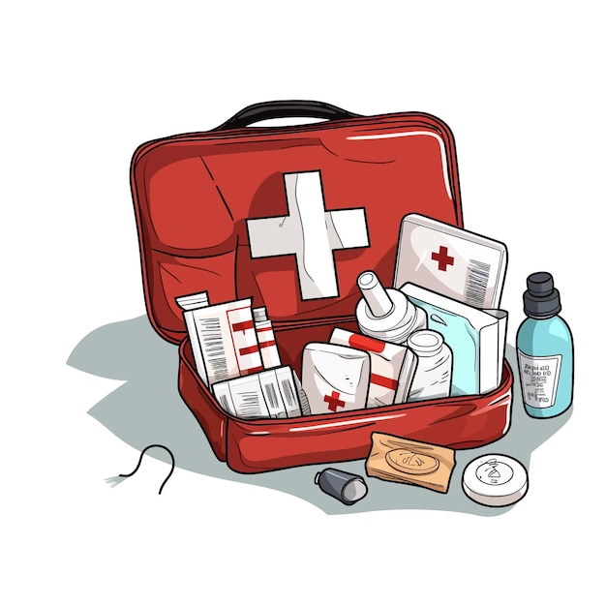
First Aid
BASIC INSTRUCTIONS AND EQUIPMENT
Μαρια κολλημενου

Slide 2
WHAT IS FIRST AID?
First aid refers to medical attention that is usually administered immediately after the injury occurs and at the location where it occurred. It often consists of a one-time, short-term treatment and requires little technology or training to administer. First aid can include cleaning minor cuts, scrapes, or scratches; treating a minor burn; applying bandages and dressings; the use of non-prescription medicine; draining blisters; removing debris from the eyes; massage; and drinking fluids to relieve heat stress. OSHA's revised recordkeeping rule, which went into effect January 1, 2002, does not require first aid cases to be documented. For example: A worker goes to the first-aid room and has a dressing applied to a minor cut by a registered nurse. Although the registered nurse is a health care professional, the employer does not have to report the accident because the worker simply received first aid. The selected references below provide more information on first aid.

Slide 3
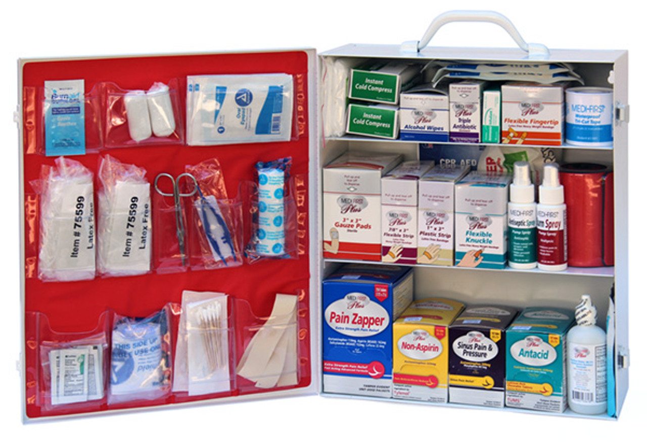
First Aid kit
Bandages, roller bandages and tape
(Sterile) Gauze
Antiseptic wipes and swabs
Absorbent compresses
Antibiotic cream
Burn ointment
Mask for breathing(rescue breathing/CPR)
Chemical cold pack
Eye shield and eye wash
First aid reference guide that includes local phone numbers

Slide 4
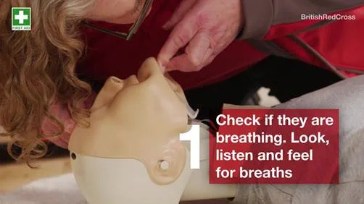
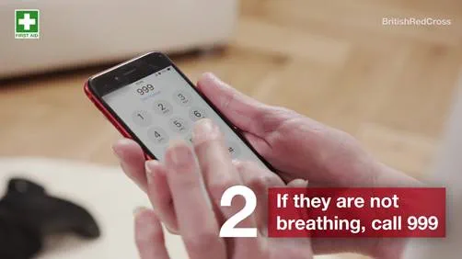
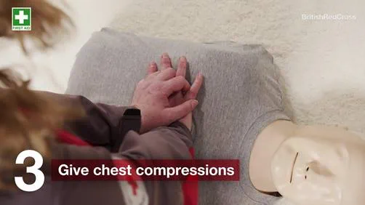
Unresponsive and not breathing: learn first aid
1. Check if they are breathing. Tilt their head back - is their chest moving? Look, listen and feel for breaths.
2. If they are not breathing, call for help.
3. Give chest compressions by pushing firmly in the middle of the chest up and down. Push the chest hard and fast at a rate of 2 pushes per second.

Slide 5
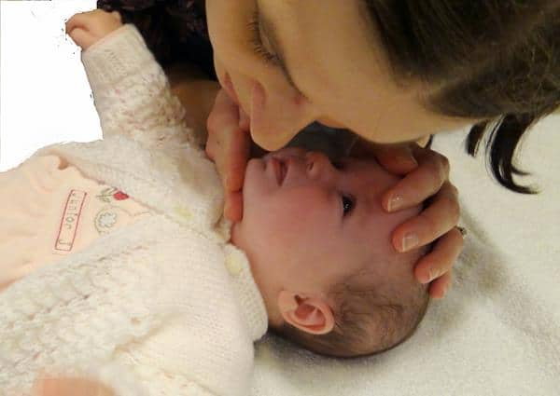
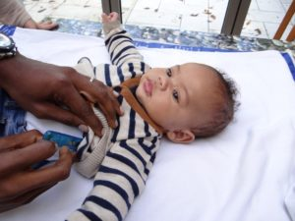
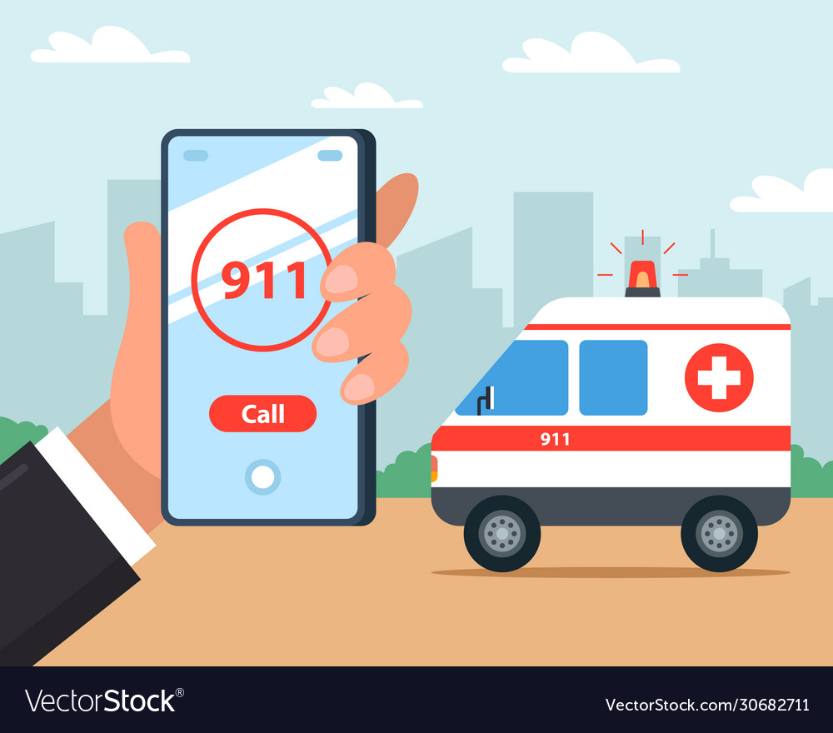
Learn first aid for a baby who is unresponsive and breathing
1. Check their breathing by tilting their head back slightly and looking, listening and feeling for breaths.
2. Hold the baby on their side with their head slightly tilted back, supported and lower than their bottom.
3. Call for help as soon as possible.

Slide 6
information
http://www.osha.gov/medical-first-aid/recognition
https://www.redcross.org.uk/first-aid/learn-first-aid/unresponsive-and-not-breathing
https://www.redcross.org.uk/first-aid/learn-first-aid-for-babies-and-children/unresponsive-and-breathing-baby

