Slide 1
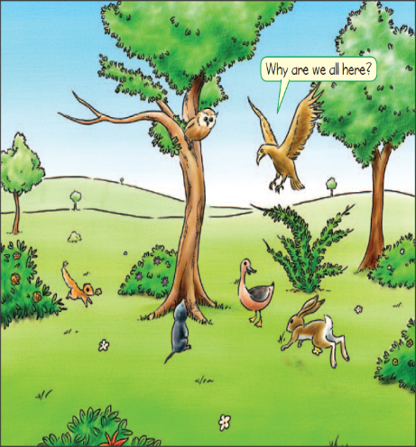

Slide 2
owl
duck
weasel
mole
hare

Slide 3
What’s this?
It’s a board.

Slide 4
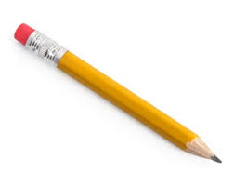
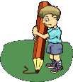
What’s this?
It’s a pencil.

Slide 5
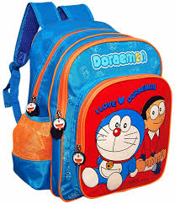
What’s this?
It’s a schoolbag.

Slide 6
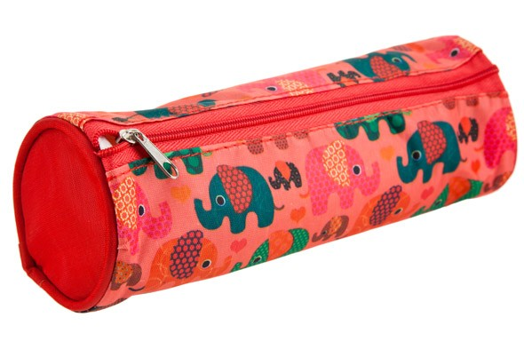
What’s this?
It’s a pencil case.

Slide 7
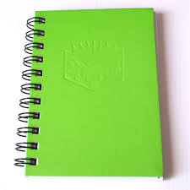
What’s this?
It’s a notebook.

Slide 8
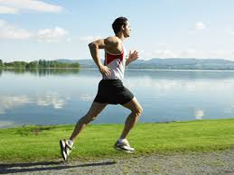
running
I like running.

Slide 9
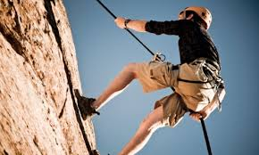
climbing
I like climbing.

Slide 10
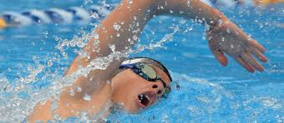
swimming
I like swimming.

Slide 11
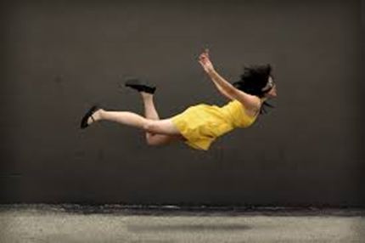
flying
I like flying.

Slide 12
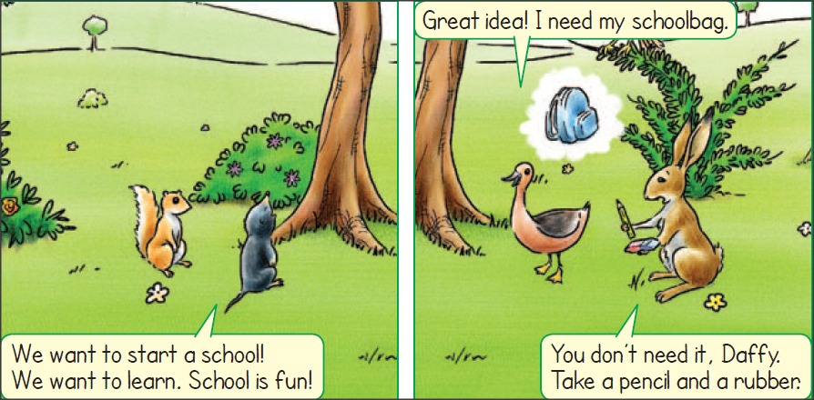
want = θέλω
start = αρχίζω
learn = μαθαίνω
need = χρειάζομαι

Slide 13
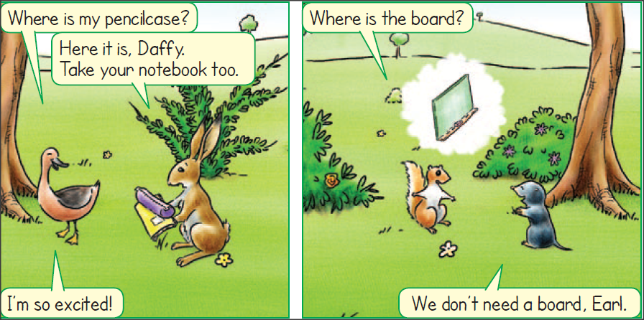
Where is…? = Πού είναι;

Slide 14
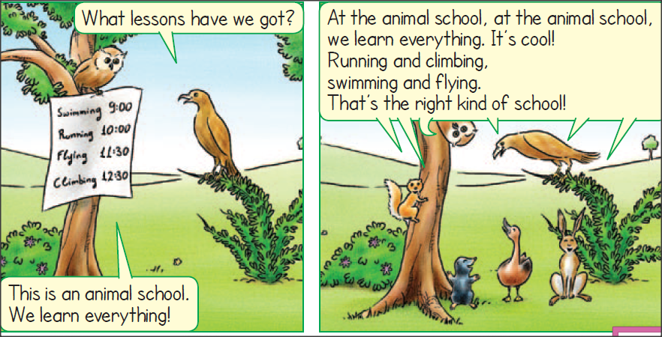
We learn everything =
Μαθαίνουμε τα πάντα

Slide 15
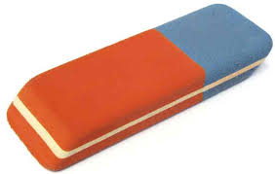
rubber
board
pencil case
schoolbag

Slide 16
climbing
swimming
running
flying

Slide 17
Thank you, kids

