Slide 1
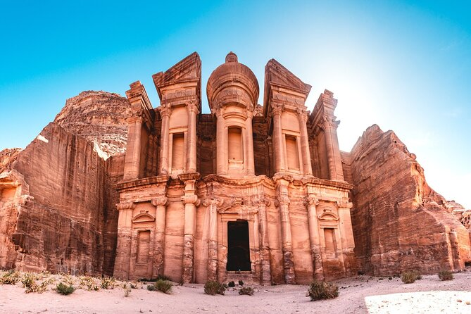
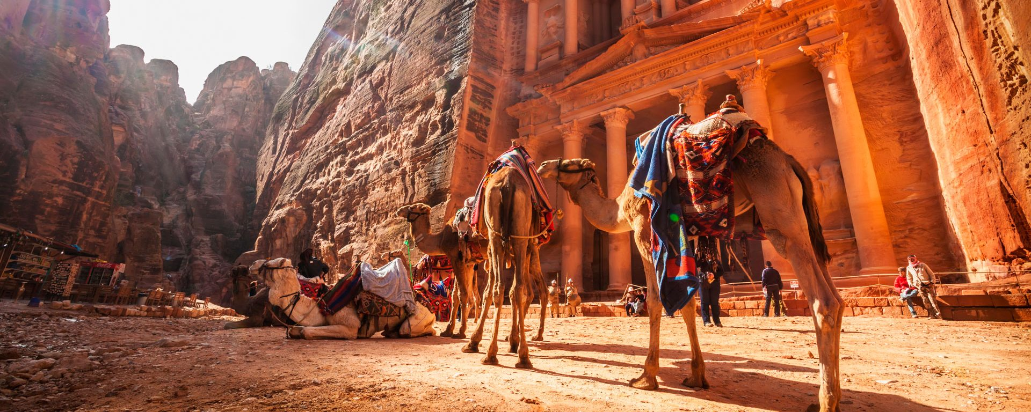
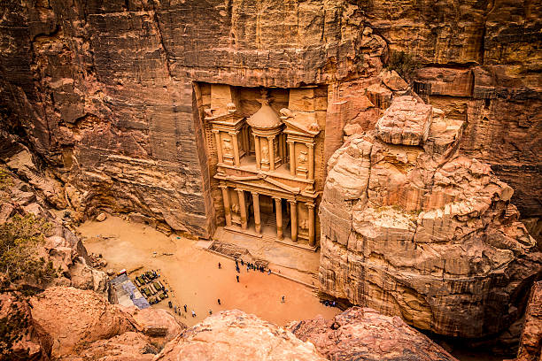
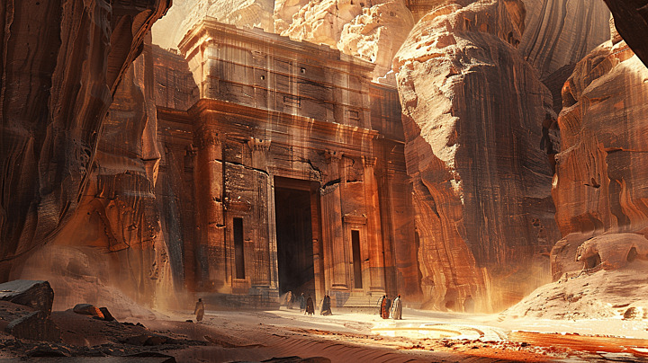
AL-KHAZNEH

Slide 2
Historical Context
Petra, founded by the Nabateans around the 4th century BCE, thrived as a trade hub. Al-Khazneh, built in the 1st century CE, is believed to have been a royal tomb or a ceremonial structure. Its name, "The Treasury," comes from a local legend about hidden treasures in the urn atop the monument.

Slide 3
Architectural Features
Al-Khazneh, carved into Petra's cliffs, stands 40 meters tall. Its façade blends Hellenistic, Egyptian, and Eastern styles, featuring Corinthian columns and an urn at the top, reflecting Nabatean craftsmanship.

Slide 4
Al-Khazneh Today
Al-Khazneh is a UNESCO World Heritage site, attracting millions of tourists and scholars. Its dramatic beauty makes it one of Jordan's most photographed landmarks, continuing to inspire awe and research into the Nabatean civilization.

Slide 5
MADE BY
AGGELOS PAPADHMHTRIOU
XARHS SIAMANTAS

