Slide 1
CHRISTMAS
IN LONDON

Slide 2
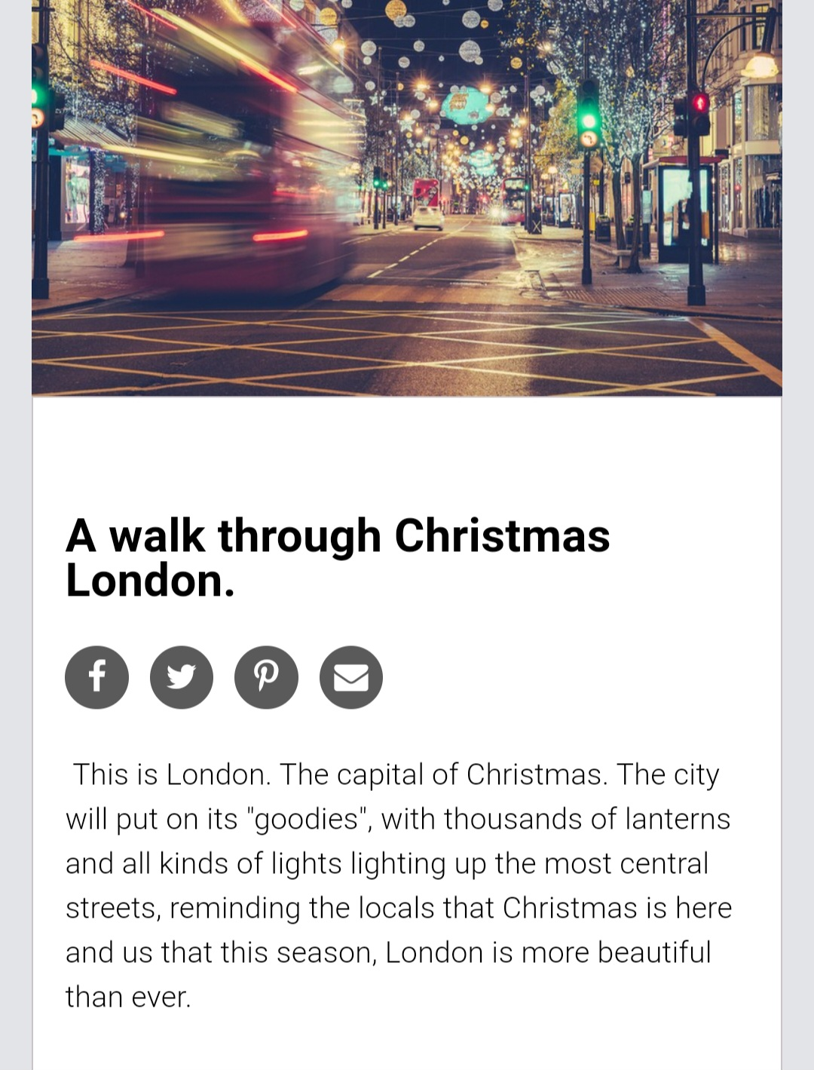
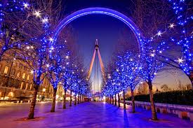

Slide 3
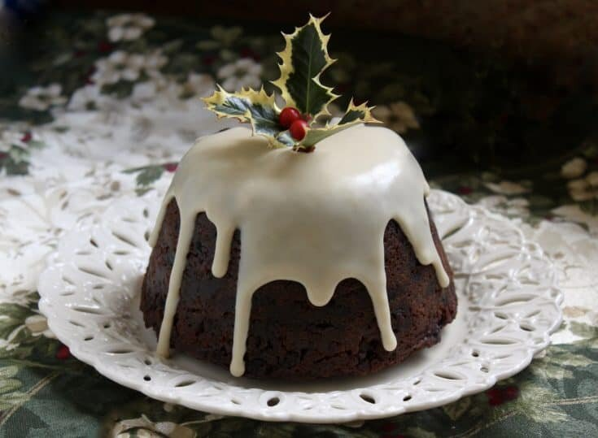
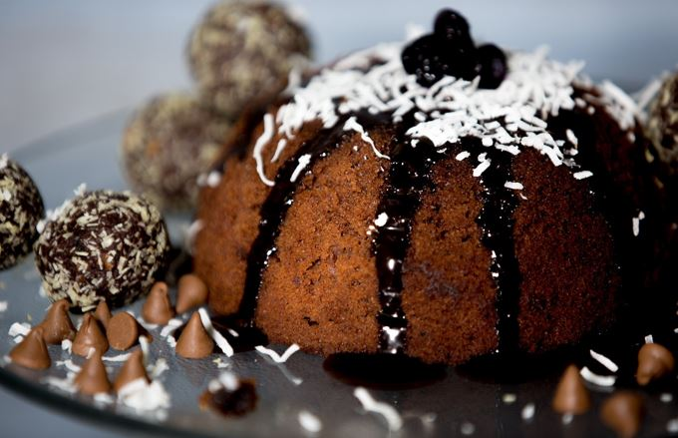
Christmas pudding is sweet, dried-fruit
pudding traditionally served as part of
Christmas dinner in Britain and other
countries to which
the tradition has been exported. It has
its origins in medieval England,
with early recipes making use of dried
fruit, suet, breadcrumbs, flour,
eggs and spice, along with liquid such
as milk or fortified wine. In 1845, cookery writer Eliza Acton
wrote the first recipe for a dish
called "Christmas pudding".

Slide 5
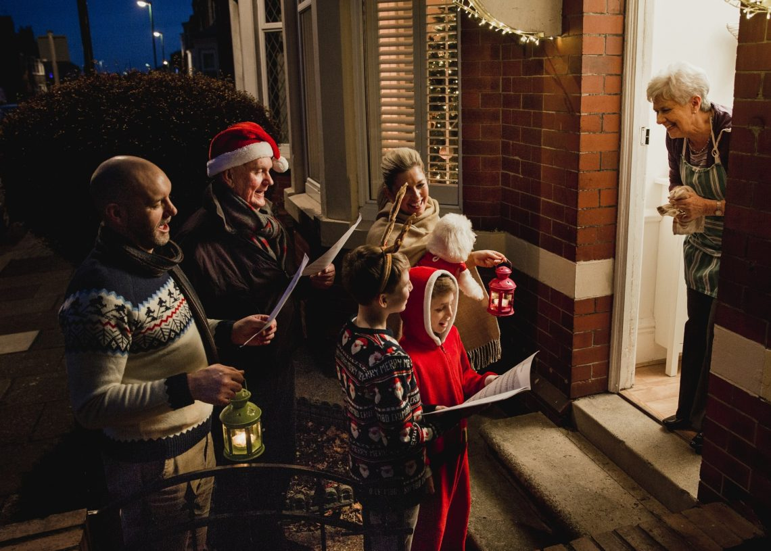
CHRISTMAS CAROLS
If you've ever wondered when Christmas carols first came about, the answer lies in the 14th century . Even before Christianity, it is thought that midwinter songs existed to keep up people's spirits, along with dances, plays and feasts.

Slide 6
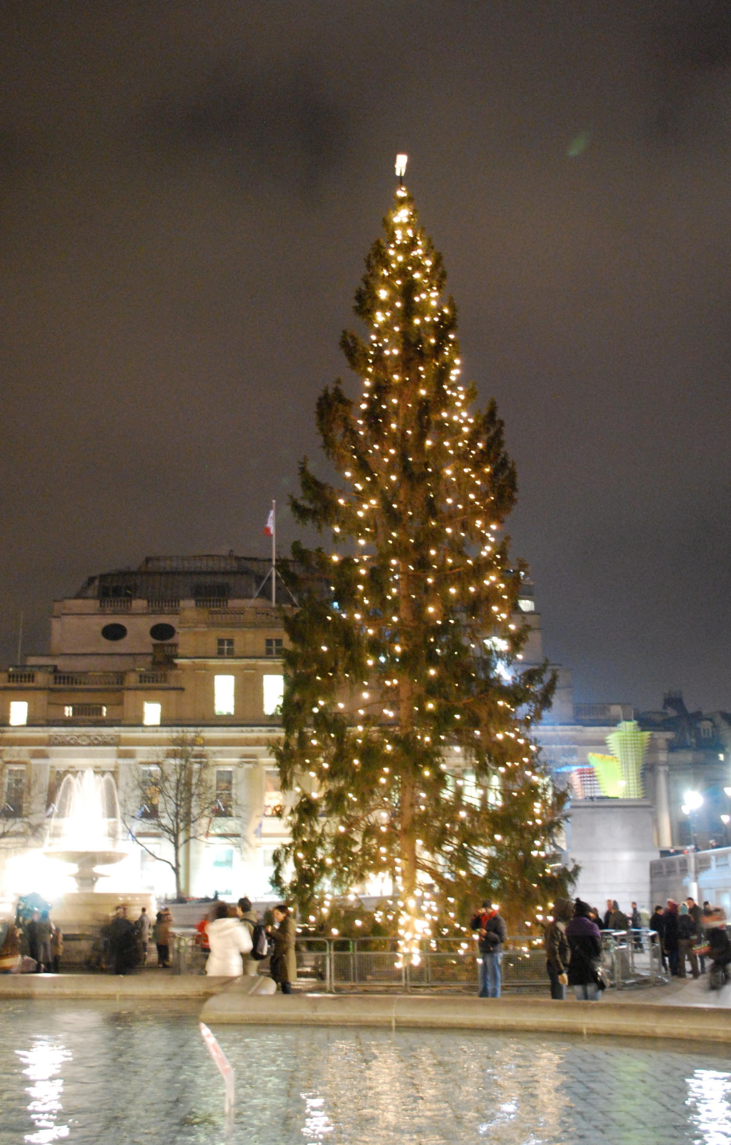
The lighting ceremony
Don’t miss the lighting of the world’s most famous Christmas tree, The 25-metre-high tree is a gift from the people of Norway to London, in thanks for Britain’s support in World War II. This historic tradition has happened every year since 1947 and signals the countdown to Christmas in London.

Slide 7
BY
KRYSTALLINA
&
JOANNA

