Slide 1
Easter Island Σταυρόπουλος Γιώργος

Slide 2
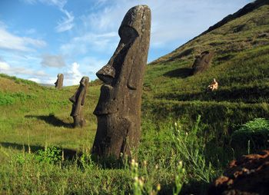
Easter Island, also known as Rapa Nui, is a tiny island known for its huge Moai statues scattered all over the island.
The world is fascinated by the creation of these statues not only for the impressive size and quantity of them, but also for the circumstances under which they were built. This small island had very limited resources; not much drinking water, no cattle and no metal. The statues were transported to their final location several kilometers across hilly terrain - all of this being accomplished with the highest leader being a tribal chieftain.

Slide 3
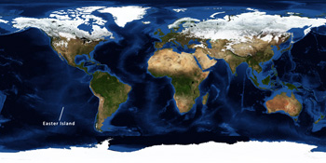
LOCATION
Rapa Nui is located in the Pacific Ocean, west of Chile in South America. Flying from Chile's capital Santiago, which is the closest flight connection, takes around 5 hours.

Slide 4
CULTURE
The Rapa Nui people are Polynesians, such as Hawaiians, Tahitians and the Māori of New Zealand. The native languages of these islands are very similar.
Music, dance and art has always been a central part of Rapa Nui culture. The island is today part of Chile, and strong South American influences threaten the existence of the fragile Rapa Nui culture which a mere 3000 people are part of.

Slide 5
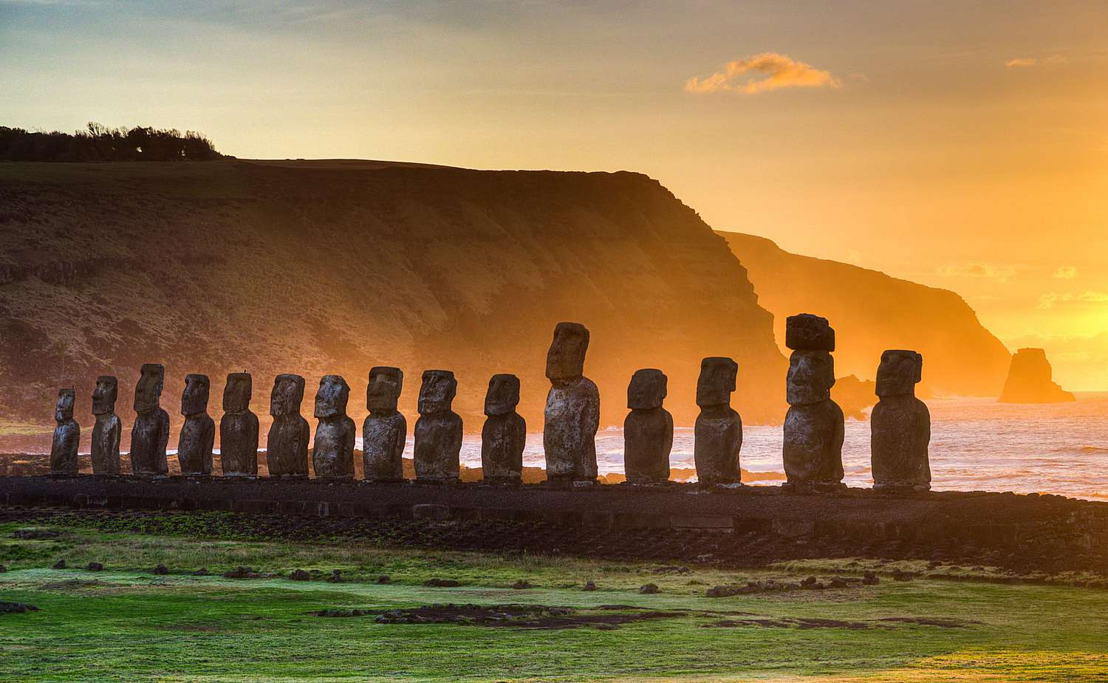
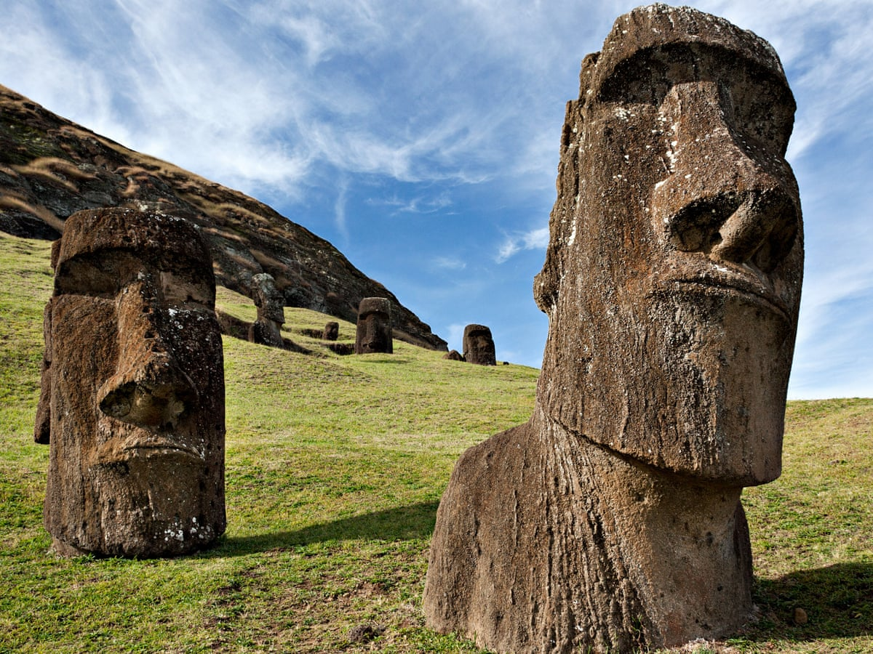
TOURISM
After NASA extended the airport landing stretch in 1987 for possible space shuttle emergency landings, tourism has constantly increased, and continues to do so by around 20% per year. Tourism is the main source of income for the islanders. In 2012, Rapa Nui received 70 000 visitors. The tourism services of the island are well prepared to receive and take good care of outside visitors.

Slide 6
ECONOMY
Official currency is Chilean pesos (CLP), though US dollars are also accepted.
Because of the remoteness (everything has to be flied or shipped in) and tourism, prices are quite high. A meal and a beverage at a restaurant may cost around 10 000 CLP - 30 000 CLP and a night at a hotel may cost 80 000 CLP - 200 000 CLP.

Slide 7
Rapa Nui music today
Most Rapa Nui people are artists in some way. It may be in carving, handicrafts, drawing as often is the case in music. For a small group of around only 3000 people, surprisingly many have recorded CDs and perform on a regular basis. One of them is Alicia Makohe Ika of Easter Island Travel.

Slide 8
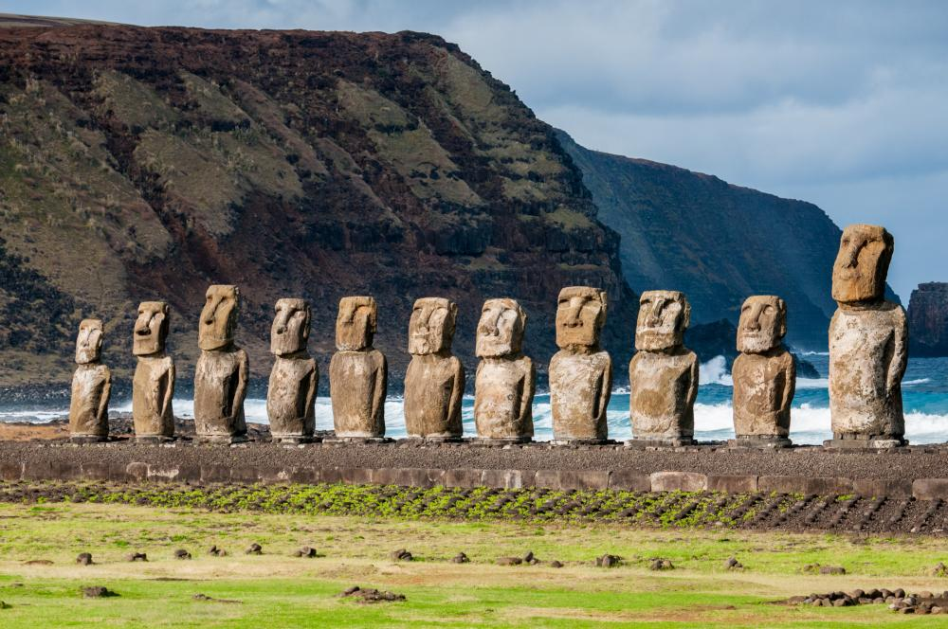

Slide 9
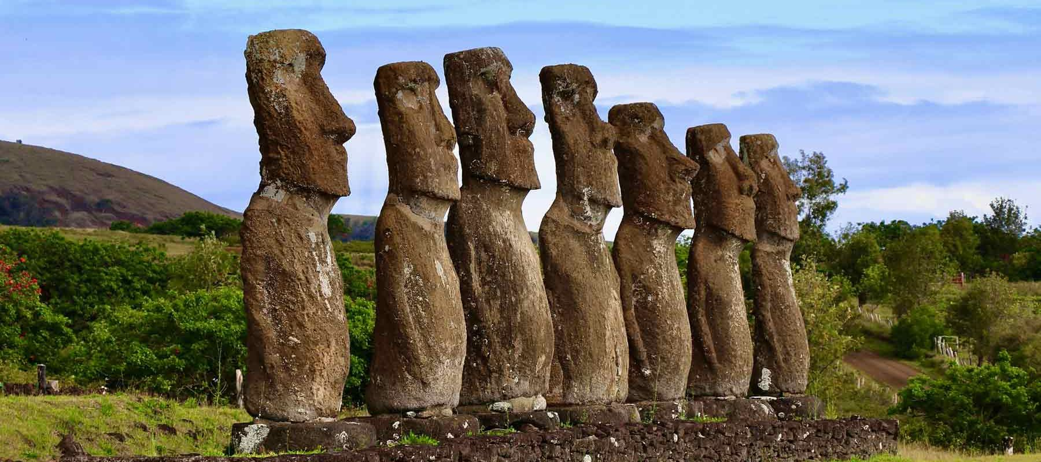

Slide 10
