Slide 1
TECH - ADDICTS
vs
TECH - SAVVY USERS
Are we smart users of our smart devices?

Slide 2
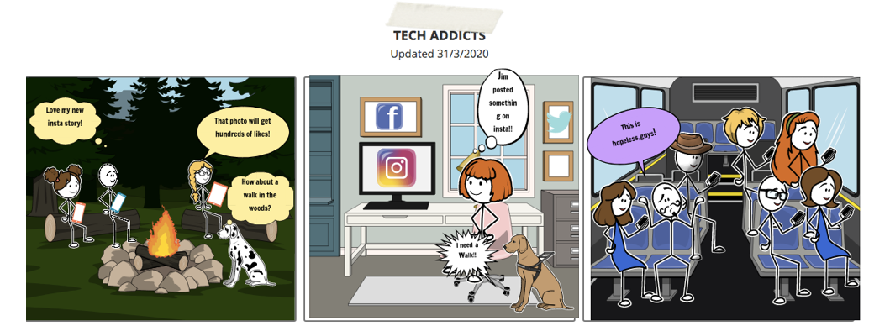
Love my smartphone: What do addicted users do?

Slide 3
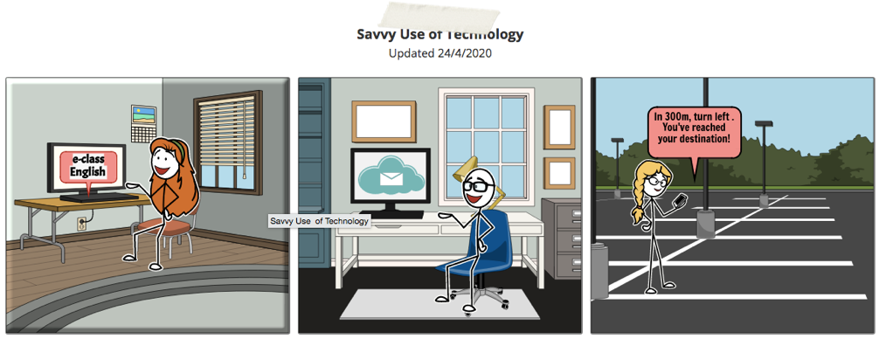
Tech Savvy Users:
What do they do?

Slide 4
Can you give the Definitions for:
Tech Savvy User =
Tech Addicted User=
Don’t forget to write your name:

