Slide 1
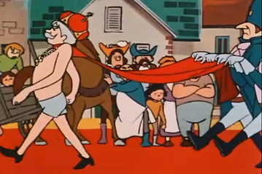
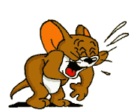

Slide 2
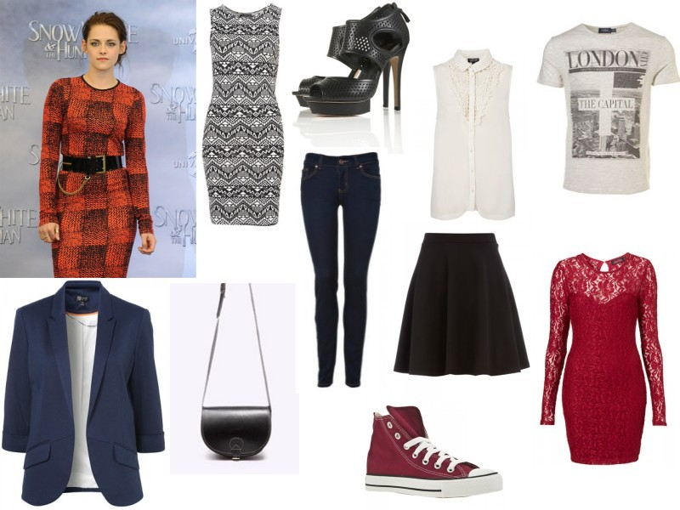
I like new clothes

Slide 3
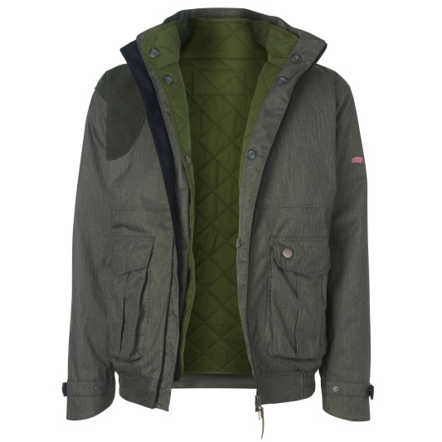
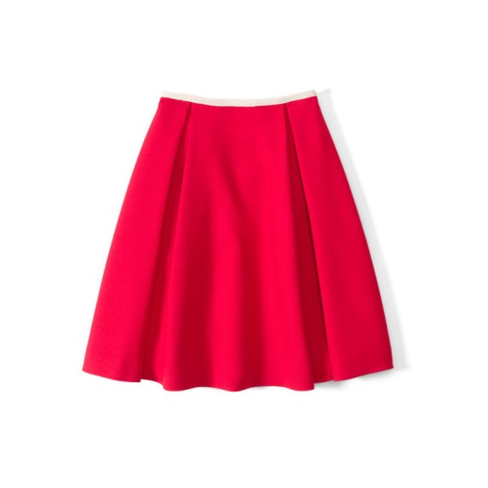
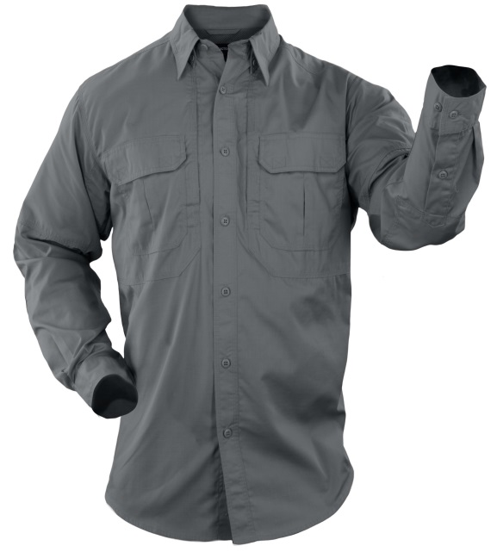
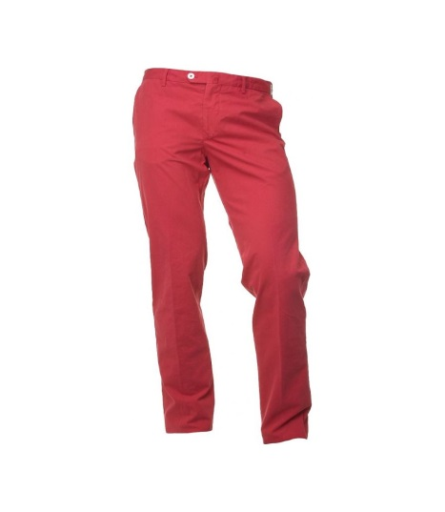
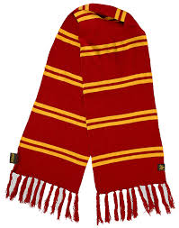
clothes
jacket
skirt
shirt
trousers
scarf

Slide 4
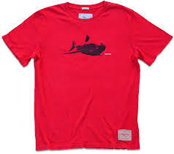
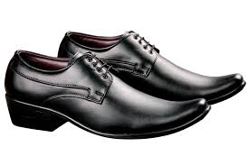
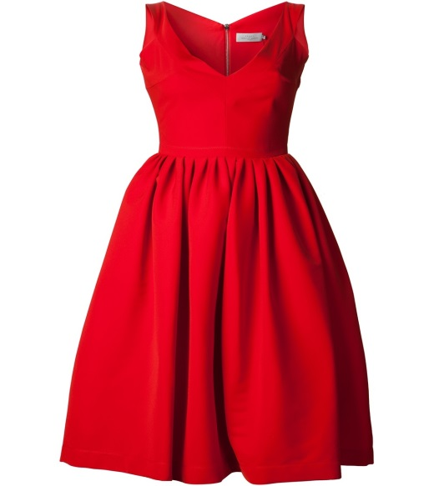
The emperor has no clothes on
T-shirt
shoes
dress

Slide 5
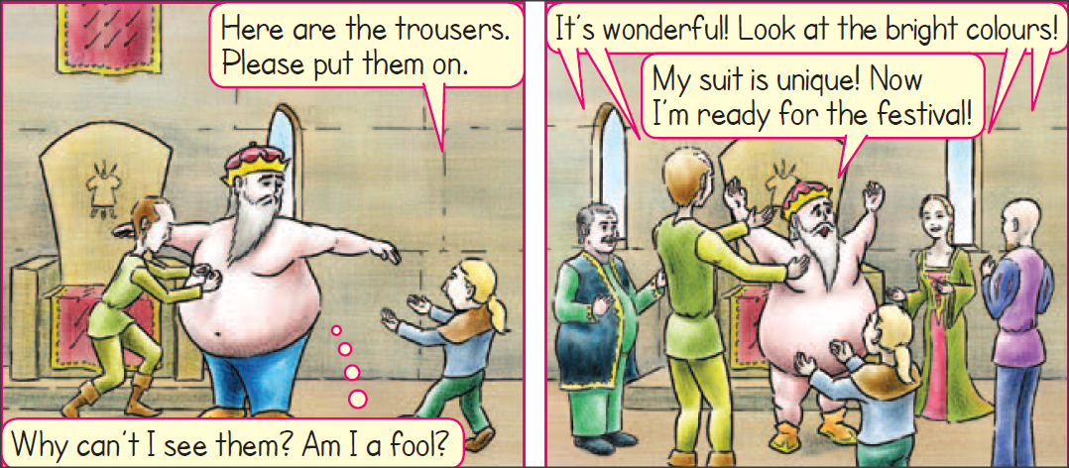
It’s wonderful = Είναι υπέροχο
unique = μοναδικός

Slide 6
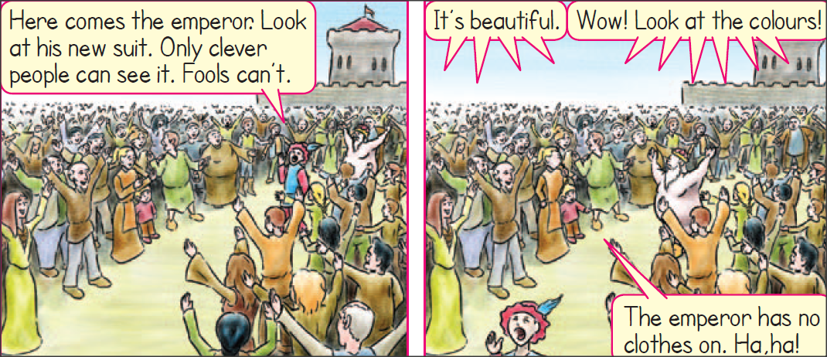
The emperor has no clothes on
Ο αυτοκράτορας δεν φοράει ρούχα

Slide 7
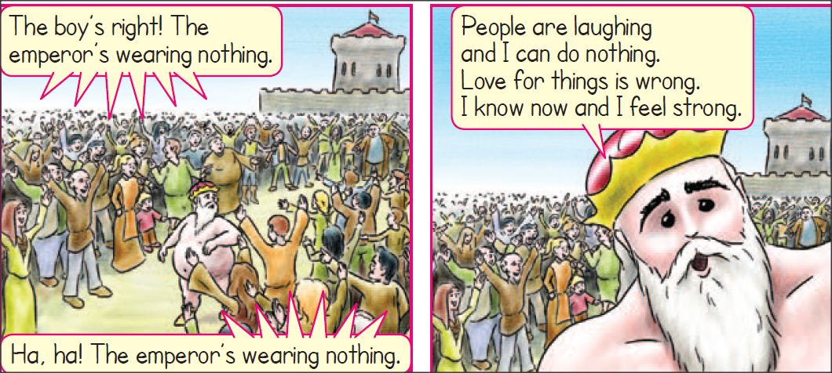
The boy is right = Το αγόρι έχει δίκιο
People are laughing = Οι άνθρωποι γελούν

Slide 8
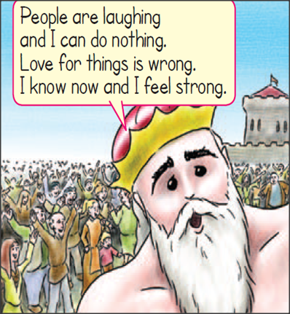
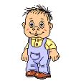
I feel strong = Νιώθω δυνατός

Slide 9
skirt
jacket
trousers

Slide 10
scarf
T-shirt
dress

Slide 12
Thank you kids

