Slide 1
How I passed my holiday
Nickolas Papatriantafillou

Slide 2
Christmas Holidays
This Christmas I went on holidays in Kastoria with my family. We arrived there at the Christmas Eve ( 24th December) at 20:00 o’ clock. Our hotel was 5 kilometers away from the city. We were tired and hungry from the long trip, so we went at a restaurant to eat. The food was delicious! Later that day we went to our hotel to rest. The next day we woke up very early. Prespes was our next destination. Since we were there, we went on a walk at the lake and it was fantastic. After that, it was a essential for us to visit a tradiotional tavern. We have heard that the food there was high quality and we could understand it after our visit. At the evening we went on a walk at Kastoria. The next day we went to Florina. Florina is an amazing city. The Christmas decoration there was great. We were lucky enough to admire a snowing landscape. It was great opportunity for me and my brother to play with the snow. Unfortunately this was our last day. The next morning we left our hotel and we headed . It was one of the best trips of my life.

Slide 3
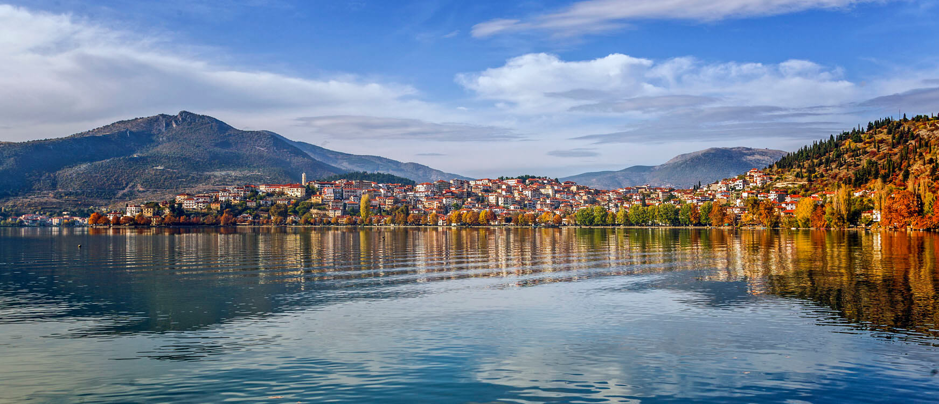

Slide 4
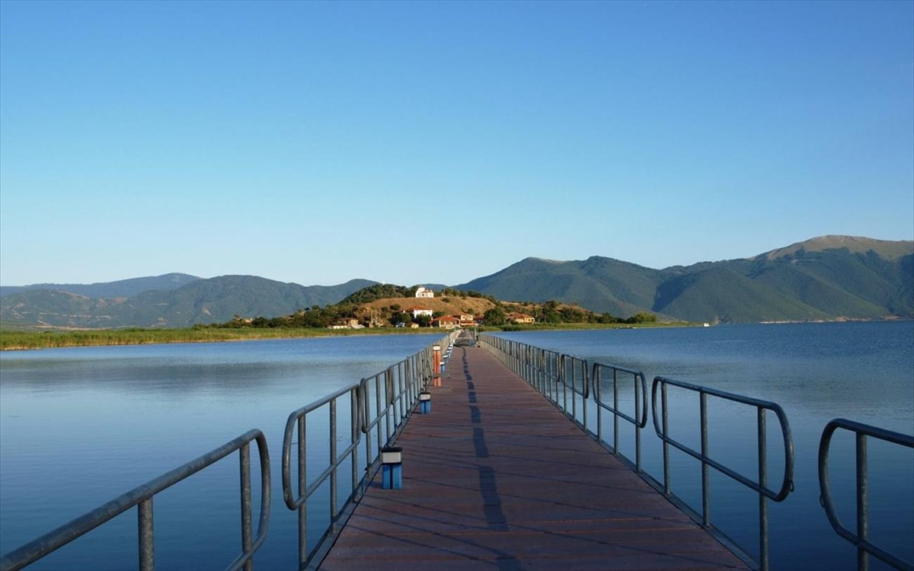

Slide 5
