Slide 1
UNIT 4
The weasel and the mole

Slide 2
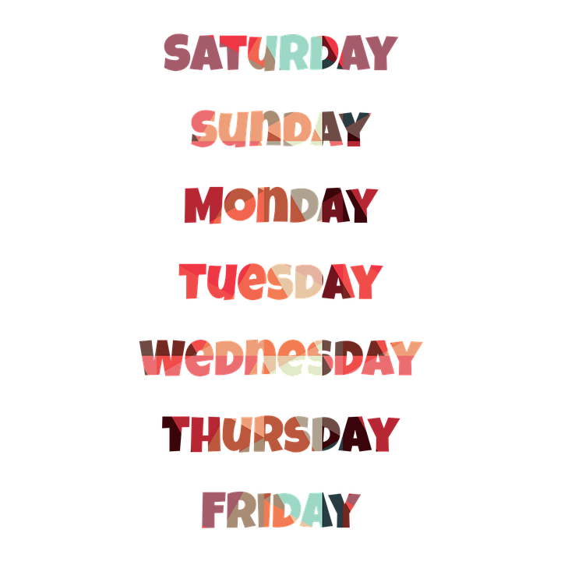
3 new things I learned
1
Food
2
Present Continuous
3
The days of the week
Healthy food
Vegetables
Fruit
Junk food
I am reading

Slide 3
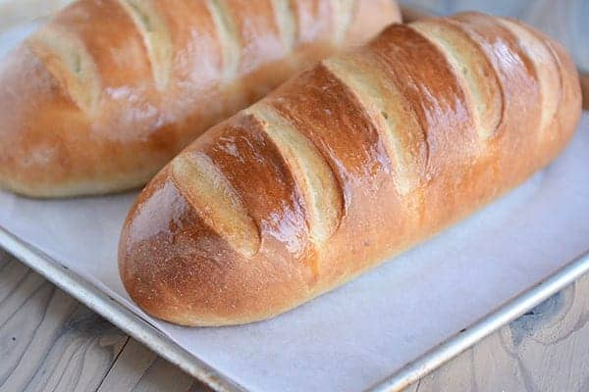

Slide 4
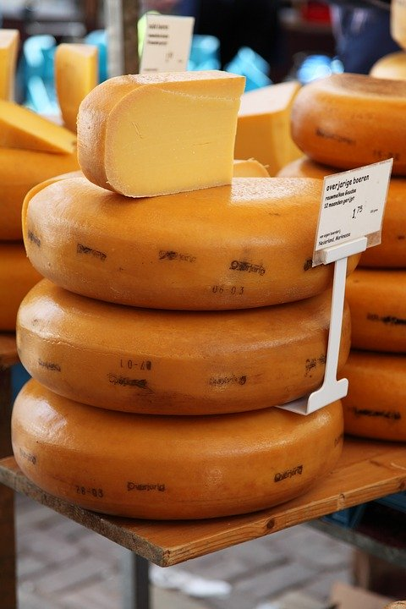
???????

Slide 6
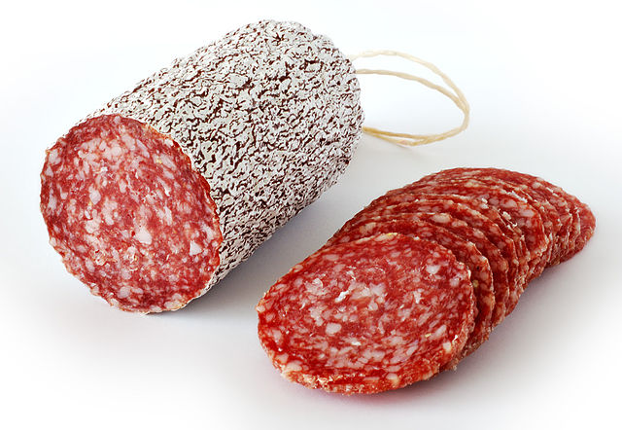

Slide 7
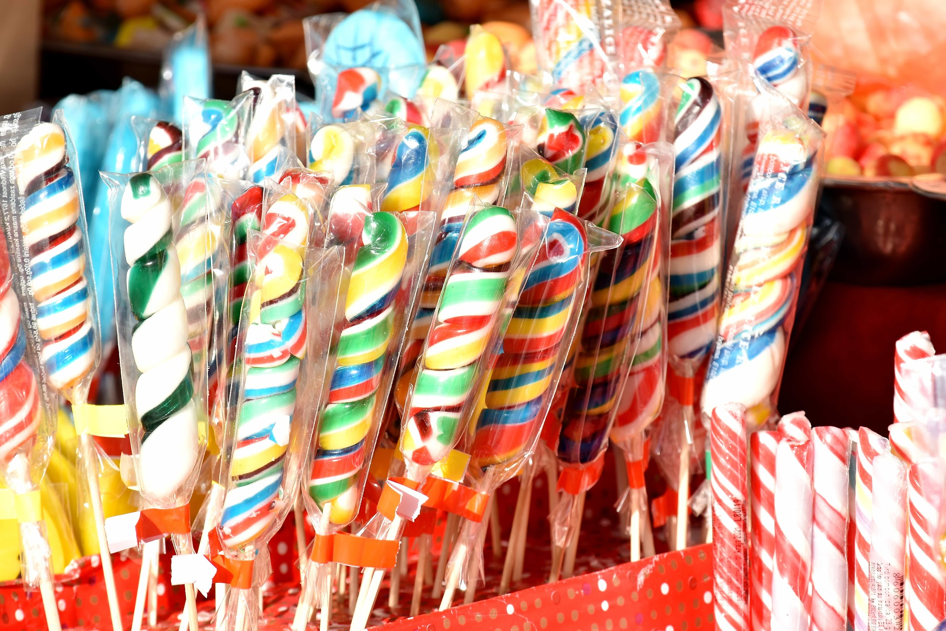

Slide 8
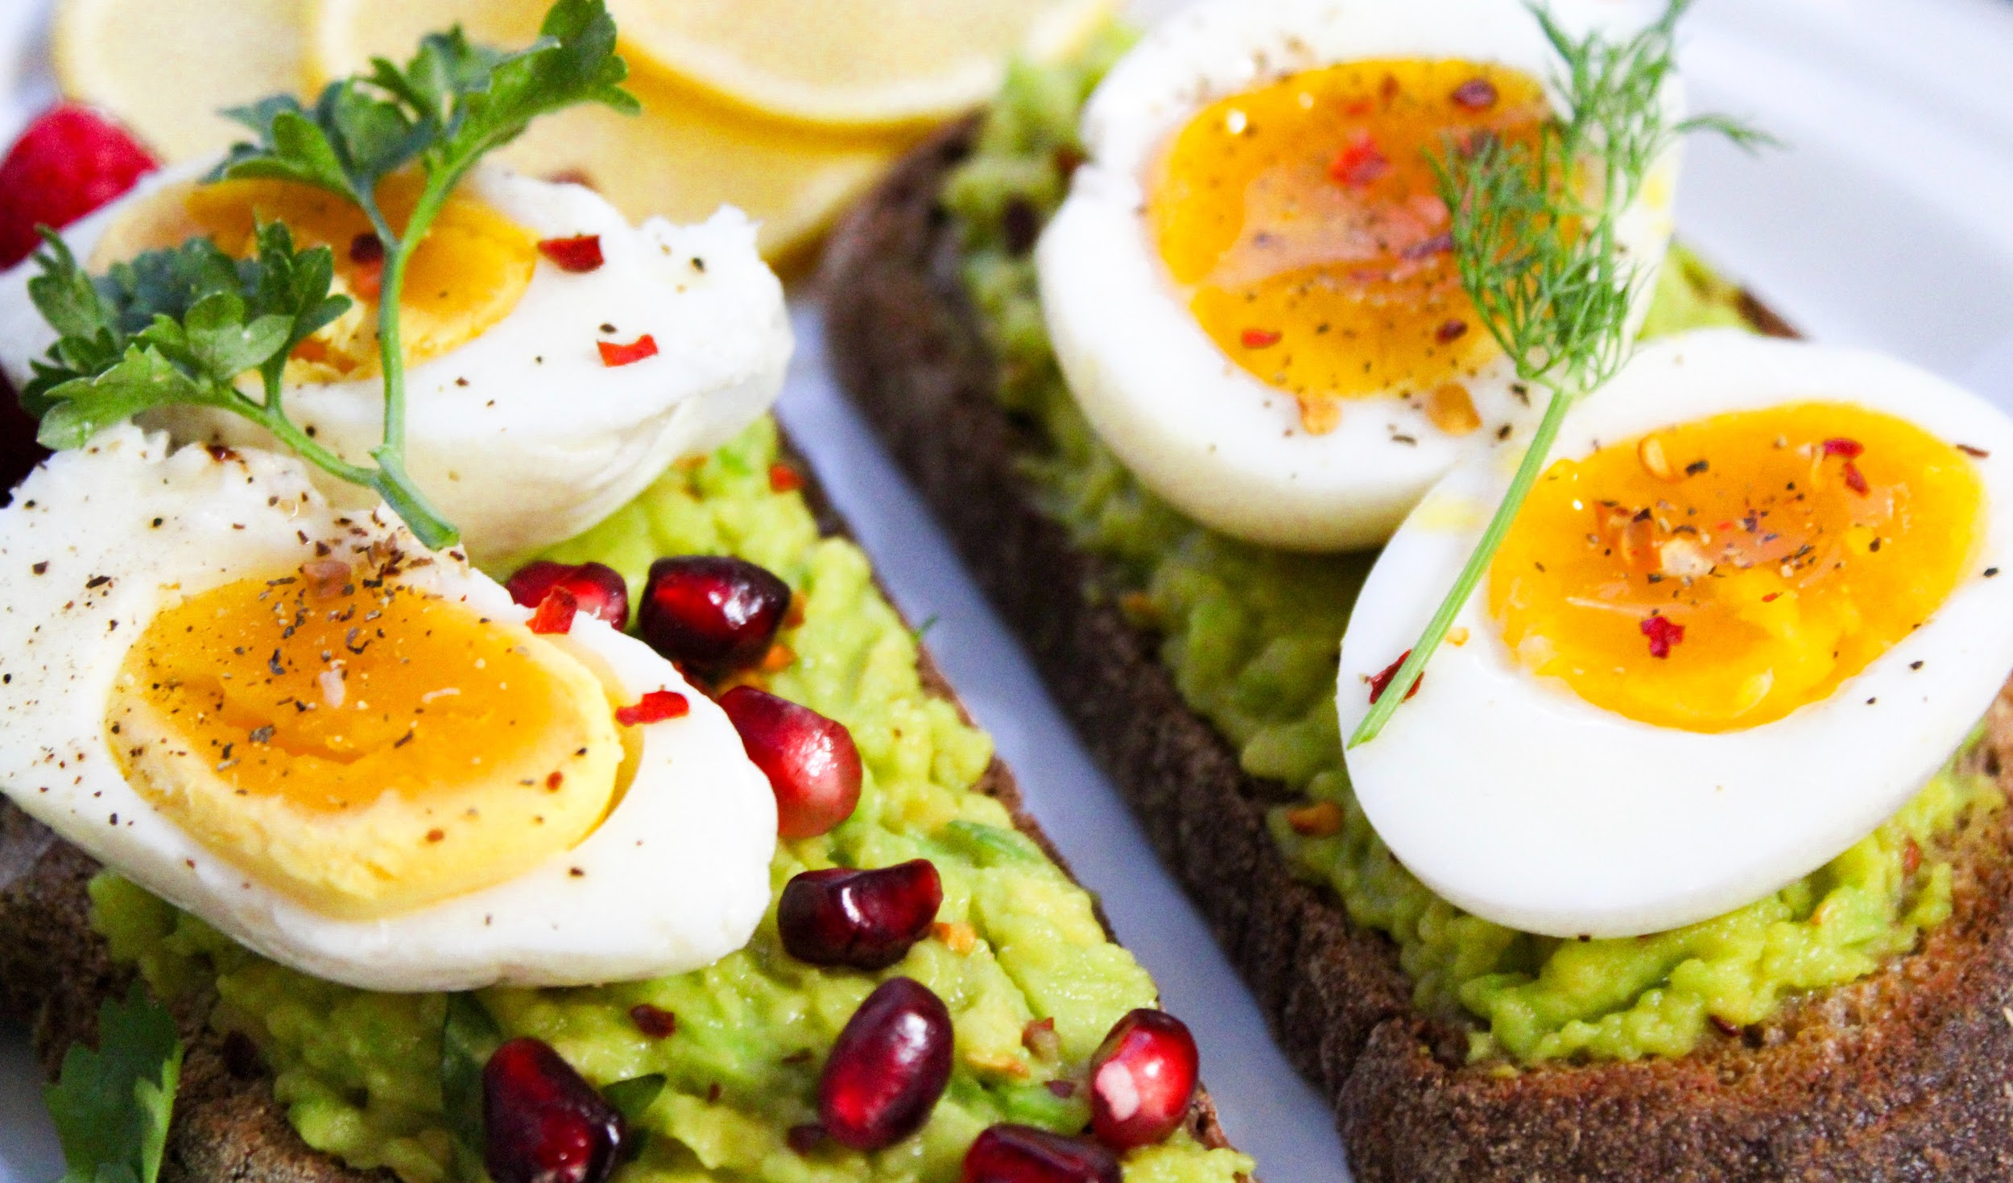

Slide 9
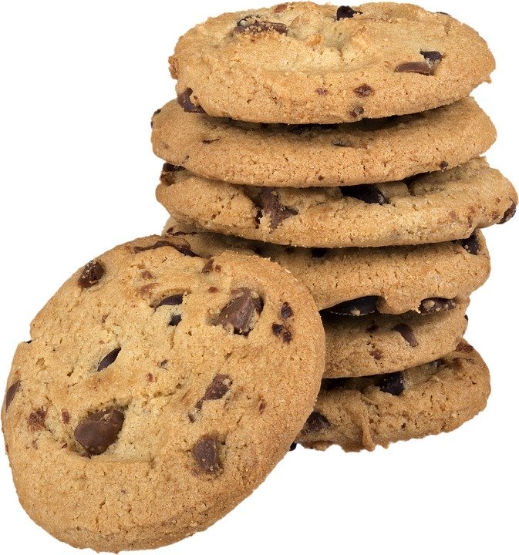

Slide 10
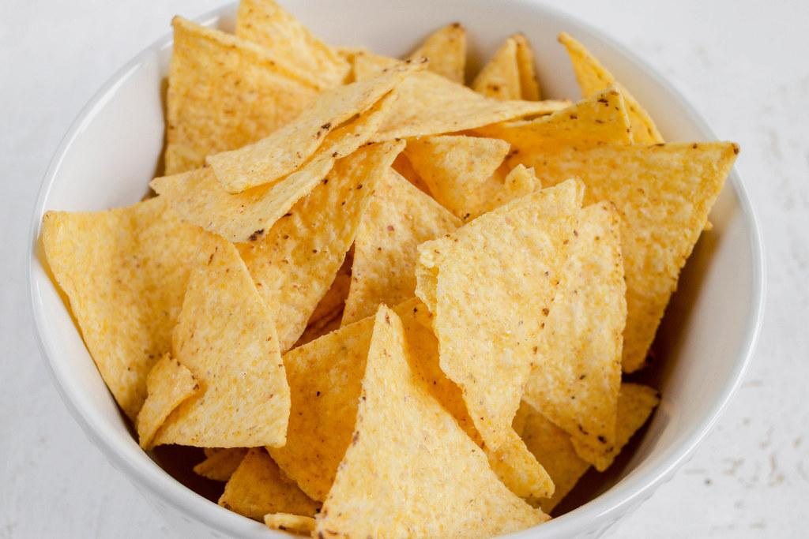
Bicycle

Slide 11
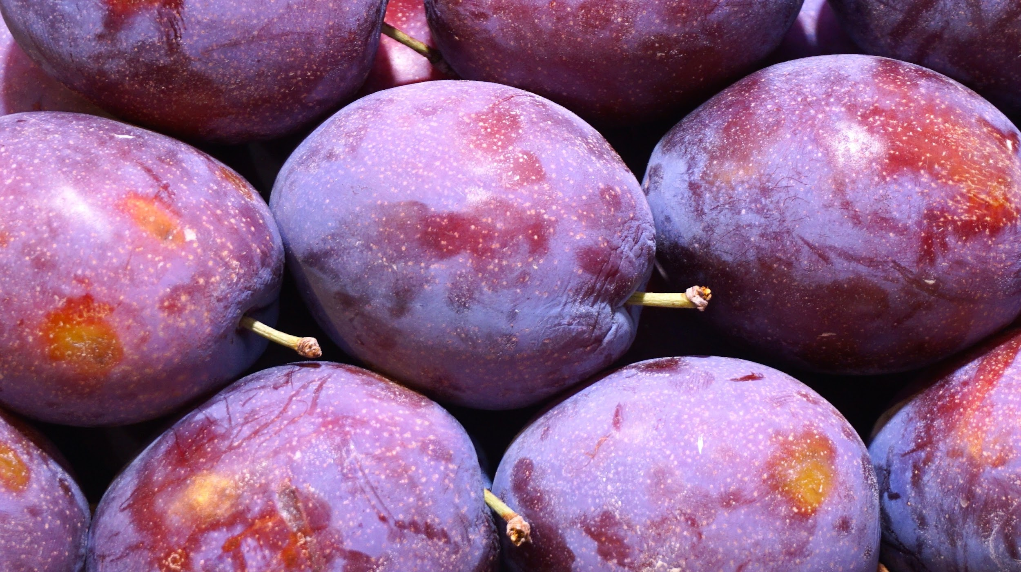
Bicicleta
Bicycle

Slide 12
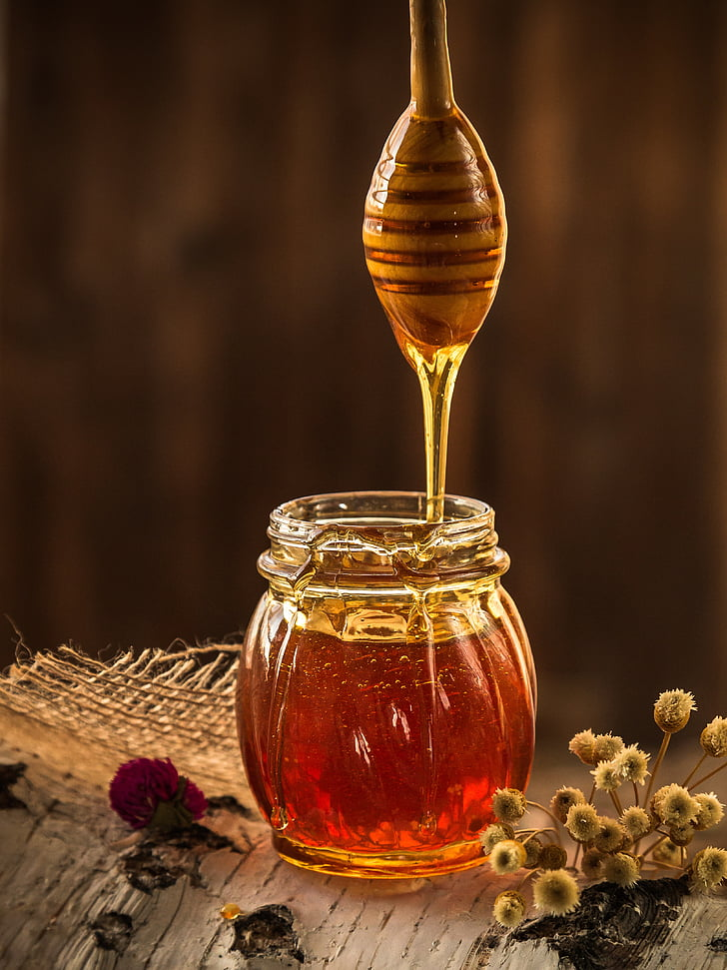

Slide 13
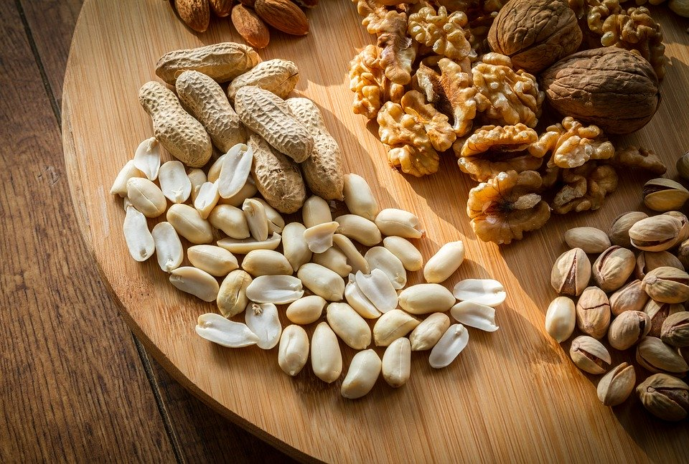

Slide 14
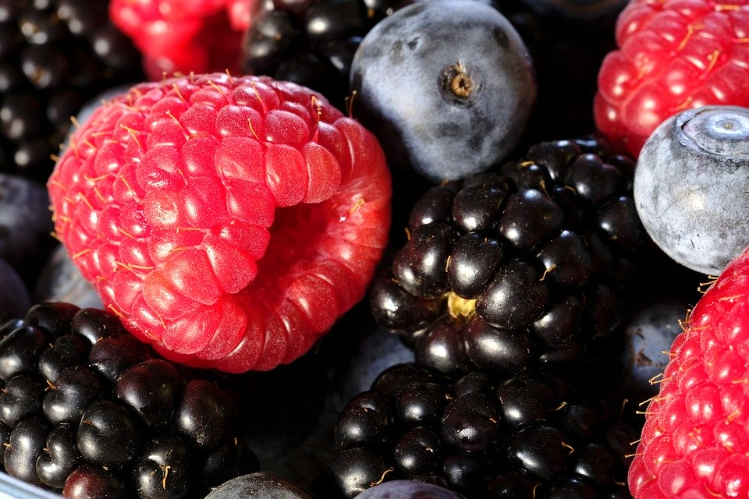

Slide 15
What’s the right kind of food? Choose a or b?

Slide 16
Eating right ...
...can make you
happy!!

Slide 17
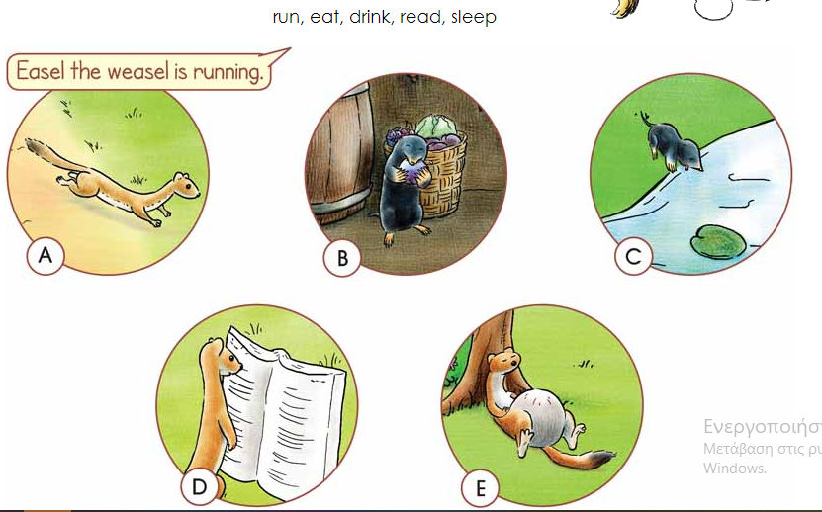
Look and say (run, eat, drink, read, sleep)

Slide 19
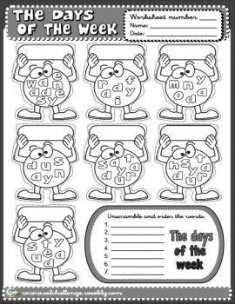
Sunday
Wednesday
Tuesday
Friday
Thursday
Monday
Saturday

Slide 20
Thank you!!!

