Slide 1
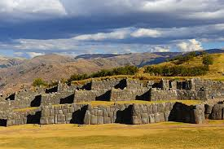
SacsayhuamAN

Slide 2
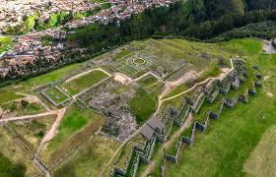
Key features (Pt1)
1. Massive stones:
Its walls are made of gigantic stones, some weighing over 100-200 tons, transported from many miles away. The perdition of the stonework is extraordinary with the rocks fitting perfectly.

Slide 3
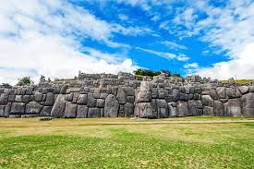
Key features (pt2)
2. Zigzag Walls:
The three massive terraces form a zigzag pattern, likely for defense and symbolic purposes

Slide 4
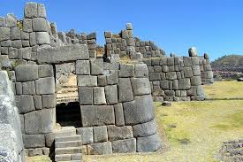
Key features (pt3)
Main Plaza and Towers:
A large central area hosted ceremonies , while tall towers served as observation points and possibly water reservoirs

Slide 5
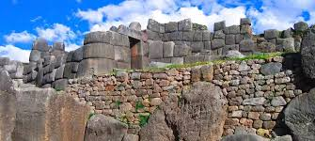
Key features (pt4)
4. Chincanas (Tunnels) Underground tunnels and caves connect various parts of the site, adding to its mystique

Slide 6
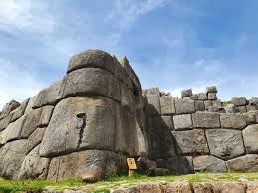
purpose
Its elevated location and design made it a key defensive stronghold. Dedicated to Inti, the sun god it was central to rituals like the Inti Raymi (Festival of the sun)

Slide 7
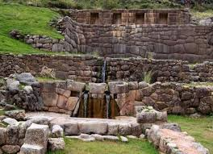
The mystery
The transportation of massive stones,precision of fitting , and earthquake-resistant design are still not fully understood.These feats showcase advanced knowledge of geometry and construction.

