Slide 1
Magic Book 2
Unit 3. Lesson 2.
Let’s learn English
Teacher : Papadamos Konstantinos

Slide 2
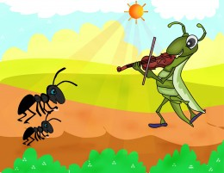
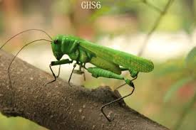
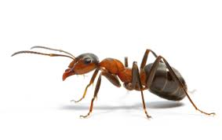
cricket
ant

Slide 3
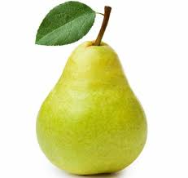
one pear
two pears
three pears
four pears

Slide 4
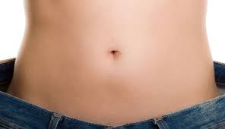
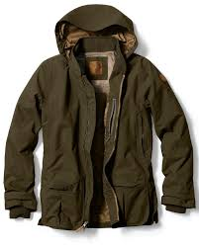
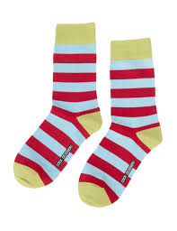
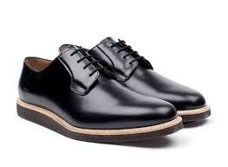
tummy
pear
jacket
socks
shoes

Slide 5
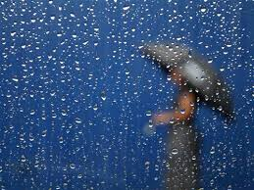
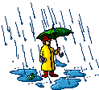
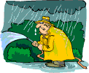
It’s raining

Slide 6
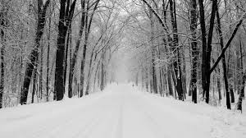
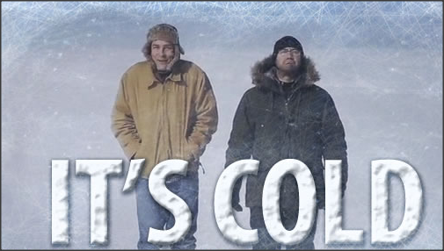
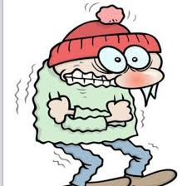
It’s cold = Κάνει κρύο

Slide 7
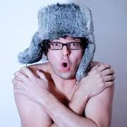
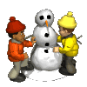
I’m cold = Κρυώνω

Slide 8
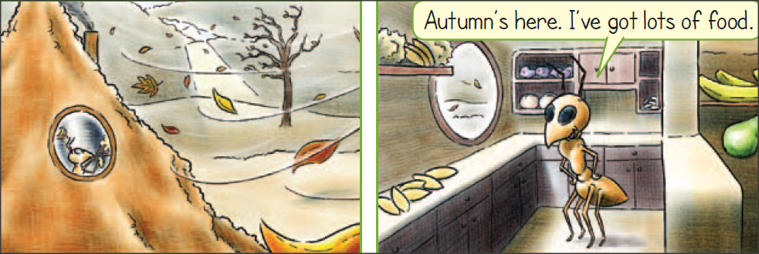
I’ve got lots of food.
έχω πολύ φαγητό.

Slide 9
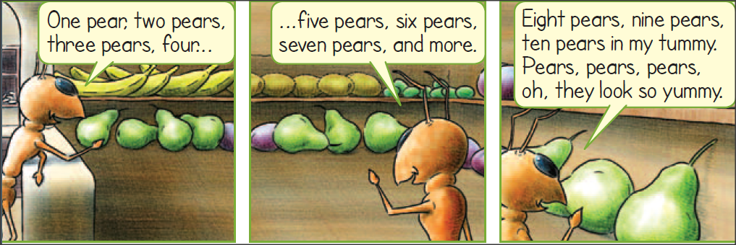
pear
tummy = κοιλιά

Slide 10
socks
jacket
shoes

Slide 11
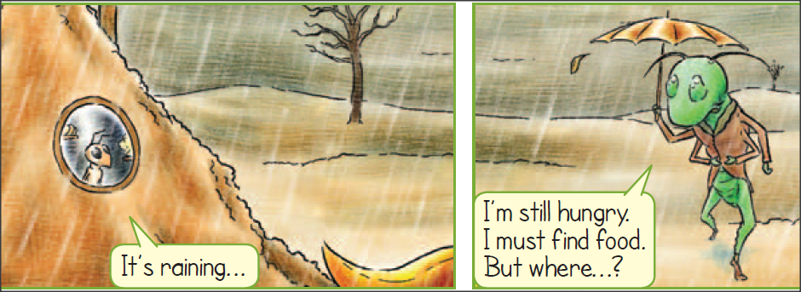
It’s raining
Βρέχει
I’m still hungry = Ακόμα
πεινάω

Slide 12
cricket
ant
pear
tummy

Slide 13
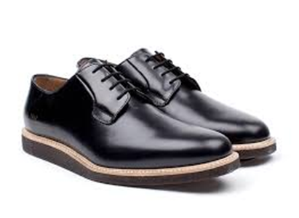
shoes
jacket
socks

Slide 14
Thank you, kids
cricket
ant
Techer: Papadamos Konstantinos

