Slide 2
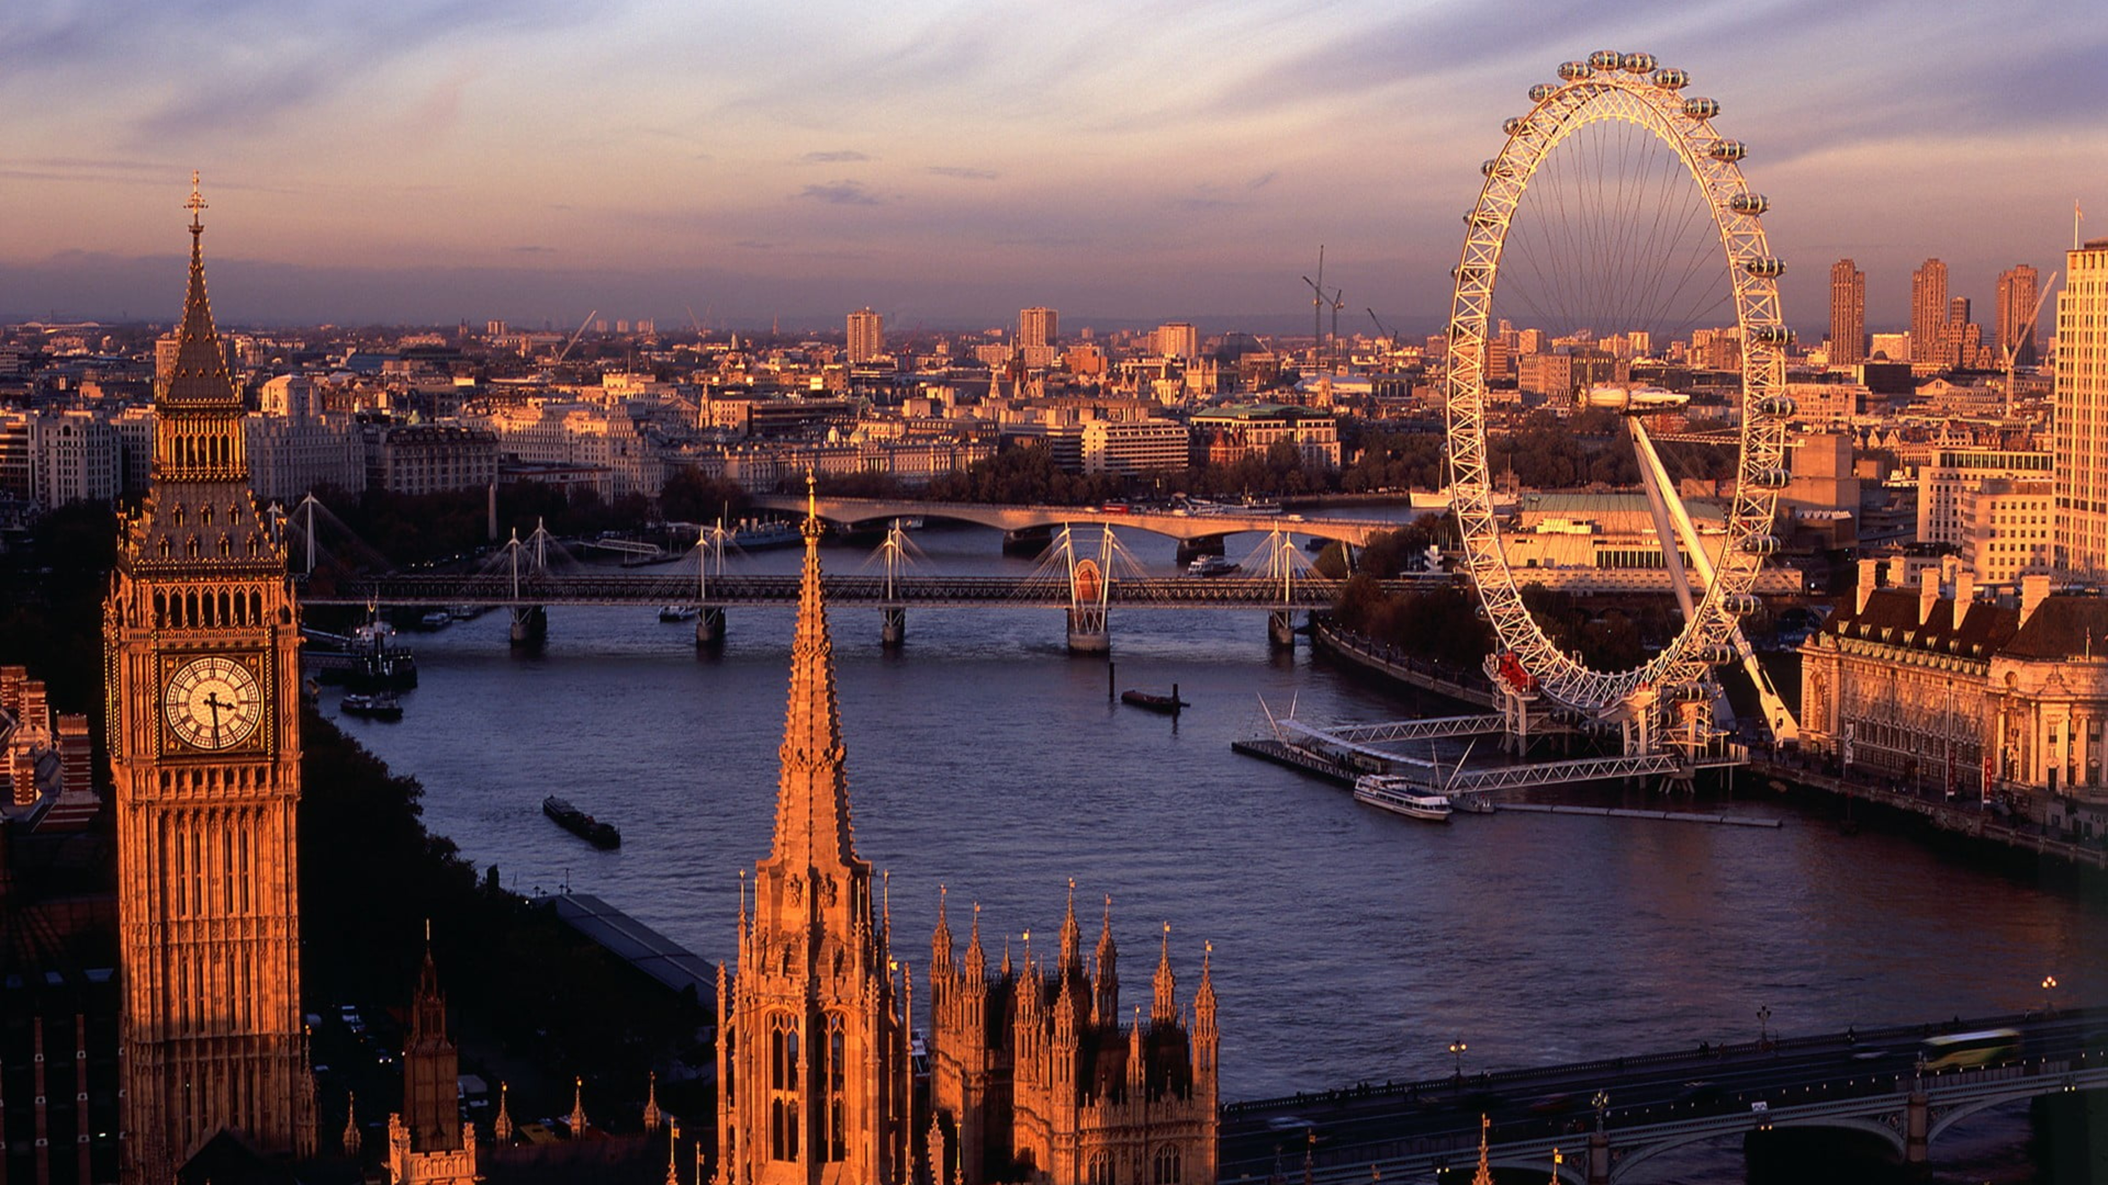

Slide 3
Από τον Αλέξανδρο Βαγγελάκο και την Φιλοθέη Καγκάλου

Slide 4
Christmas Traditions
Από τον Αλέξανδρο Βαγγελάκο και την Φιλοθέη Καγκάλου

Slide 6
1:Christmas Crackers
Christmas crackers are a fun part of Christmas in Britain, often used during Christmas dinners or parties. This is a colorful paper tube, usually with festive designs. Two people pull each end of the cracker, and it splits with a small bang. Inside, there’s a small toy or gift, a paper hat, and a joke. Everyone enjoys reading the jokes, even if they’re a bit silly. The cracker was created in the mid-19th century by Tom Smith, a sweet maker from London. He was inspired by French sweets wrapped in paper and added the bang and gifts to make the crackers we enjoy today.

Slide 7
1:Christmas Crackers
Christmas crackers are a fun part of Christmas in Britain, often used during Christmas dinners or parties. This is a colorful paper tube, usually with festive designs. Two people pull each end of the cracker, and it splits with a small bang. Inside, there’s a small toy or gift, a paper hat, and a joke. Everyone enjoys reading the jokes, even if they’re a bit silly. The cracker was created in the mid-19th century by Tom Smith, a sweet maker from London. He was inspired by French sweets wrapped in paper and added the bang and gifts to make the crackers we enjoy today.

Slide 8
2:Carol Singing
Singing Christmas songs, or carolling, is a beloved tradition. People, often in groups, sing Christmas carols from house to house. This custom dates back to the Middle Ages. Popular carols like “Silent Night,” “O Holy Night,” and “Deck the Halls” are often sung. These songs have evolved over time. For example, “Deck the Halls” is based on a Welsh melody from the 16th century. Carolling is more than just a way to spread Christmas joy, it often helps raise money for charity. In Britain, it’s common for carollers to collect donations for various causes, continuing the tradition’s spirit of community and giving.

Slide 9
2:Carol Singing
Singing Christmas songs, or carolling, is a beloved tradition. People, often in groups, sing Christmas carols from house to house. This custom dates back to the Middle Ages. Popular carols like “Silent Night,” “O Holy Night,” and “Deck the Halls” are often sung. These songs have evolved over time. For example, “Deck the Halls” is based on a Welsh melody from the 16th century. Carolling is more than just a way to spread Christmas joy, it often helps raise money for charity. In Britain, it’s common for carollers to collect donations for various causes, continuing the tradition’s spirit of community and giving.

Slide 10
3:The Christmas tree
And decorations
A Christmas tree, decorated with lights and ornaments, is a common sight in many British homes. Prince Albert, Queen Victoria’s husband, made the Christmas tree popular in Britain in the 19th century. It was a tradition from his native Germany. Decorating the house with holly, ivy, and mistletoe adds to the festive feeling.

Slide 11
3:The Christmas tree
And decorations
A Christmas tree, decorated with lights and ornaments, is a common sight in many British homes. Prince Albert, Queen Victoria’s husband, made the Christmas tree popular in Britain in the 19th century. It was a tradition from his native Germany. Decorating the house with holly, ivy, and mistletoe adds to the festive feeling.

Slide 12
4:The king’s Christmas day speech
On Christmas Day, the King gives a special speech, continuing a tradition that was famously carried out by the Queen for many years. This tradition started in 1932 with King George V. It was first a radio broadcast, but now it’s shown on TV. People often watch it together with their families after lunch. The King shares his thoughts about the past year and the Christmas season, just as the Queen used to do during her reign. It’s a time for everyone to think and feel united in the Christmas spirit.

Slide 13
4:The king’s Christmas day speech
On Christmas Day, the King gives a special speech, continuing a tradition that was famously carried out by the Queen for many years. This tradition started in 1932 with King George V. It was first a radio broadcast, but now it’s shown on TV. People often watch it together with their families after lunch. The King shares his thoughts about the past year and the Christmas season, just as the Queen used to do during her reign. It’s a time for everyone to think and feel united in the Christmas spirit.

Slide 14
5: Mince Pies and Christmas Pudding
We can’t forget the food! Mince pies are small, sweet pastries that are a must-have at Christmas. They used to have meat in them, but now they’re filled with dried fruits and spices. Eating a mince pie on each of the 12 days of Christmas is said to bring good luck. Christmas pudding is another important dish. It’s a rich pudding made with fruit and spices. It’s traditionally made a month before Christmas and is a symbol of good luck and happiness for the coming year.

Slide 15
5: Mince Pies and Christmas Pudding
We can’t forget the food! Mince pies are small, sweet pastries that are a must-have at Christmas. They used to have meat in them, but now they’re filled with dried fruits and spices. Eating a mince pie on each of the 12 days of Christmas is said to bring good luck. Christmas pudding is another important dish. It’s a rich pudding made with fruit and spices. It’s traditionally made a month before Christmas and is a symbol of good luck and happiness for the coming year.

Slide 16
6:Boxing Day
Boxing Day is the day after Christmas, on the 26th of December. Just like Christmas, it’s a bank holiday in the UK, which means people get the day off work. Its name comes from an old tradition where bosses gave “Christmas boxes” to service workers, like postmen or milkmen, as a thank you. Nowadays, it’s known for big sales in shops, similar to Black Friday, and watching sports like football. It’s a relaxing day that continues the Christmas celebrations.

Slide 17
6:Boxing Day
Boxing Day is the day after Christmas, on the 26th of December. Just like Christmas, it’s a bank holiday in the UK, which means people get the day off work. Its name comes from an old tradition where bosses gave “Christmas boxes” to service workers, like postmen or milkmen, as a thank you. Nowadays, it’s known for big sales in shops, similar to Black Friday, and watching sports like football. It’s a relaxing day that continues the Christmas celebrations.

Slide 18
SUMMARY
In summary, from sharing crackers to listening to the King’s speech, these British traditions are all about bringing people together, showing the true meaning of Christmas. As times change, these traditions might also change, but the values of family, community, and joy will stay the same. Merry Christmas!

Slide 19
SUMMARY
In summary, from sharing crackers to listening to the King’s speech, these British traditions are all about bringing people together, showing the true meaning of Christmas. As times change, these traditions might also change, but the values of family, community, and joy will stay the same. Merry Christmas!

Slide 22
Από τον Αλέξανδρο Βαγγελάκο και την Φιλοθέη Καγκάλου

Slide 23
Christmas Traditions
Από τον Αλέξανδρο Βαγγελάκο και την Φιλοθέη Καγκάλου

Slide 24
Christmas Traditions
Από τον Αλέξανδρο Βαγγελάκο και την Φιλοθέη Καγκάλου
The end

