Slide 1
Healthy Food Pyramid

Slide 2
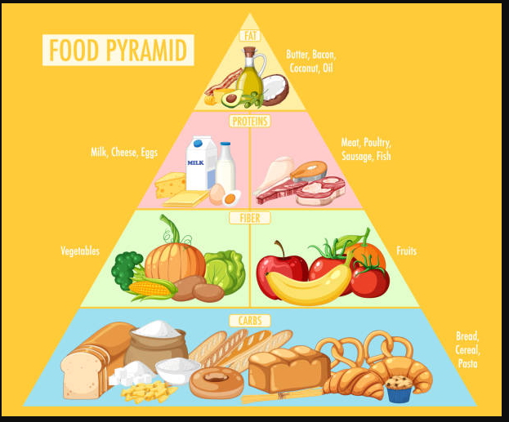

Slide 3
Food Pyramid: Simple Guide
The food pyramid helps us know what to eat to stay healthy.
Bottom Level: Grains Foods like bread, rice, and pasta give us energy to run, play, and learn.
Next Level: Vegetables and Fruits Vegetables and fruits keep us strong, healthy, and protect us from getting sick.
Next Level: Dairy Milk, cheese, and yogurt make our bones and teeth strong.
Middle Level: Protein Foods like meat, eggs, beans, and nuts help our muscles grow and keep us strong.
Top Level: Fats, Oils, and Sweets These are things like butter, chips, and candy. They taste good but we should eat very little of them.
The pyramid shows that we should eat more foods from the bottom and less from the top to stay healthy and grow!

