Slide 1
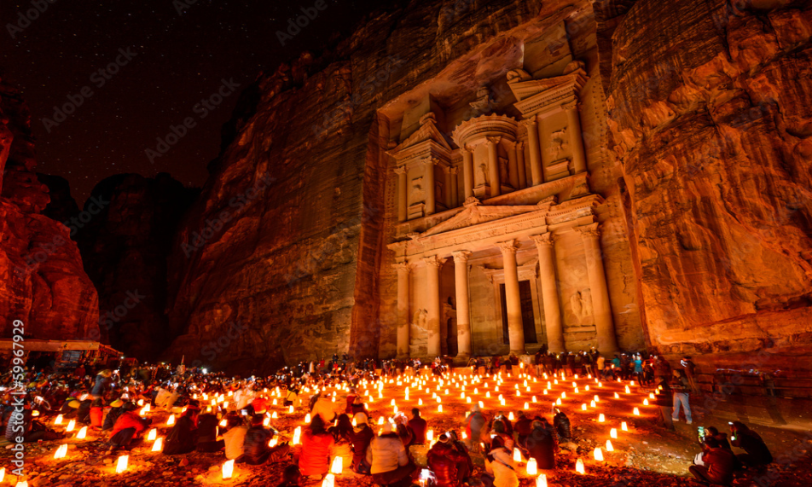
AI-KHAZNEH

Slide 2
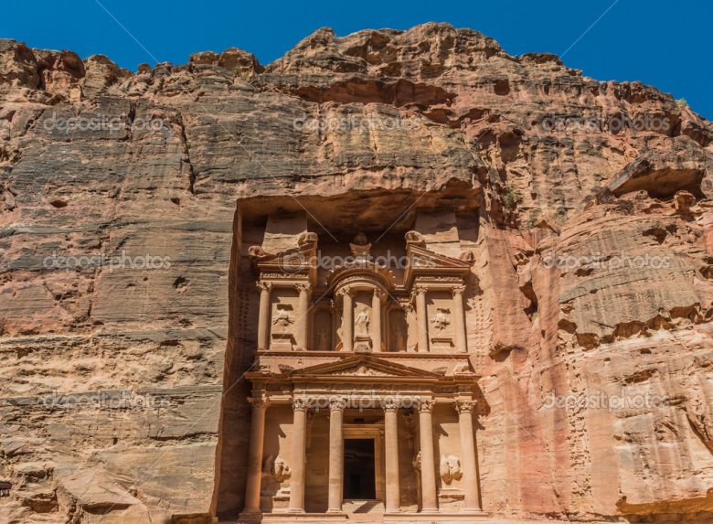
What is AI-Khazneh and who built it
Al-Khazneh is one of the most elaborate rock-cut tombs in Petra
Tis was built by the Arabs in ancient times.
This structure was carved out of a sandstone rock face.

Slide 3
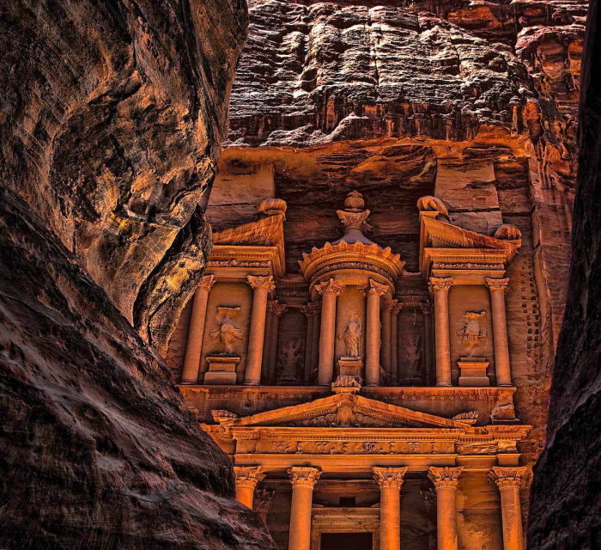
When it was built and where it’s name came from
Al-KIt is thought that Al-Khazneh was built as a mausoleum and crypt at the beginning of the 1st century .
hazneh means "The Treasury" in Arabic.
It came to be called "Al-Khazneh" in the early 19th century by the area's Bedouins as they had believed it contained treasures.

Slide 4
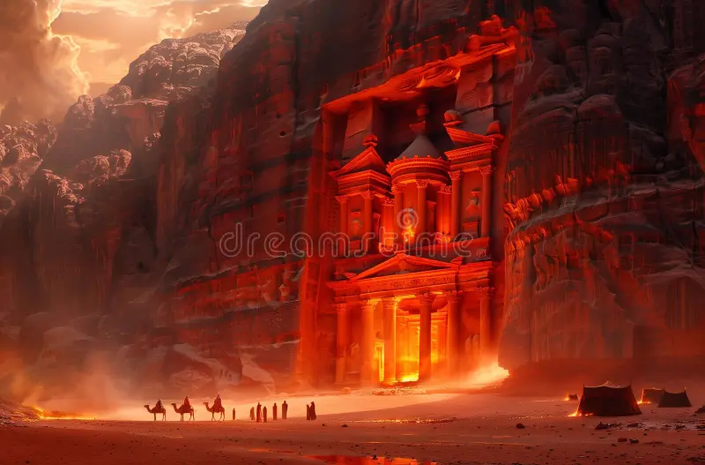
How it was found
One legend is that the Egyptian Pharaoh and some of his armies escaped the closing of the Red Sea, created the Khazneh by magic as a safe place for his treasury, and continued in his pursuit of Moses.

