Slide 1
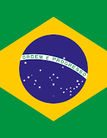
BRAZIL
Καθηγήτρια:Καρανίκα Ε.
Από τις:Ιωάννα Βώσσου,
Ηλιάνα Βαρέση,
Ειρήνη Κουκουλοπουλου,
Κρυσταλλία Ερικτσή

Slide 2
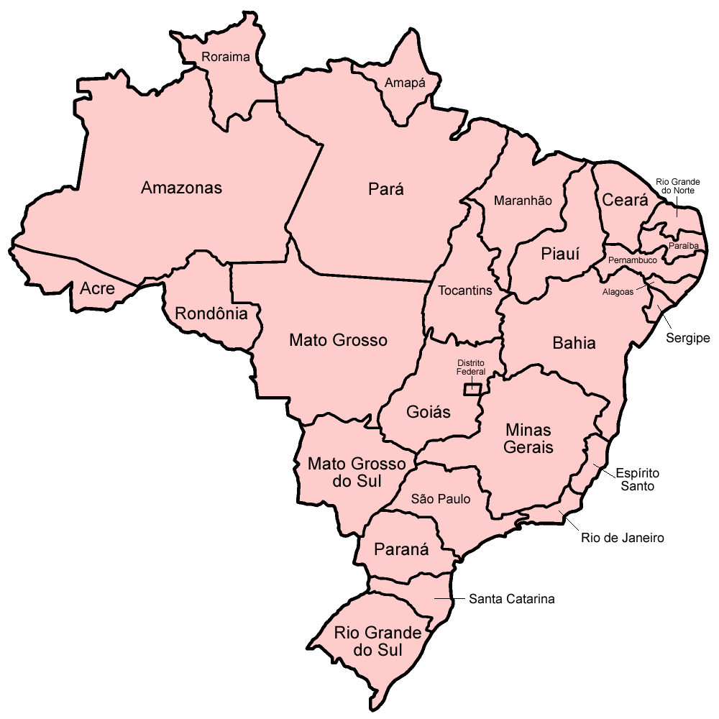
GEOGRAFY
Brazil , officially the Federative Republic of Brazil, is the largest and most populous country in Latin America , in South America . It is also the fifth-largest country in the world by area and the fifth-most populous.
Brazil occupies a vast area on the east coast and inland of South America, bordering all countries of the continent except Chile and Ecuador : Uruguay to the south, Argentina and Paraguay to the southwest, Peru and Bolivia to the west, Colombia to the northwest, and Venezuela, Suriname, Guyana and French Guiana to the north. Its size, morphology, climate and natural resources make Brazil geographically multidimensional. It is the fifth largest country in the world

Slide 3
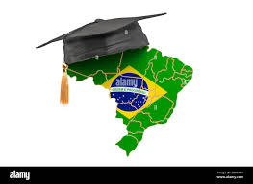
EDUCATION
Brazil's Education System has 5 Levels. Brazil's education system has primary, secondary, and tertiary levels. Primary education is compulsory for Brazilians aged 7 to 14. At this level, students learn the fundamentals of reading and writing. They also study other subjects like science, history, and physical education.

Slide 4
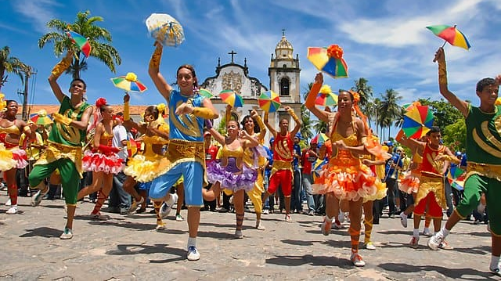
ARTS
Frevo is a dance and musical style originating from Recife, Pernambuco, Brazil, traditionally associated with Brazilian Carnival. The word frevo is said to come from frever, a variant of the Portuguese word ferver (to boil). It is said that the sound of the frevo will make listeners and dancers feel as if they are boiling on the ground. The word frevo is used for both the frevo music and the frevo dance.

Slide 5
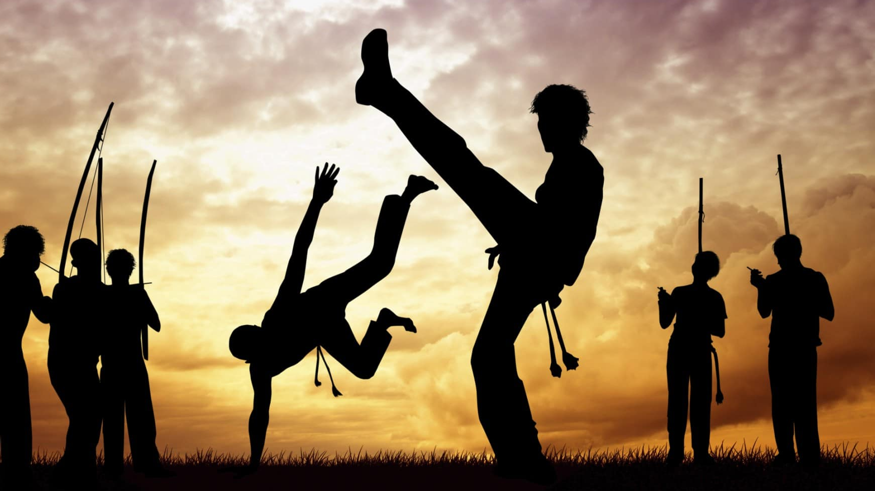
Capoeira is an Afro-Brazilian martial art and game that includes elements of dance, acrobatics, music and spirituality.
It is known for its acrobatic and complex manoeuvres, often involving hands on the ground and inverted kicks. It emphasizes flowing movements rather than fixed stances; the ginga, a rocking step, is usually the focal point of the technique. Though often said to be a martial art disguised as a dance,^{[5]} capoeira served not only as a form of self defense, but also as a way to maintain spirituality and culture.^{[6]}

Slide 6
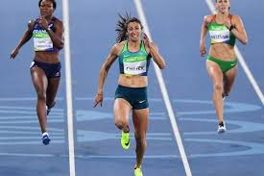
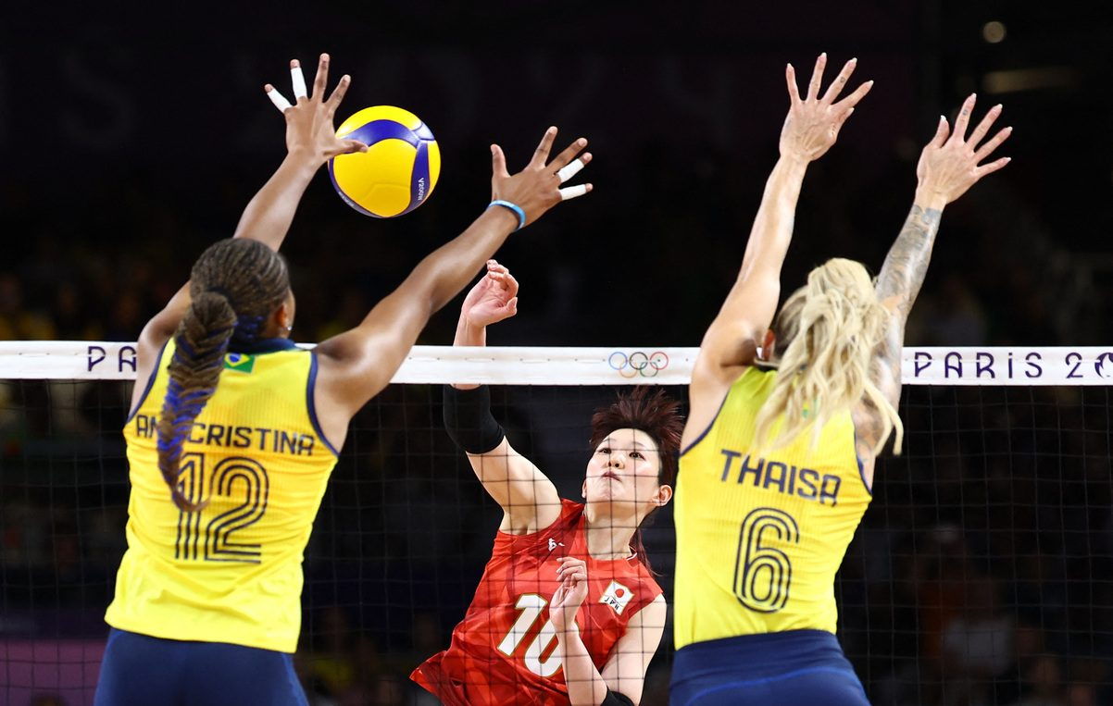
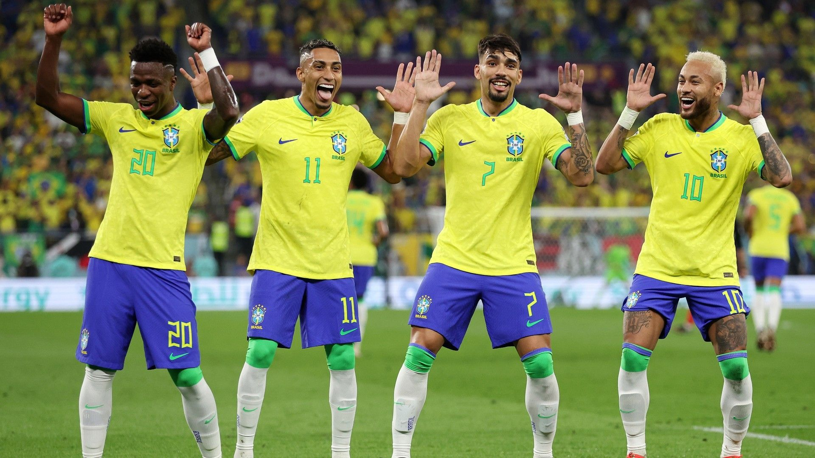
LEISURE TIME &SPORTS
In their leisure time Brazilians usually do sports.
Sports in Brazil are those that are widely practiced and popular in the country, as well as others which originated there or have some cultural significance. Brazilians are heavily involved in sports. Football is the most popular sport in Brazil. Other than football, sports like volleyball, mixed martial arts, basketball, tennis, and motor sports, especially Formula One, enjoy high levels of popularity.

Slide 7
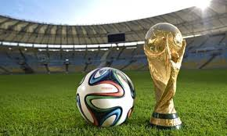
Brazil is the most successful country in volleyball and it is Brazil's second most popular sport.
Football is the most popular sport in Brazil. It is among the favorites to win the trophy every time the competition is scheduled. he national football team has also won the Copa América 9 times, the Olympic football tournament twice and is the most successful team in the FIFA Confederations Cup, with 4 titles

Slide 8
THANK YOU VERY MUCH!!!

