Slide 1
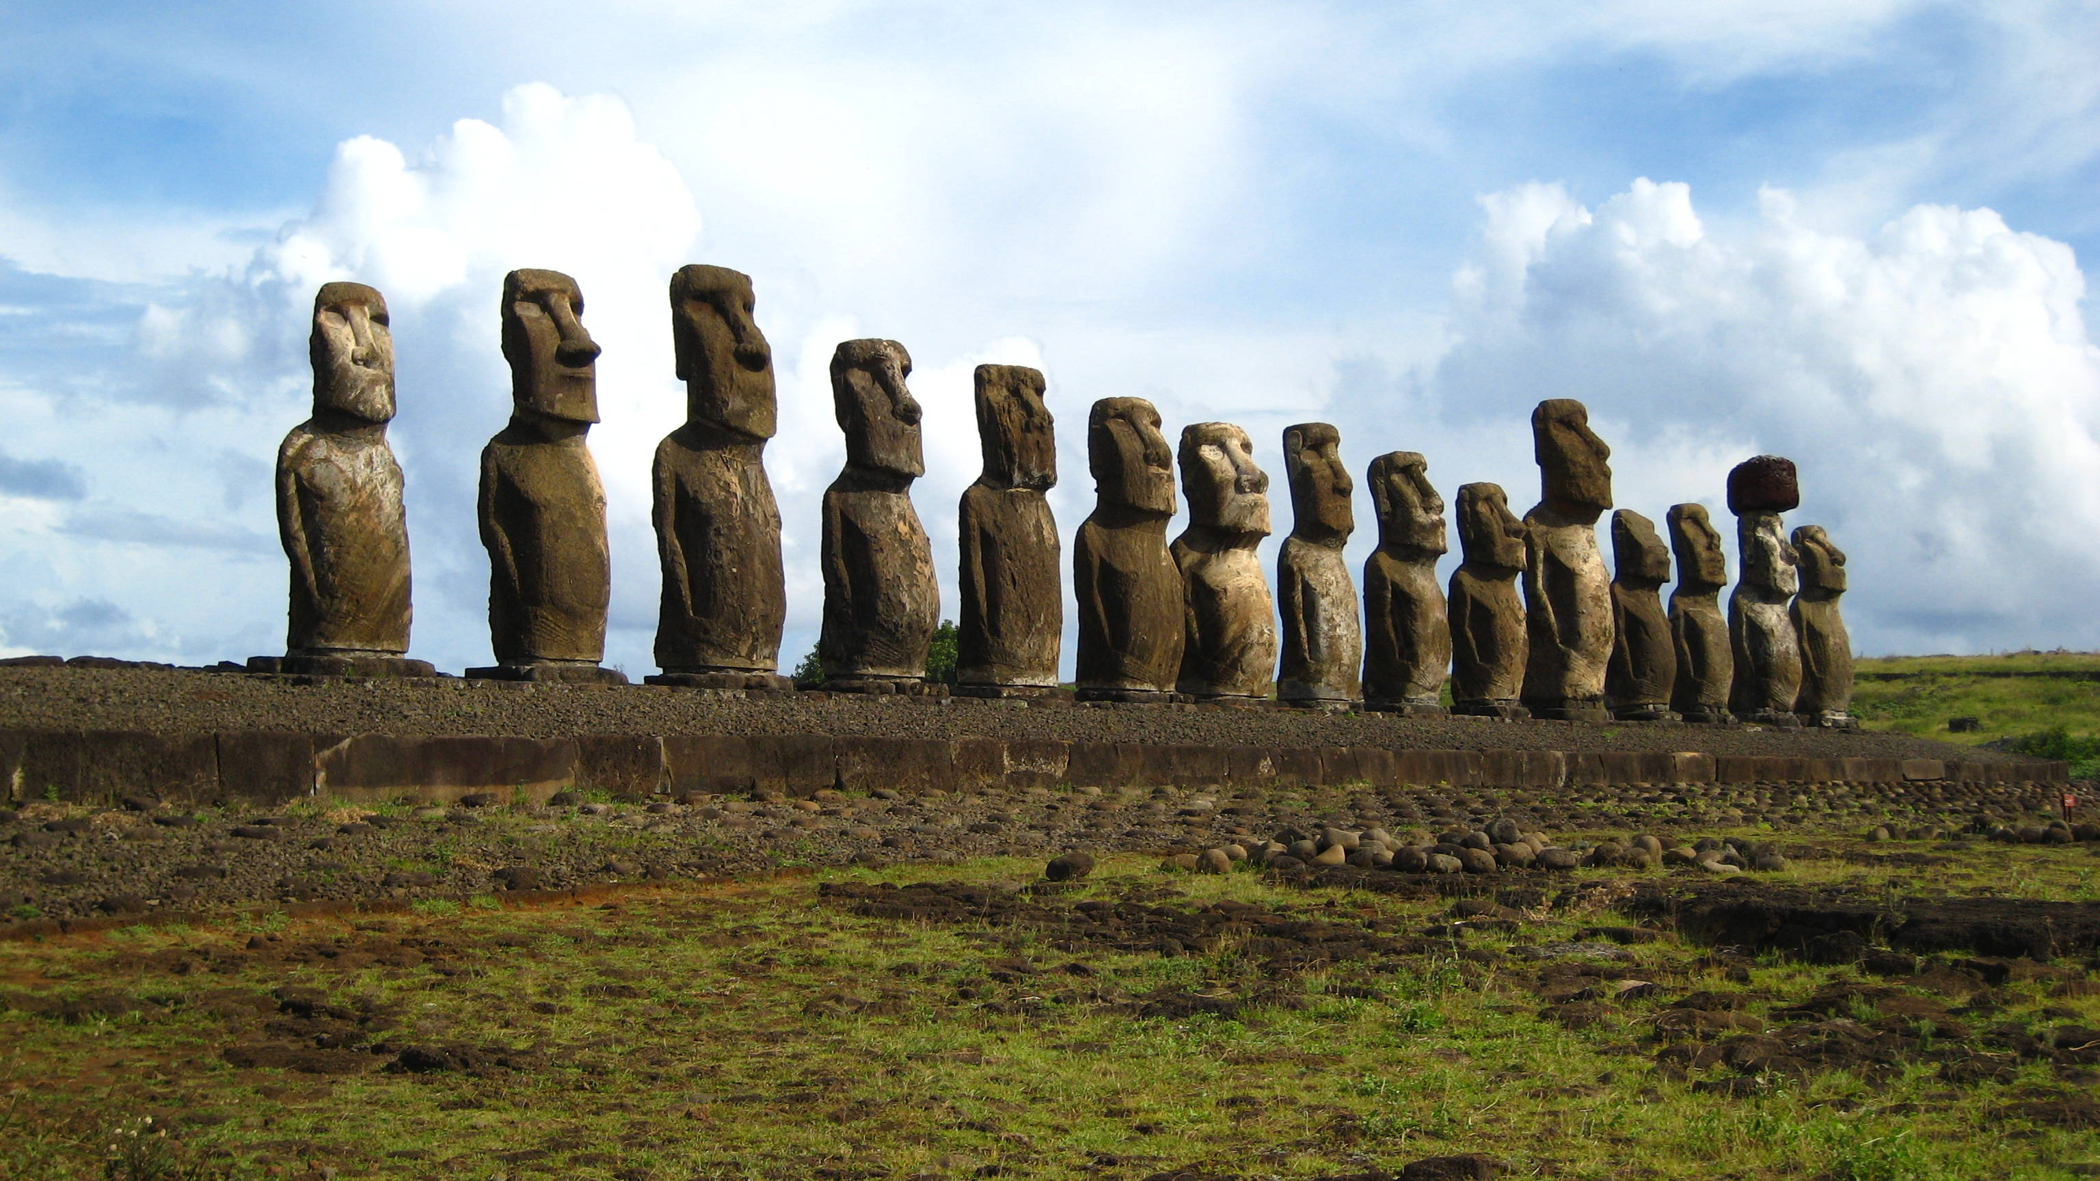
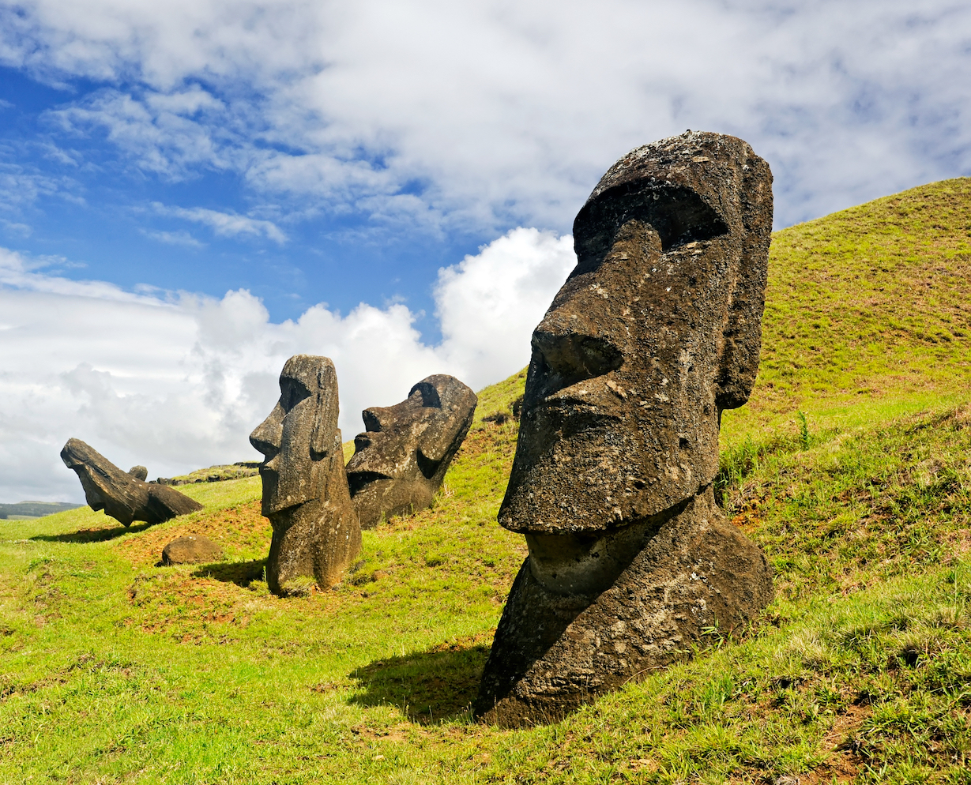
Easter island statues

Slide 2
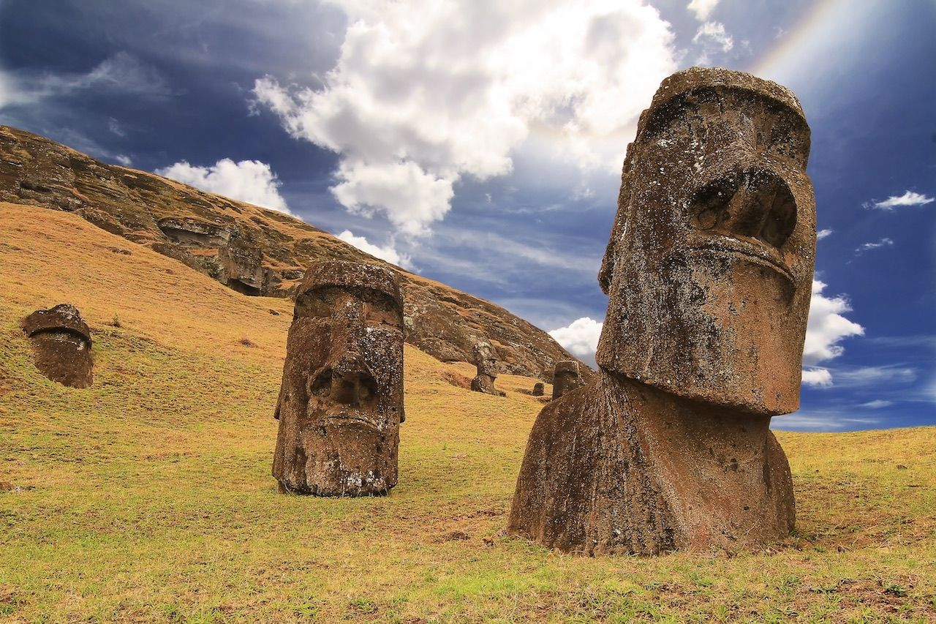
What are the Moai statues?
The Moai statues are large stone figures found on Easter Island. They were created by the Rapa Nui people between 1400 and 1650 AD to honor ancestors and important leaders. The statues are known for their large heads, which represent the power and spiritual presence of those they depict.

Slide 3
How Were the Moai Statues Made?
The Moai statues were carved from volcanic rock, mainly at a quarry called Rano Raraku on Easter Island. The Rapa Nui people used stone tools to shape the statues. Some statues were over 30 feet tall and weighed several tons.

Slide 4
The Mystery of the Moai
Why Are the Moai So Mysterious?
The Moai statues are mysterious because no one knows for sure how the Rapa Nui people moved the massive statues across the island. The statues are very heavy, some weighing over 80 tons, and were placed in distant locations. The techniques used to transport and erect the Moai remain unclear, leading to much speculation and research. Additionally, the exact purpose and the reasons behind the decline of the Moai-building culture add to the mystery.

Slide 5
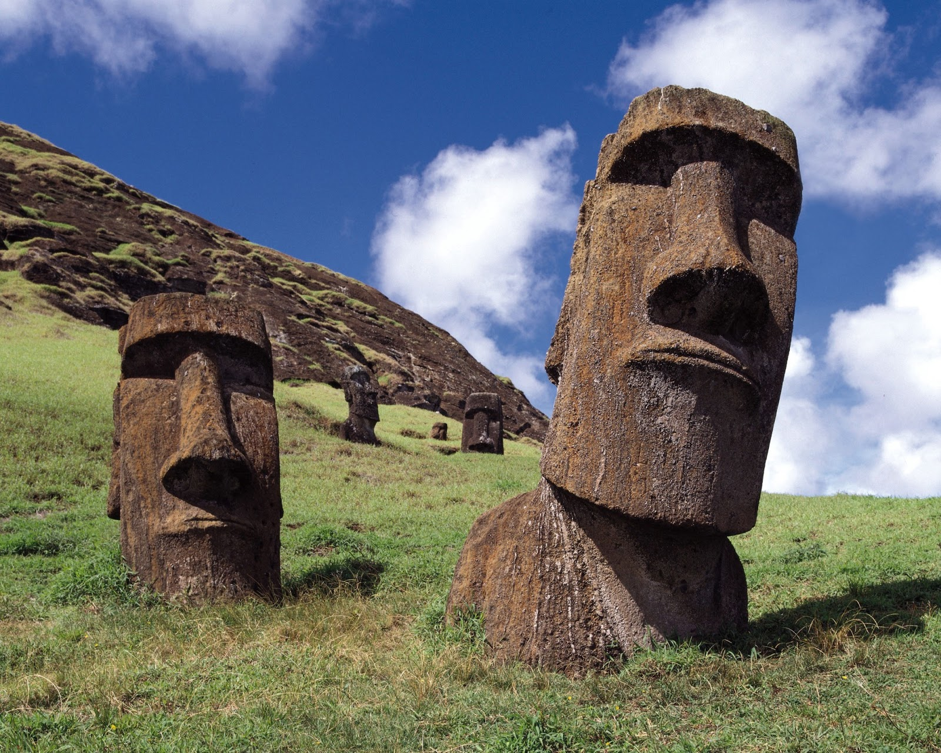
The Fall of the Moai Statues
Why Are Some Moai Fallen?
Some Moai statues are fallen because they were toppled during conflicts between different tribes on Easter Island. Over time, the statues were also damaged by natural events such as storms, earthquakes, and the erosion of the land. Additionally, after the decline of the Moai-building culture, many statues were purposely knocked over, possibly as part of efforts to regain power or change leadership.

