Slide 1
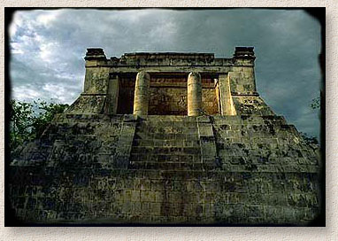
Chichen Itza
English project
Nagia Kourenta & Eva Mettou

Slide 2
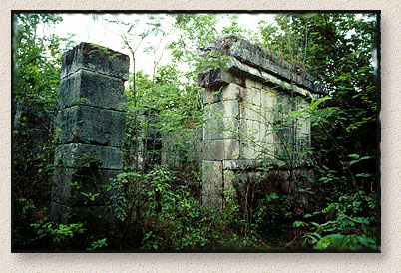
Introduction
Deep within the jungles of Mexico and Guatemala and extending into the limestone shelf of the Yucatan peninsula lie the mysterious temples and pyramids of the Maya. While Europe was still in the midst of the Dark Ages, these amazing people had mapped the heavens, evolved the only true writing system native to the Americas and were masters of mathematics. They invented the calendars we use today. Without metal tools, beasts of burden or even the wheel they were able to construct vast cities across a huge jungle landscape with an amazing degree of architectural perfection and variety. Their legacy in stone, which has survived in a spectacular fashion at places such as Palenque, Tikal, Tulum, Chichén Itzá, Copan and Uxmal, lives on as do the seven million descendants of the classic Maya civilization
The Maya are probably the best-known of the classical civilizations of Mesoamerica. Originating in the Yucatan around 2600 B.C., they rose to prominence around A.D. 250 in present-day southern Mexico, Guatemala, northern Belize and western Honduras. Building on the inherited inventions and ideas of earlier civilizations such as the Olmec, the Maya developed astronomy, calendrical systems and hieroglyphic writing.
Nagia Kourenta & Eva Mettou

Slide 3
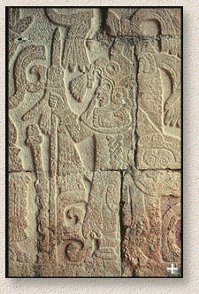
The Maya
The Maya were noted as well for elaborate and highly decorated ceremonial architecture, including temple-pyramids, palaces and observatories, all built without metal tools. They were also skilled farmers, clearing large sections of tropical rain forest and, where groundwater was scarce, building sizable underground reservoirs for the storage of rainwater. The Maya were equally skilled as weavers and potters, and cleared routes through jungles and swamps to foster extensive trade networks with distant peoples.
Around 300 B.C., the Maya adopted a hierarchical system of government with rule by nobles and kings. This civilization developed into highly structured kingdoms during the Classic period, A.D. 200-900.
Their society consisted of many independent states, each with a rural farming community and large urban sites built around ceremonial centers. It started to decline around A.D. 900 when – for reasons which are still largely a mystery – the southern Maya abandoned their cities. When the northern Maya were integrated into the Toltec society by A.D. 1200, the Maya dynasty finally came to a close, although some peripheral centers continued to thrive until the Spanish Conquest in the early sixteenth century.
Nagia Kourenta & Eva Mettou

Slide 4
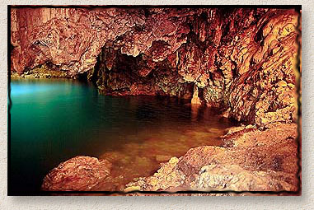
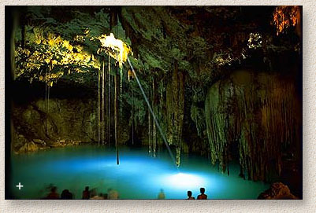
The Cenote
East of the major Chichén Itzá ruins is a dark underground world the Mayans called Cenoté. They are deep water filled sinkholes formed by water percolating through the soft limestone above. Since the porous soil held little water, these underground bodies were extremely important to the city. A visit to one is a spine chilling experience. Entry is through a vertical hole with narrow stair steps carved by the Mayan’s themselves. The air is thick and musty. One misstep on the slimy ledges threatens to send you falling over 20 feet.
Once your eyes get used to the light level a bizarre world takes shape. Stalagtites of blood red limestone seem to ooze from the dripping walls. Ahead is a strange green pool of glowing water. As you approach the pool you notice roots of trees hanging before you. In their search for water they’ve penetrated the ceiling, dropping 50 feet to the pool below. It’s like an eerie underground forest.
After you’ve crawled under some especially low hanging stalactites you’re greeted by an incredible scene. A beautiful blue green pool of unknown depth stretches out before you. A massive stalactite hangs down, just inches from touching the surface, and above a piercing beam of light streams in from the ceiling, illuminating the pool and the entire chamber.
By pure luck I was at the Cenoté for a rare event. Once a year, in April, the beam of light touches the tip of the stalactite. There are many instances of ancient peoples building monuments to take advantage of events like these but this is something that is totally natural and unplanned.
Nagia Kourenta & Eva Mettou

Slide 5
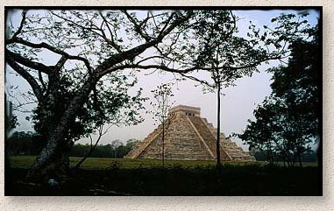
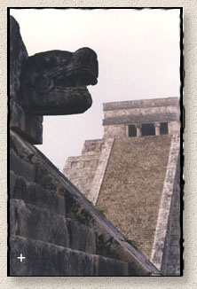
El Castillo
The massive Kukulcán pyramid called “El Castillo” (the castle) is roughly at the center of the site. Climbing it is quite a challenge and those who make it are rewarded with a spectacular view of the city and surrounding country side. A trip inside the pyramid is quite the opposite. The dark, unbearably humid corridors and chambers are too much for some people.
Early morning, before the onslaught of tourists, Chichén Itzá is a magical place. I had the opportunity to wander around the site for two hours before the gates were opened one day. Watching the massive pyramid take shape through the lifting fog is an experience I will not soon forget.
The construction of the Kukulcán Pyramid at Chichén Itzá was planned so that each Vernal Equinox the dying sun would cast a shadow of a serpent writhing down the steps of the pyramid. Every year over 40,000 people make the trek to the great pyramid to watch in awe as the snakes diamond backed body slowly appears.
If you stand facing the foot of the temple and shout the echo comes back as a piercing shriek. Also, a person standing on the top step can speak in a normal voice and be heard by those at ground level for some distance. This quality is also shared by another Mayan pyramid at Tikal.
Nagia Kourenta & Eva Mettou

